Slide 1

Housing and health in drug users
SSA Conference 2018 , Newcastle
Asna Ahmed, PhD Student, University of Leeds.
Dr Amanda Harrison, School of Psychology, University of Leeds

Slide 2
Drugs and Housing
There are approximately 78,000 individuals in the UK who are either homeless or temporarily housed (1).
Approximately 83% of a sample of homeless people in London had used a drug in the last month, 36% and 25% were dependent on heroin or alcohol respectively and 63% reported that their drug use was one of the reasons they became homeless (2).
Research on the relationship between housing instability and drug use has primarily used dichotomous measures of housing stability, contrasting those who are homeless and those who are housed. However, many drug users are not homeless, but do have a range of accommodation problems that may impact on their well-being and recovery. (3,4,5).
A recent report in the UK highlighted the lack of this knowledge and the lack of attention given to housing status in treatment plans and advocated the need for further research in this area.(6).
Objectives: To assess
Differences in the health and well-being of drug users based on their housing status.
Use of a particular class of drug predicts poor health.

Slide 3
Method
N=109 participants were recruited from Leeds Drug and Alcohol Service and assigned to one of the 3 categories:
NHP- no housing problems or stable, safe accommodation.
HP- unstable housing (temporary accommodation with tenancy ending soon/ short term hostel residence) or unsuitable accommodation e.g. with problems such as damp, lack of heating, rodent infestation.
NFA- no fixed abode e.g. sleeping rough or seeking accommodation on a night by night basis such as sofa surfing.
Paper questionnaires were used in 1-2-1 meetings to assess current drug use, physical and psychological health and quality of life.
Data were analyzed using one way independent ANOVA and Multiple regression analysis.

Slide 4
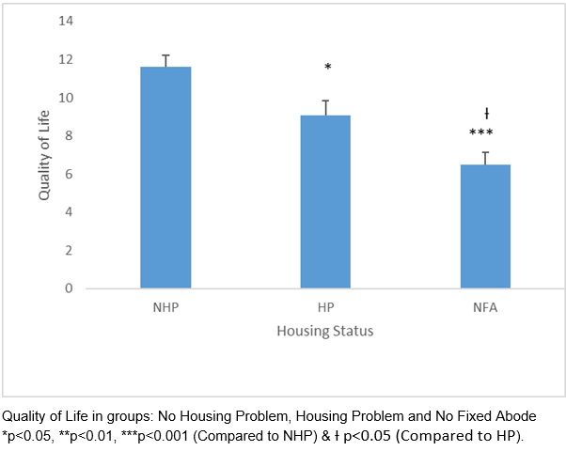
Quality of Life

Slide 5
Physical and Psychological well-being
(Mean± (SED))
Measure | No Housing Problem (n=35) | Housing Problem (n=36) | No Fixed Abode (n=38) | Predictive Drugs
Physical Health | 11.83 (0.78) | 10.03 (0.79) | 8.42 (0.69)** | Opiates F(1,107)=12.21, p<.05
Psychological Health | 11.94 (3.99) | 8.80 (4.37)** | 7.47 (4.52)*** | Opiates F(1,107)= 16.46, p<.001
Stress (PSS-10) | 21.66 (6.74) | 27.78 (6.74)** | 28.32 (7.19)*** | Opiates F(1,107)= 9.68, p<.05
Anxiety (GAD-7) | 8.17 (5.44) | 12.78 (6.70)* | 14.50 (4.71)*** | Opiates F(1,107)= 6.31,p<.05
Depression (PHQ-9) | 11.54 (6.33) | 15.28 (5.90)* | 16.87 (5.81)** | Opiates F(1,107)= 11.70, p<.05
* p<0.05, **p<0.01, ***p<0.001 compared to No Housing Problem group.

Slide 6
Summary
These results indicate that opiates were the only significant predictor of each category of health.
The results highlight that it is not only homeless drug users that have complex treatment needs associated with their housing status.
Drug users should be considered as a diverse population in which there are different treatment needs based on their housing status.
Crisis Homelessness monitor. https://www.crisis.org.uk /media/238700 /homelessness _monitor_England _2018 .pdf (accessed 6 June 2018). Google scholar.
FOUNTAIN, J., HOWES, S., MARSDEN, J., TAYLOR, C. & STRANG, J. 2003. Drug and alcohol use and the link with homelessness: results from a survey of homeless people in London. Addiction Research & Theory, 11, 245-256.
KERTESZ, S. G., CROUCH, K., MILBY, J. B., CUSIMANO, R. E. & SCHUMACHER, J. E. 2009. Housing first for homeless persons with active addiction: are we overreaching? Milbank Quarterly, 87, 495-534.
4. EYRICH-GARG, K. M., CACCIOLA, J. S., CARISE, 4. D., LYNCH, K. G. & MCLELLAN, A. T. 2008. Individual characteristics of the literally homeless, marginally housed, and impoverished in a US substance abuse treatment seeking sample. Social psychiatry and psychiatric epidemiology, 43, 831-842.
5. KRUPSKI , A., GRAVES, M. C., BUMGARDNER, K., & ROY-BYRNE, P. 2015. Comparison of Homeless and Non-Homeless Problem Drug Users Recruited from Primary Care Safety-Net Clinics. Journal of Substance Abuse Treatment, 58, 84–89.
6. PUBLIC HEALTH ENGLAND. An evidence of the outcomes that can be expected of drug misuse treatment in England. Public Health England. 2017

