Slide 1
Constructing alcohol identities: the role of Social Network Sites (SNS) in young peoples’ (YP) drinking cultures
Amanda Atkinson, Senior Researcher
Kim Ross-Houle, Emma Begley & Harry Sumnall
CPH, Liverpool John Moores University, UK

Slide 2
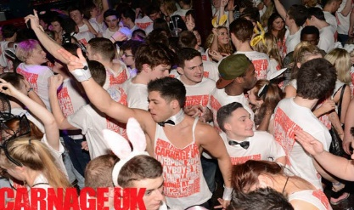
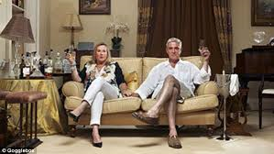
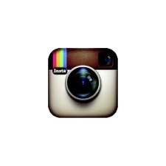
Background
Alcohol marketing, consumption, intoxication, alcohol-related behaviours &
environments provide opportunities & contexts for individuals to craft
identities.
Consumption of cultural items & practices play an important role in the
creation & expression of ‘tastes’ which create distinction between groups.
Consumer items & leisure practices not valued purely for practical functions
but their aesthetic, social & symbolic value.

Slide 3
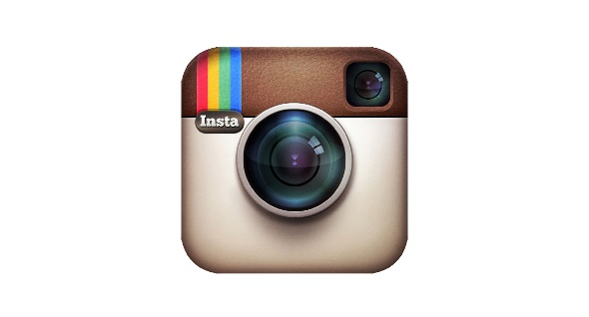
Background
SNS an important aspect of YP social lives & leisure.
Intoxigenic spaces (e.g. night life) in which drinking practices &
related identities are created have entered online environments.
Exposed to, create & interact with new forms of online alcohol marketing & self/ peer created content.

Slide 4
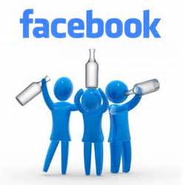
Research questions
To explore the role of alcohol, drinking and related practices in YP identity construction & how drinking culture/capital creates distinction & in turn social acceptance (or not) within and between peer groups.
To explore the role of SNS in YP drinking culture & the formation of alcohol-related identities within the context of the peer group.

Slide 5
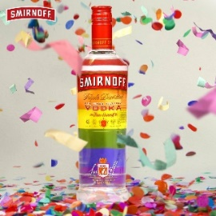
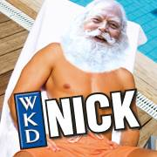
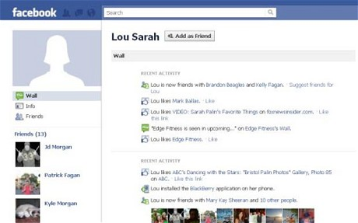
Methods
1) Content analysis of SNS (Twitter, Facebook) alcohol marketing for top 5 brands
consumed by YP, user interaction & comparison with SNS alcohol health
campaigns.
Friendship group interviews (N=14) with YP (15-21 yrs) (N= 70, male 30,
Female 40) with YP.
Facebook profile analysis (N=43) to explore the role of alcohol in
online identities & peer networks/ interactions (text (n=586
status) & photograph (n=28,207 photos, 1,425 profile photo ) analysis).
Notes:
Did not fous on drinking itself but drinking culture and the meanings attached to the drinking context.
So although we did look into drinking frequencid, it was more the value YP placed on a night out or in, and how, where ad who YP drank with that were foussed on. So the culture of drinking as opposed to driking levels.

Slide 6
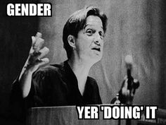
Identity
Image individuals display & how they are & want to be perceived in
certain social contexts- fluid.
Result of distinctions created by consumption, leisure and lifestyle.
Crafted & performed in certain contexts (e.g. peer groups)
Structured-influenced by existing social positions & related
consumption practices, tastes & etiquettes of certain social groups.
‘Celebritisation of the self’-consumer products, celebrity media imagery & related leisure influences identity formation.
Notes:
Kim will now go onto say a little around some of the specific social theories that we applied to explore the process through which drinking behaviour and contexts allow individuals to distinguish themselves from others in turn create individual and group identities.
The theories are also useful in framing SNS as an extension of the context in which alcohol-related identities are performed and reproduced.
We also applied these theories as they allow us to go beyond the simple concept of peer pressure which can often frame YP as passive, to explore the more complex processes through which participating in alcohol and drinking in important to YP’s social acceptance and how they are also active in this process.

Slide 7
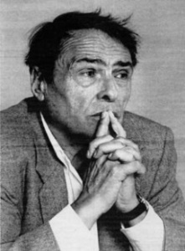
Theory: ‘Capital’ (Bourdieu, 1984) (1)
1) Social capital – ‘Who you know’ –social networks/hierarchies participated &
accepted in that hold social value & provide social status (e.g. peer groups)
2) Cultural capital – key to being accepted & justifying your position within the social
group. A way in which certain groups attach meaning, importance & status to
particular cultural artefacts & behaviours/experiences/knowledge including alcohol
and drinking practices.
‘Distinction’ –process through which distinguish themselves from others reinforcing group & individual identity. ‘What I’m not’
e.g. ‘fine wine’ ‘football & ‘WAG’ or ‘ladette’ culture’.

Slide 8
Theory: ‘Capital’ (Bourdieu, 1984) (2)
3) Economic capital- economic means to participate in the social network.
Holding a high degree of economic capital can also bring status & prestige in itself (symbolised through ‘exclusive’ alcohol practises)
4) Symbolic capital – process through which all forms of capital are symbolised & interpreted as meaningful to an audience. e.g. how cultural drinking is expressed to peers.
SNS are an extension of the context(field) in which YP create, act out and display drinking ‘capital’ to peers
‘Peer pressure’?
Notes:
3)
So certain
And crucially,
• It’s important to add that this process is also Classed and gendered.
• ‘Capital’ is also useful as it moves beyond the commonly used concept of ‘peer pressure’ do dissect the complex social processes involved in YP drinking culture in relation to peer group identity.
• Also, ‘peer pressure’ frames YP as passive and easily absorbing pressure/mimicking others. ‘Capital’ acknowledges their active role in creating, negotiating and also rejecting culture
.
Alcohol/drinking and social media are ways in which this process ca be achieved.

Slide 9
FINDINGS

Slide 10
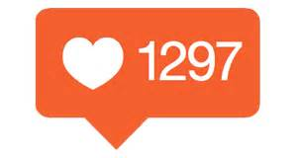
Peer & self created content
Positive (‘fun’) & social aspects of drinking displayed
as cultural capital on SNS for peer recognition & approval.
Distinct forms of drinking experience acted as forms of cultural capital that
enhanced social capital & status when viewed as important by the peer group.
SNS played a vital role in symbolising cultural drinking capital:
extension of the space in which young people expressed tastes & lifestyle behaviours to their peers & gained appraisal through.
created peer group drinking stories & lasting memories that bonded the group & reinforced social capital due to shared tastes & lifestyles.
Visual culture

Slide 11
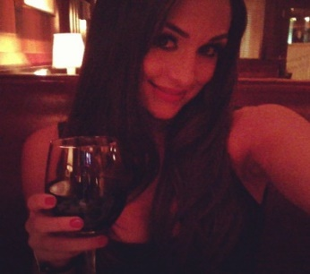
Image management
Highly managed to avoid representing the ‘wrong’ drinking
experience & judgement & social shaming.
‘Othering’ and distinction- managed identity through distinguishing themselves from other groups tastes & lifestyles.
Gender (i.e. femininity and masculinity)
Age (i.e. in relation to connotations of immaturity)
‘Classed’ connotations (i.e. through the stereotype of the ‘chav’)

Slide 12
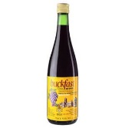
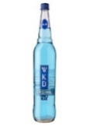
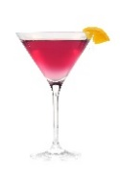
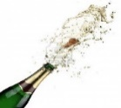
1. Brand and drink associations
Symbolic values, taste and lifestyles associated with different drinks & brands.
Carefully selected what was drank & shown on SNS.
Drank or avoided certain drinks based on aged, classed & gendered associations.
Some drinks not consumed in public or shown on SNS (e.g. WKD ‘chav’ &
‘kids drinks’ , ‘smack head’ beer, ‘pretty’ & expensive cocktails, ‘posh’ wine, ‘girly’
drinks.
Photographs of some drinks deliberately uploaded to SNS (e.g. ideal photo props) due to connotations of prestige, luxury & celebrity.

Slide 13
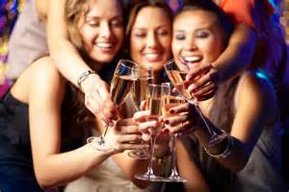
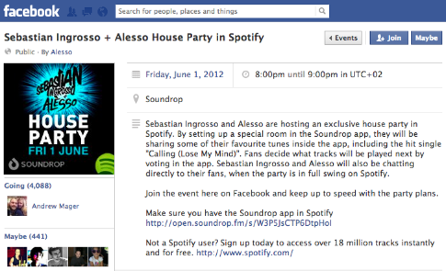
2. Participation in drinking environments
Private & public drinking environments acted as cultural capital & provided opportunities to signify & accumulate cultural drinking capital.
SNS provided a mechanism of displaying & reinforcing cultural capital & social capital through shared drinking practices in drinking environments:
Acceptance to SNS invitations to night life events & parties.
Documenting participation in the nightlife environments (photographs).
Rarely ‘tagged’ themselves in drinking locations on Facebook. ‘Trying too hard’, immature and associated with older generations.

Slide 14
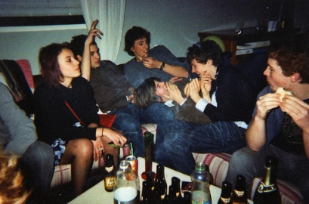
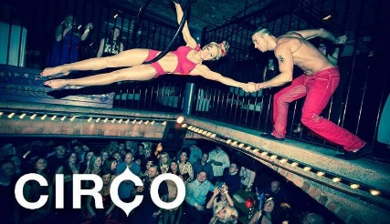
‘Parties’ & nightlife
House parties & birthday celebrations. SNS organising role. Invited & hosting status giving & enhanced social capital. Reinforced by SNS invitations & photos.
‘Gate-crashing’ by younger people.
Stereotype of ‘park drinking’ for distinction from younger groups.
Night life (e.g. bars and clubs, not pubs- older generations) held high cultural capital. ‘Ideal’ drinking contexts for photo creation.
SNS important in keeping up to date with nightlife events & offers.
Young women highly valued being depicted drinking in specific ‘exclusive’
clubs with celebrity connotations.
Avoided certain venues based on connotations of social class (‘chavvy’ & ‘dodgy’).

Slide 15
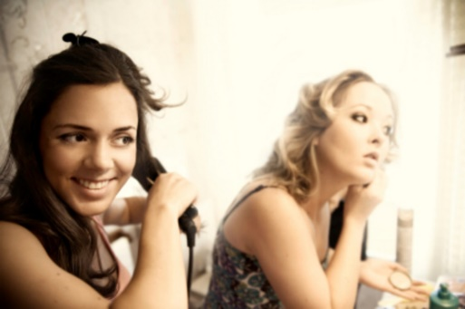
Space to bond with female friends whilst ‘getting ready’ for the night out- crafting feminine identities/appearance. Most enjoyable aspect of a ‘night out’. Apprehension & build up pleasurable. Activity practiced by females (‘girly’) Pre-loading overcome economic restrictions on drinking in the night life environments. Context for creating ‘ideal’ SNS drinking photos.
Pre-loading/drinking

Slide 16
No homogenous culture of intoxication -degree to which intoxication held cultural capital varied. For some, intoxication a key element of ‘nights out’/ intentional drunkenness common. Others regarded intoxication as the ‘wrong’ form of cultural capital. Judged those displaying such behaviours. Displaying statuses outwardly referencing alcohol use & intentional intoxication viewed as immature. Divided on displaying intoxication. A source of annoyance, embarrassment and shame (age, class, gender) Symbolic display of intoxication as a form of cultural capital varied & reinforced group distinctions.
3. Intoxication

Slide 17
Decisions to upload intoxicated images/status based on whether they would be interpreted as humorous and worthy of a good drinking story. Negative drinking experiences, that could be interpreted as the ‘wrong’ drinking capital turned into the ‘right’ cultural capital through humour. Accepted if infrequent, but viewed negatively and less humorous when more frequent. ‘Lack of self control’, ‘immature’ and an inability to ‘hold drink’. Openly discussed such experiences as humorous. Being captured on camera intoxicated anxiety provoking for women and a threat to their managed self-image.
Intoxication: drinking stories

Slide 18
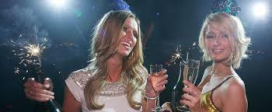
Intoxication: managing femininity
Young women highly managed their display of intoxication on SNS.
Society judges women for their drinking & intoxication- ‘un-feminine’.
Caricature of the ‘chav’ (‘chavvy’)
Sexual promiscuous (e.g. ‘slutty’)
Intoxicated photos were the ones that they felt portrayed them as unattractive.
Pre-loading valued-opportunity to crate highly contrived glamorous/celebrity style photographs to upload to SNS before intoxication. Positive peer appraisal motivating factor.
‘Celebritisation of the self’.
Drinking contexts an opportunity to craft feminine identities in a controlled manner through self & peer surveillance in accordance with what they felt was socially acceptable behaviour for women.

Slide 19
Inclusion and exclusion
Included & excluded young people through the process of capital and distinction.
Not partaking in drinking/ SNS drinking culture restricted creation of cultural drinking capital & led to feelings of exclusion/ lack of peer appraisal.
Observing others’ inclusion caused anxiety & a feeling of ‘missing out’
(i.e. non/moderate drinkers lack capital & drinking stories).
Exclusionary & stressful for young people who are not meant to drink due to religion.
Need to depict & participate in SNS drinking culture for status, acceptance & identity influenced some young peoples’ involvement in drinking occasions & drinking practices.

Slide 20
To conclude:
Adds to our understanding of the changing nature of young people's drinking culture in a social media age.
Highlights the significant role of alcohol & drinking experiences in group belonging, acceptance & (aged, classed, gendered) identity construction.
Concept of 'capital' as a useful tool beyond ‘peer pressure’ for understanding drinking experience as a symbolic & powerful social practice that YP engage in to distinguish themselves from others & enhance their group belonging & acceptance by the peer group.
SNS were shown to have a pivotal role in the creation, display &
performance of distinct alcohol-related identities through the process of cultural
capital accumulation, display and recognition.

Slide 21
Acknowledgements
Alcohol Research UK
Professor Harry Sumnall (CPH, LJMU)
Kim Ross-Houle & Emma Begley (Researcher Assistants, CPH)
Telephone Research Team within CPH
Aiden O’Sullivan, CPH/UofLiv
All young people who participated in the research

