Slide 1
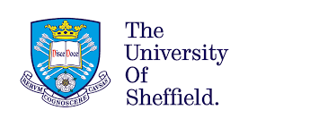
The invention of addiction in early modern England, 1629 - 1700
Jose Murgatroyd Cree
Department of History - University of Sheffield
@murgatroydcree

Slide 2
PART ONE: ON THE ORIGINS OF ADDICTION
The character of the English lexicon was permanently altered.
David Crystal, The Stories of English (England, 2004)
Learned men were faced with the solemn duty of educating by means of the vernacular their less fortunate brothers.
Richard Foster Jones, The Triumph of the English Language (London, 1953)
We need to be aware that borrowing is not always a straightforward process of one language taking a word from another.
Christian Kay and Kathryn Allan, English Historical Semantics (Edinburgh, 2015)

Slide 3
George Joye, The Psalter of David (1530)
PART ONE: ON THE ORIGINS OF ADDICTION
Psalm 17 | Deliver us from these mortal men which are thy hand wherest thou smitest / even the mortal men addict to this world. | addictis
Psalm 92 | All that are addict unto wickedness, shall begin to spread themselves to thentente they should be blown away forever | dediti
Psalm 94 | Shall they thus boast them selves / these men addict and all given to wickedness | dediti
Psalm 106 | They were addict & married unto Baal peor and they ate the dead sacrifices. | adiuncti
Psalm 119 | Make fast they promises to thy servant: which is addict unto thy worship. | addixit

Slide 4
George Joye, The Psalter of David (1530)
PART ONE: ON THE ORIGINS OF ADDICTION
Psalm 17 | Deliver us from these mortal men which are thy hand wherest thou smitest / even the mortal men addict to this world. | addictis
Psalm 92 | All that are addict unto wickedness, shall begin to spread themselves to thentente they should be blown away forever | dediti
Psalm 94 | Shall they thus boast them selves / these men addict and all given to wickedness | dediti
Psalm 106 | They were addict & married unto Baal peor and they ate the dead sacrifices. | adiuncti
Psalm 119 | Make fast they promises to thy servant: which is addict unto thy worship. | addixit

Slide 5
George Joye, The Psalter of David (1530)
PART ONE: ON THE ORIGINS OF ADDICTION
Psalm 17 | Deliver us from these mortal men which are thy hand wherest thou smitest / even the mortal men addict to this world. | addictis
Psalm 92 | All that are addict unto wickedness, shall begin to spread themselves to thentente they should be blown away forever | dediti
Psalm 94 | Shall they thus boast them selves / these men addict and all given to wickedness | dediti
Psalm 106 | They were addict & married unto Baal peor and they ate the dead sacrifices. | adiuncti
Psalm 119 | Make fast they promises to thy servant: which is addict unto thy worship. | addixit

Slide 6
George Joye, The Psalter of David (1530)
PART ONE: ON THE ORIGINS OF ADDICTION
Psalm 17 | Deliver us from these mortal men which are thy hand wherest thou smitest / even the mortal men addict to this world. | addictis
Psalm 92 | All that are addict unto wickedness, shall begin to spread themselves to thentente they should be blown away forever | dediti
Psalm 94 | Shall they thus boast them selves / these men addict and all given to wickedness | dediti
Psalm 106 | They were addict & married unto Baal peor and they ate the dead sacrifices. | adiuncti
Psalm 119 | Make fast they promises to thy servant: which is addict unto thy worship. | addixit

Slide 7
George Joye, The Psalter of David (1530)
PART ONE: ON THE ORIGINS OF ADDICTION
Psalm 17 | Deliver us from these mortal men which are thy hand wherest thou smitest / even the mortal men addict to this world. | addictis
Psalm 92 | All that are addict unto wickedness, shall begin to spread themselves to thentente they should be blown away forever | dediti
Psalm 94 | Shall they thus boast them selves / these men addict and all given to wickedness | dediti
Psalm 106 | They were addict & married unto Baal peor and they ate the dead sacrifices. | adiuncti
Psalm 119 | Make fast they promises to thy servant: which is addict unto thy worship. | addixit

Slide 8
George Joye, The Psalter of David (1530)
PART ONE: ON THE ORIGINS OF ADDICTION
Psalm 17 | Deliver us from these mortal men which are thy hand wherest thou smitest / even the mortal men addict to this world. | addictis
Psalm 92 | All that are addict unto wickedness, shall begin to spread themselves to thentente they should be blown away forever | dediti
Psalm 94 | Shall they thus boast them selves / these men addict and all given to wickedness | dediti
Psalm 106 | They were addict & married unto Baal peor and they ate the dead sacrifices. | adiuncti
Psalm 119 | Make fast they promises to thy servant: which is addict unto thy worship. | addixit

Slide 9
George Joye, The Psalter of David (1530)
PART ONE: ON THE ORIGINS OF ADDICTION
Psalm 17 | Deliver us from these mortal men which are thy hand wherest thou smitest / even the mortal men addict to this world. | addictis
Psalm 92 | All that are addict unto wickedness, shall begin to spread themselves to thentente they should be blown away forever | dediti
Psalm 94 | Shall they thus boast them selves / these men addict and all given to wickedness | dediti
Psalm 106 | They were addict & married unto Baal peor and they ate the dead sacrifices. | adiuncti
Psalm 119 | Make fast they promises to thy servant: which is addict unto thy worship. | addixit

Slide 10
PART ONE: ON THE ORIGINS OF ADDICTION
Adiunctus =
Joined or attached
Addictus =
a Judgment that delivered over the debtor into the hands of his Creditor.
Deditus =
To yield or give into the power of another, to surrender, to submit.
ORIGINS

Slide 11
PART ONE: ON THE ORIGINS OF ADDICTION
Adiunctus =
Joined or attached
Addictus =
a Judgment that delivered over the debtor into the hands of his Creditor.
Deditus =
To yield or give into the power of another, to surrender, to submit.
ORIGINS
Addicted =
favouring one thing over another
Addicted =
bound to a person or a god
Addicted =
devoted to an activity or behaviour
MEANINGS

Slide 12
PART ONE: ON THE ORIGINS OF ADDICTION
Adiunctus =
Joined or attached
Addictus =
a Judgment that delivered over the debtor into the hands of his Creditor.
Deditus =
To yield or give into the power of another, to surrender, to submit.
ORIGINS
Addicted =
favouring one thing over another
Addicted =
bound to a person or a god
Addicted =
devoted to an activity or behaviour
MEANINGS
IMPACT
Very few uses

Slide 13
PART ONE: ON THE ORIGINS OF ADDICTION
Adiunctus =
Joined or attached
Addictus =
a Judgment that delivered over the debtor into the hands of his Creditor.
Deditus =
To yield or give into the power of another, to surrender, to submit.
ORIGINS
Addicted =
favouring one thing over another
Addicted =
bound to a person or a god
Addicted =
devoted to an activity or behaviour
MEANINGS
Begins to decrease at the start of the seventeenth century
IMPACT
Very few uses

Slide 14
PART ONE: ON THE ORIGINS OF ADDICTION
Adiunctus =
Joined or attached
Addictus =
a Judgment that delivered over the debtor into the hands of his Creditor.
Deditus =
To yield or give into the power of another, to surrender, to submit.
ORIGINS
Addicted =
favouring one thing over another
Addicted =
bound to a person or a god
Addicted =
devoted to an activity or behaviour
MEANINGS
Begins to decrease at the start of the seventeenth century
The predominant meaning of addiction throughout the early modern period
IMPACT
Very few uses

Slide 15
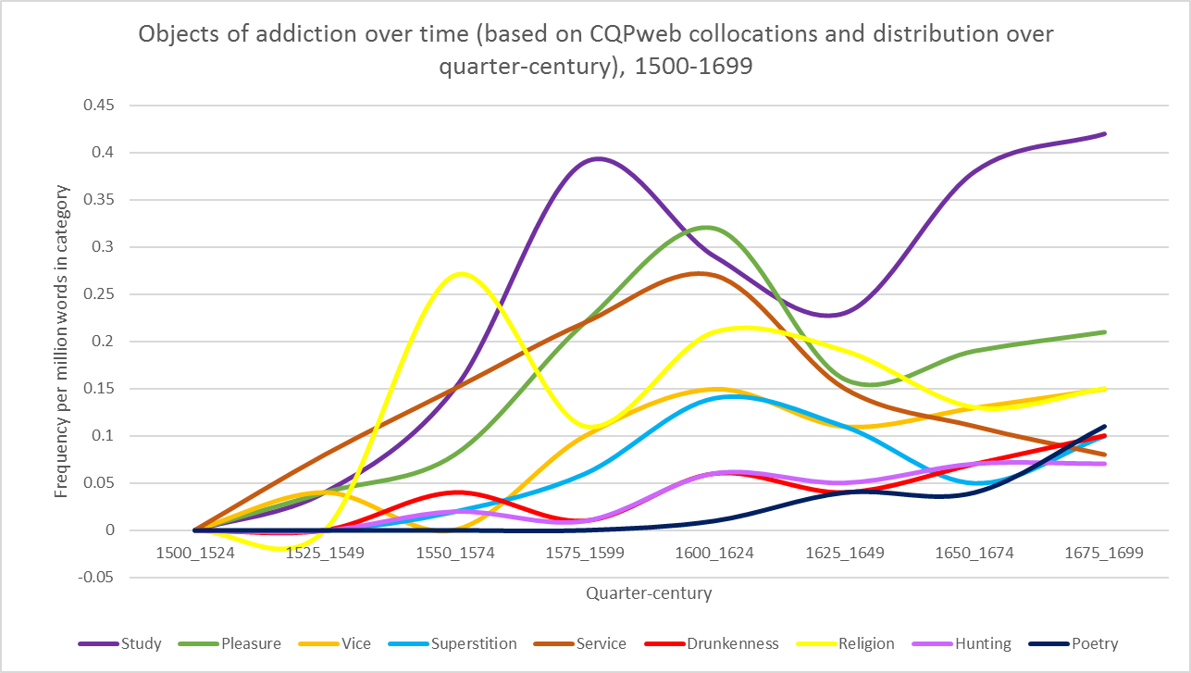
PART TWO: ON THE USES OF ADDICTION

Slide 16
PART TWO: ON THE USES OF ADDICTION
PART TWO: ON THE USES OF ADDICTION
Page images of virtually every work printed in England, Ireland, Scotland, Wales and British North America and works in English printed elsewhere from 1473–1700. Approx. 132,000 titles.
The Text Creation Partnership transcribe and encode the page images of books from EEBO. EEBO-TCP currently contains 48,339 titles.

Slide 17
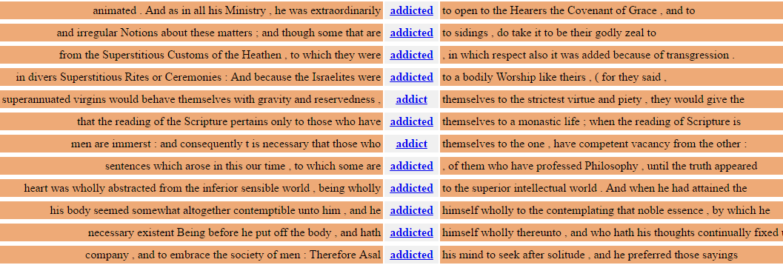
PART TWO: ON THE USES OF ADDICTION

Slide 18
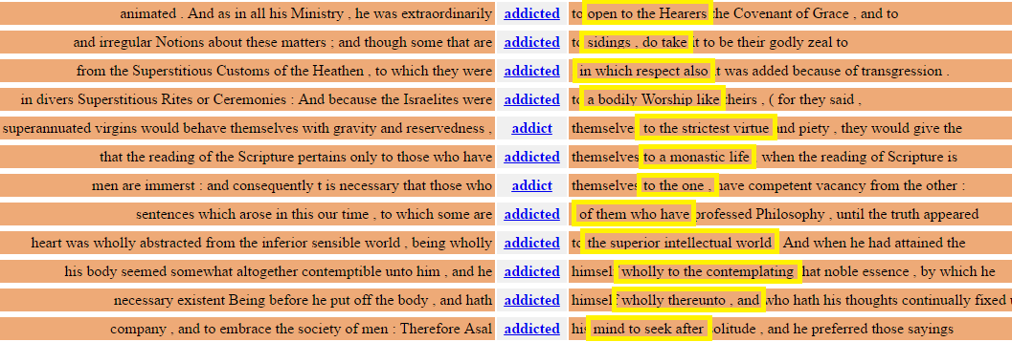
PART TWO: ON THE USES OF ADDICTION

Slide 19
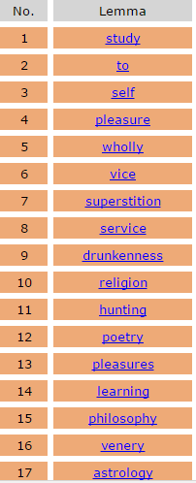
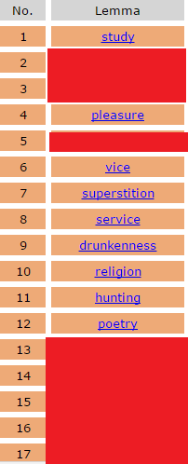
PART TWO: ON THE USES OF ADDICTION
Extra information
Search = ad[d,][I,y]ct*
Collocation analysis based on lemma, with a window of +2 to +5
Results ordered by log-likelihood
(the higher the score, the more evidence you have that the association is not due to chance)
9,823 different lemmas in your collocation database

Slide 20
PART TWO: ON THE USES OF ADDICTION

Slide 21
PART TWO: ON THE USES OF ADDICTION
You are not ignorant, how her highness is addicted to study, and with what a desire she longeth after learning
M. G. Haddon, 1576
some of our students even of Divinity… have addicted themselves to study Popish writers, and Monkish discourses.
William Perkins, 1606
To this drunkenness the Byzantines were so addicted, that they sold their lands
Lloyd, Lodowick, 1573
The Persians are much addicted to Venery with both sexes
Samuel Purchas, 1613
the same constitution of body, equal courage in battle, and semblable addiction unto hunting, even from their Childhoods.
Giovanni Botero, 1630

Slide 22
CONCLUSIONS
Addiction could mean a binding attachment to a person, or to god. This was a common sixteenth century use, but it declined steadily throughout the seventeenth century
Addiction could also mean devotion or dedication to an activity or behaviour.
This type of addiction:
A. Had links to the Latin word deditus, suggesting a self-imposed action
B. Was linked to behaviours rather than substances
C. Was not inherently negative or positive
D. Was most frequently applied to study (followed by pleasure, and vice)
Jose Murgatroyd Cree Department of History - University of Sheffield @murgatroydcree

