Slide 1
The Effects of Transcranial Direct Current Stimulation (tDCS) in Impulsivity and Risk-taking Behaviour
Elena Gomis Vicent
University of East London

Slide 2
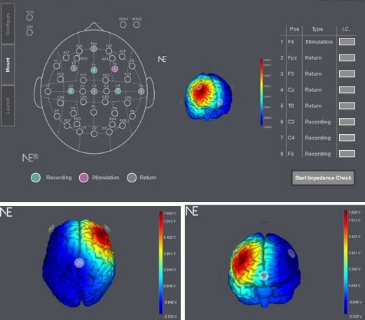
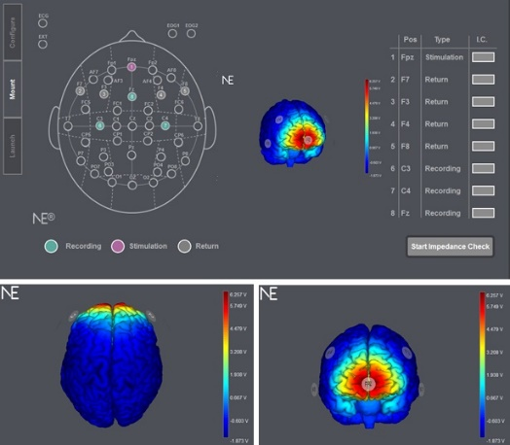
OVERVIEW
Gambling disorder (GD) has been associated with excessive impulsivity and risk-taking behaviour (Albein-Urios et al 2012; Mishra et al 2010).
Novel technologies help to study addiction disorders (Fecteau et al 2007; Boggio et al 2012): transcranial direct current stimulation (tDCS).
Further research is necessary to clarify what tDCS protocols are more effective to investigate GD-related cognitive mechanisms.
My PhD project
Which brain area to target with tDCS (DLPFC - inhibition vs vmPFC - reward)?
Can tDCS enhance therapy treatment effects in gambling disorder?
8 weeks of treatment (tDCS + CBT) at the National Problem Gambling Clinic
rDLPFC
vmPFC

Slide 3
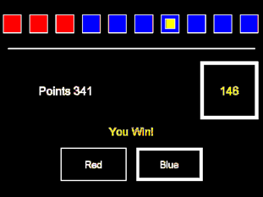
METHOD
1. Which brain area to target with tDCS (DLPFC vs vmPFC)?
Two experiments were conducted using two different tDCS montages.
Table 1 Participant groups in experiments 1 and 2
Groups | Experiment 1 (N =24) | Experiment 2 (N=40)
tDCS target | rDLPFC (n=12) | rDLPFC (n=19)
 | vmPFC (n=12) | vmPFC (n=21)
Impulsivity (UPPS positive urgency scores) | Low (LI, 50th percentile, n=12) | Low (LI, 25th percentile, n=10)
 |  | Middle (MI, 26-74th percentile, n=19)
 | High (HI, 51st percentile, n=12) | High (HI, 75th percentile, n=10)
Fig 1. Cambridge Gambling Task (CGT)
OUTCOME MEASURES
Quality of decision making (number of rational responses)
Percentage staked
Delay aversion (impulsivity)

Slide 4
RESULTS
Experiment 1
tDCS real stimulation was associated with higher quality of decision making compared to sham (a).
Experiment 2
The high impulsivity (HI) group bet higher percentage of their points in the highest risk condition compared to the other two groups (b).
tDCS real stimulation was associated with lower delay aversion in higher risk conditions compared to sham (c).

Slide 5
CONCLUSIONS
GD-related cognitive mechanisms seem to be modulated by tDCS: real stimulation was associated with lower delay aversion (impulsivity) and higher quality of decision-making (number of rational responses) compared to sham.
Our results showed no significant differences between rDLPFC and vmPFC tDCS stimulation.
DLPFC targeted tDCS has reduced symptoms in other addiction studies, and the current data further support stimulation of this site for future GD research and therefore for the next phase of this project at the National Problem Gambling Clinic.

Slide 6
THANK YOU
Dr Volker Thoma, Director of Studies
Prof John Turner, Second Supervisor
Dr Davide Rivolta, Third Supervisor
Dr Amanda Roberts, External Advisor
Dr Henrietta Bowden-Jones, Consultant Psychiatrist
This PhD has been funded by
e.gomisvicent@uel.ac.uk
Elena Gomis Vicent, PhD Student

