Slide 1



Normative misperceptions about alcohol use in the general population of drinkers
Claire Garnett¹, David Crane¹, Robert West², Susan Michie¹, Jamie Brown^{1,2} & Adam Winstock^{3,4}
¹Department of Clinical, Educational and Health Psychology, UCL; ²Cancer Research UK Health Behaviour Research Centre, UCL; ³Institute of Psychiatry, National Addiction Centre, KCL; ⁴South London and Maudsley NHS Foundation Trust, KCL
November 2014
Society for the Study of Addiction Annual Symposium
Notes:
Introduce myself and presentation
General notes/tips:
15 minute slot (10 minute talk, 5 minutes questions)
Expand each slide a bit more
Use less actual words
-> only the exact point
-> try to remember some of it
-> people read, then listen
-> animation so only shows one point at a time

Slide 2
Background
‘Normative misperception’ about alcohol use = underestimation of own alcohol consumption relative to others
Reducing this misperception can reduce subsequent alcohol use
(Collins et al., 2002; Cunningham et al., 2001, 2012; Neighbors et al., 2004).
Current research limited to college and university students (Neighbors et al., 2004), and heavy drinkers (Cunningham et al., 2001, 2012).
Not clear how widespread normative misperceptions are in the general population or if any factors are associated with them.
Notes:
Normative misperceptions refer to the underestimation of your own alcohol consumption compared with other peoples. For example, the (often incorrect) belief that your drinking is less than average.
Giving people normative feedback, therefore reducing the misperception, can reduce subsequent alcohol use, suggesting that this misperception contributes to excessive drinking.
However, all of this research, on the existence of normative misperceptions and their role in excessive drinking, has been limited to college and university students, and heavy drinking samples.
This means that it’s not clear to what extent NMs exist in the general population of alcohol users, or what factors may be associated with them.

Slide 3
Research questions
What is the prevalence of normative misperceptions about alcohol use in the general population of alcohol users from the UK, US, Australia, and Canada?
To what extent are normative misperceptions about alcohol use associated with a range of socio-demographic and drinking variables?
Notes:
Therefore, this study aimed to address the following research questions:
First, what is the prevalence of NMs in four English speaking countries (the UK, US, Australia and Canada) in the general population of alcohol users?
Secondly, are there any associations between NMs and socio-demographic and drinking variables?

Slide 4

Methods
Design/setting:
Anonymous, cross-sectional online survey
  Global Drugs Survey-2012
Participants from:
  Australia
  Canada
  UK
  US
Notes:
This study had a cross-sectional design and was conducted using the Global Drugs Survey, an anonymous, online survey that is conducted annually.
This data set was from 2012 and was conducted in 116 countries.
We used a convenience sample with data from Australia, Canada, UK, and US.
And as you can see from the graph, the majority of participants were from the UK

Slide 5
Methods
Measurements:
AUDIT questionnaire | Scoring system |  |  |  |  | Your score
 | 0 | 1 | 2 | 3 | 4
1) How often do you have a drink containing alcohol? | Never | Monthly or less | 2 - 4 times per month | 2 - 3 times per week | 4+ times per week
2) How many units of alcohol do you drink on a typical day when you are drinking? | 1 -2 | 3 - 4 | 5 - 6 | 7 - 9 | 10+
3) How often have you had 6 or more units if female, or 8 or more if male, on a single occasion in the last year? | Never | Less than monthly | Monthly | Weekly | Daily or almost daily
10-item questionnaire relating to 3 domains…
Qs 1-3 assess alcohol consumption (AUDIT-C)
Qs 4-6 assess alcohol dependence
Qs 7-10 assess harmful drinking
AUDIT-C
Total possible score = 12
Full AUDIT
Total possible score = 40
Notes:
The measurements used in this study were the AUDIT questionnaire, a question assessing normative beliefs and a socio-demographic assessment.
The AUDIT questionnaire is a 10-item questionnaire assessing someone’s level of alcohol-related risk.
It has questions on 3 domains: alcohol consumption (which makes up the AUDIT-C score), alcohol dependence and harmful drinking
The range of possible scores for the full AUDIT are 0 to 40 (AUDIT-C is 0-12).

Slide 6


Methods
AUDIT risk zone | 1 | 2 | 3 | 4
AUDIT Score | 0 – 7 | 8 – 15 | 16 – 19 | 20 – 40
Definition | Low-risk drinking or abstinence | Hazardous drinking | Harmful drinking | At risk of alcohol dependence
Drinking limits Units Daily 2-3 3-4 Weekly 15 22 | Under | Regularly over | Over | Over
Alcohol-related problems | Very-low/ no risk | Increasing risk | Yes | Yes (at risk of physical and/or psychological addiction to alcohol)
AUDIT risk zone ~ “drinking variable”
Notes:
Depending on the AUDIT score, each individual is placed into one of four ‘risk zones’. So if you scored 13 you’d be in zone 2 which indicates your drinking level is hazardous
The AUDIT risk zone is the measure being used for the association analysis as the ‘drinking variable’
"Regularly" means drinking this amount every day or most days of the week.

Slide 7
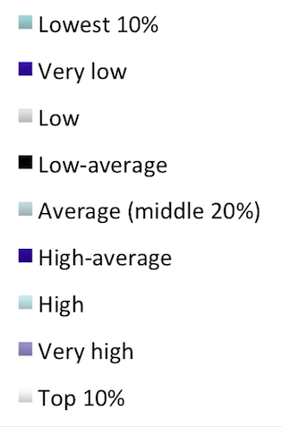
Methods
Measurements:
How do you think your use of alcohol compares to other people who have used that substance recently?
Notes:
The question assessing normative beliefs about alcohol use had 9 options, these were anchored at the extremes and middle with percentiles and linguistic terms were used for the other deciles as a compromise between precision in terms of intended meaning and using language that respondents could understand.
Each of these 9 responses was equivalent to one decile, except for point 5 which was the middle two deciles (40-60%).

Slide 8
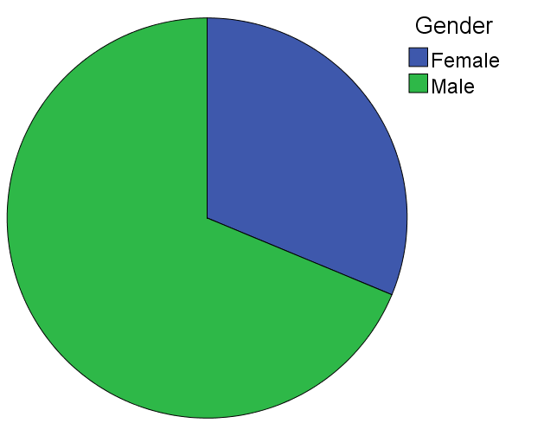
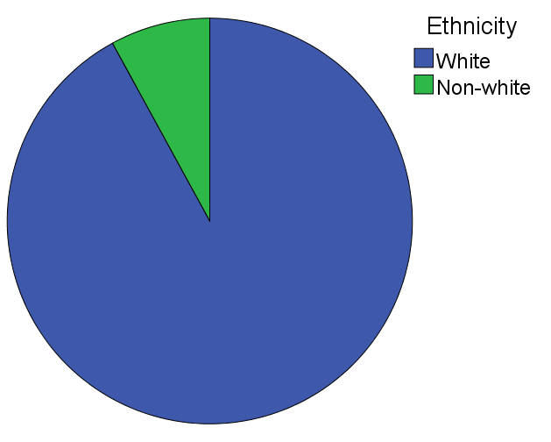
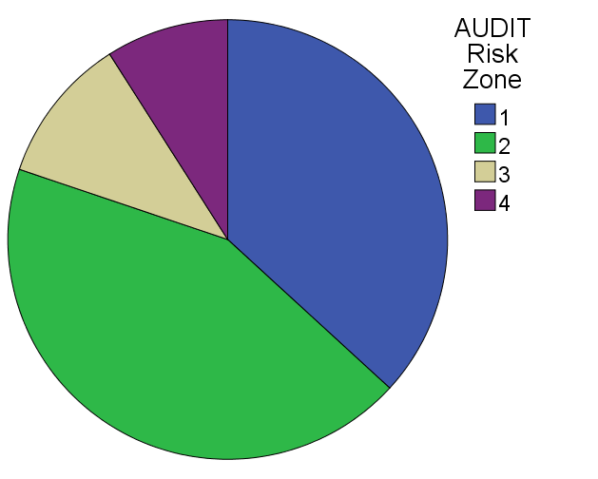
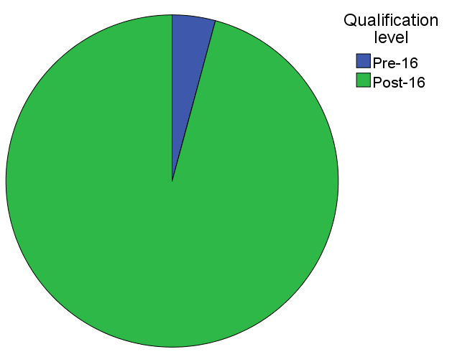
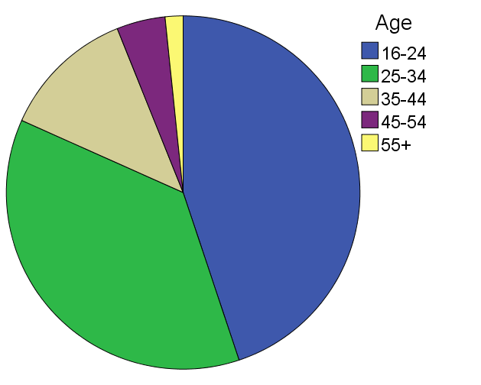
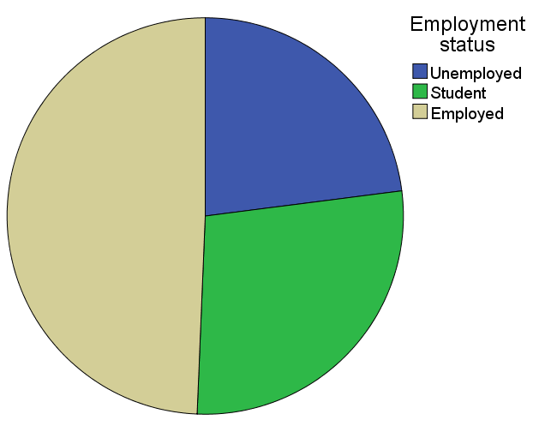
Methods
Participants:
aged 18+
consumed alcohol in the last year
9,820 participants
- mean AUDIT score = 10.5 (risk zone 2)
- majority were
    male (69%)
    aged 16-24 (45%)
    white (92%)
    employed (49%)
    post-16 qualification level (96%)
    AUDIT risk zone 2 (43%)
Notes:
Participants had to be aged 18 or over, consumed alcohol in the last year and have no missing data for any of variables to be included in the study
This resulted in 9,820 participants with a mean AUDIT score of 10.5 (equivalent to risk zone 2)
Socio-demographic questions assessed age, gender, ethnicity, country of origin, employment status and highest qualification level achieved
The majority of participants were male, aged 16-24, white, employed, had post-16 qualifications and were in AUDIT risk zone 2

Slide 9
Methods
    Normative misperception score = actual - belief
    Magnitude of score = extent of the discrepancy
Analysis:
    Prevalence was assessed through descriptive statistics and cross tabulation
Linear and multiple regression models were used to investigate if any associations existed
    Negative score = overestimating their alcohol use relative to others
    No difference = correct estimation of their alcohol use relative to others
    Positive score = underestimating their alcohol use relative to others
Notes:
NM score was difference between participant’s actual and perceived position on the 9 point scale. Their actual position was calculated using the AUDIT-C scores (as it measures consumption) for each decile and creating a 9-point scale equivalent to the responses to the normative belief questions.
This meant NM scores could range from -8 to +8
A score of 0 indicates no misperception in terms of their relative alcohol use
A positive score means they’re underestimating their alcohol use compared with others.
A negative score corresponds to an overestimation.
The magnitude of the score indicates the extent of the difference
The prevalence of normative misperception was assessed through descriptive statistics and cross tabulation.
The associations were assessed using linear (univariate association) and multiple regression (unique association) models.

Slide 10
Results
High prevalence of normative misperceptions in the general population of drinkers:
Over a third of harmful alcohol users and a quarter of alcohol users at risk of dependence believed their alcohol consumption to be average or less.
    Mean normative misperception score = 0.2 (SD=1.85)
    Sig. >0 (t₍₉₈₁₉₎=10.443, p<0.001)
    38.6%
    (95% CI= 37.6%, 39.5%) Overestimate their alcohol use relative to others
    14.5%
    (95% CI= 13.8%, 15.2%)
    Accurate in their perception
    46.9%
    (95% CI= 45.9%, 47.9%)
    Underestimate their alcohol use relative to others
Notes:
The mean NM score for all of the participants was 0.2 (indicating an underestimation), and this score was significantly greater than 0 (which would indicate a correct perception of how their alcohol consumption compared with others)
Nearly half underestimated the proportion of other people who consume less alcohol than them. 14.5% were correct and 38.6% overestimated their alcohol use relative to others
Over a third of harmful drinkers and a quarter of participants at risk of alcohol dependence believed their alcohol consumption to average or less when in fact, both groups are in the top 20% – definitely not average or below

Slide 11
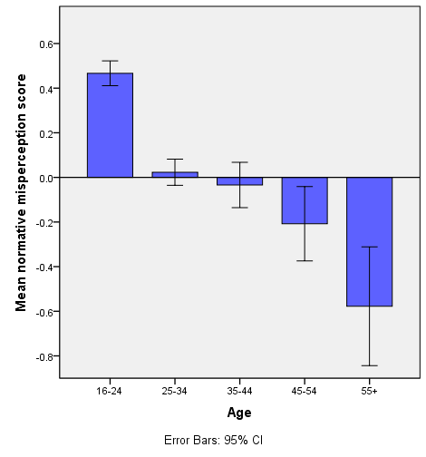
Results
A number of socio-demographic and drinking variables associated with the normative misperception score:
Age: p<0.003
*
*
*
*
Error bars: 95% CI
* p<0.005
Reference group
Notes:
These are the results for the multiple regression analysis, each of the following variables had a unique association with the NM score.
There was a significant association between age and mean normative misperception score.

Slide 12
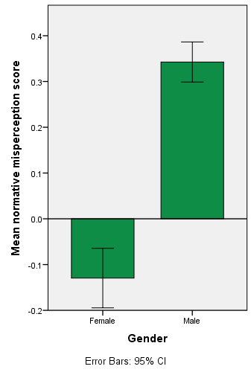
Results
A number of socio-demographic and drinking variables associated with the normative misperception score:
Age: p<0.003
Gender: p<0.001
*
Error bars: 95% CI
* p<0.005
Notes:
Sig association between gender and the mean normative misperception score

Slide 13
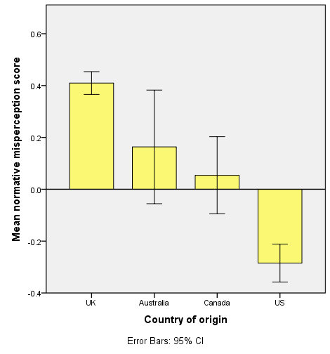
Results
A number of socio-demographic and drinking variables associated with the normative misperception score:
Age: p<0.003
Gender: p<0.001
Country of origin (from UK vs US): p<0.001
*
Error bars: 95% CI
* p<0.005
Reference group
Notes:
Sig difference between the US and UK (the reference group) for mean NM score

Slide 14
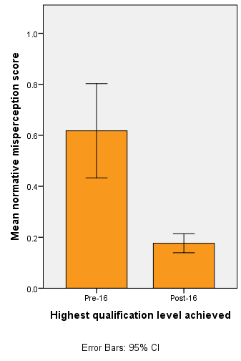
Results
A number of socio-demographic and drinking variables associated with the normative misperception score:
Age: p<0.003
Gender: p<0.001
Country of origin (from UK vs US): p<0.001
Qualification level: p=0.003
*
Error bars: 95% CI
* p<0.005
Notes:
Sig association between the highest qualification level achieved and mean NM score

Slide 15
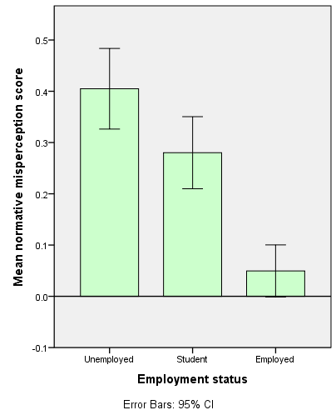
Results
A number of socio-demographic and drinking variables associated with the normative misperception score:
Age: p<0.003
Gender: p<0.001
Country of origin (from UK vs US): p<0.001
Qualification level: p=0.003
Employment status (unemployed vs employed): p<0.001
*
Error bars: 95% CI
* p<0.005
Reference group
Notes:
Sig difference between unemployed and employed participants in terms of mean NM score

Slide 16
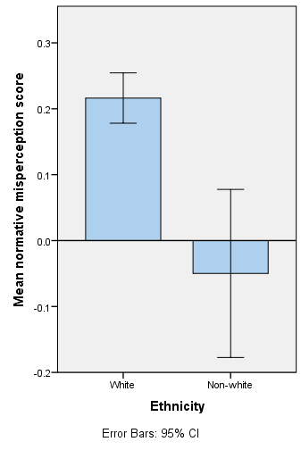
Results
A number of socio-demographic and drinking variables associated with the normative misperception score:
Age: p<0.003
Gender: p<0.001
Country of origin (from UK vs US): p<0.001
Qualification level: p=0.003
Employment status (unemployed vs employed): p<0.001
Ethnicity: p=0.035
*
Error bars: 95% CI
* p<0.005
Notes:
Sig association between ethnicity and mean NM score

Slide 17
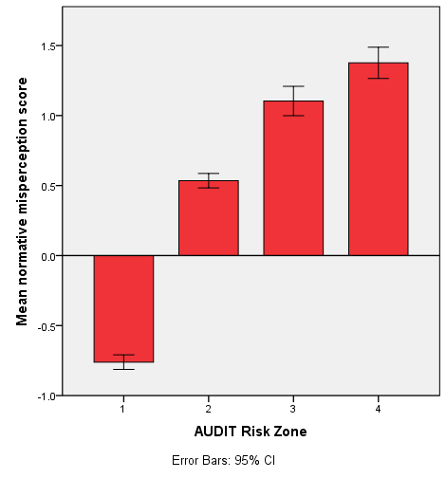
Results
A number of socio-demographic and drinking variables associated with the normative misperception score:
Age: p<0.003
Gender: p<0.001
Country of origin (from UK vs US): p<0.001
Qualification level: p=0.003
Employment status (unemployed vs employed): p<0.001
Ethnicity: p=0.035
Level of alcohol-related risk: p<0.001
*
*
*
Error bars: 95% CI
* p<0.005
Reference group
Notes:
Sig association between level of alcohol-related risk and mean NM score

Slide 18
Results
Greatest tendency for large, positive normative misperception scores amongst those who were…
  Younger
  Male
  From the UK
  Without post-16 qualifications
  Unemployed
  White
  At higher levels of alcohol-related risk
Notes:
The greatest tendency for positive NM scores (so greatest underestimation of their own alcohol use compared with others) were amongst those who were younger, male, from the UK, without post-16 qualifications, unemployed, white and at higher levels of alcohol-related risk

Slide 19
Discussion
Limitations:
AUDIT scores may not be representative of general population
- Consumption comparator would be higher
- Results are likely to be an overestimate of population prevalence
Used all four countries to calculate the nine-point AUDIT-C scale
- Sensitivity analysis showed similar pattern of results
Method chosen to calculate the normative misperception score
- Best compromise
Notes:
There are a number of limitations associated with this study.
First, the GDS may not be representative sample, the GDS used purposive sampling so likely that participants are more interested in drugs/alcohol than most
- if GDS sample was biased towards heavy drinking sample, results are likely to be an overestimate of popn prevalence because the consumption comparator would be higher than from the general popn
- So pattern of results would be the same
Used all 4 countries for the AUDIT-C scale
Participants were asked the comparison question in general, their own country was not specified and it is a global survey, though participants may have answered this in relation to their own country. A sensitivity analysis with UK and US sub-samples did show a similar pattern of results
The method chosen to operationalise the NM score was considered the best compromise between precision in terms of intended meaning and using language that respondents could understand, could have asked respondents to place themselves into deciles but instead anchored extremes and middle with deciles and used linguistic terms for others as believed this to be the best method

Slide 20
Conclusions
Underestimation of own alcohol consumption relative to others is common in general population of drinkers
Greatest tendency amongst those who were…
  Younger
  Male
  Less well educated
  Unemployed
  White
  From the UK
  High-risk drinkers
Substantial minority of harmful drinkers believe their alcohol consumption to be at or below average
Notes:
In conclusion, this study found that underestimation of one’s own alcohol use compared with others was common in the general population of drinkers.
The greatest tendency for this was amongst those who were younger, male, less well educated, unemployed, white, from the UK and high-risk drinkers.
There was a substantial minority of harmful drinkers who believed their alcohol consumption to be at or below average (when it was in fact, considerably above average).

Slide 21
Discussion
Future research:
Investigate whether interventions targeted at individuals with the associated socio-demographic and drinking variables have more impact
  -> Targeted interventions could potentially enhance the effectiveness of population wide health strategies to reduce alcohol consumption and misuse
Notes:
Future research should investigate whether there is more impact for interventions targeted at individuals with the socio-demographic and drinking variables found to be associated with NMs
If this is the case, then interventions could be targeted at these individuals to potentially enhance the effectiveness of population wide health strategies aimed at reducing excessive alcohol consumption

Slide 22
Thank you for listening.
Any questions?
c.garnett.12@ucl.ac.uk

Slide 23

Methods
I believe I am a ‘low-average’ drinker….
Calculation of normative misperception score
  9-point scale of normative perceptions
  Want to directly compare actual alcohol consumption with their normative beliefs about their alcohol consumption
    Used AUDIT-C scores -> measure of consumption
    Mapped onto same 9-point scale (combining middle 2 deciles)
Low-average
Normative belief response
Lowest 10%
Very low
Low
Low-average
Average (middle 20%)
High-average
High
Very high
Top 10%
AUDIT-C Score
0 – 3
4 (=2.5)
5
6 – 7 (=5.5)
8
9
10 – 12
AUDIT-C = 8
My normative misperception score = 3 (7-4)
But in reality, I am a ‘high’ drinker as I scored 8 on the AUDIT-C
    Normative misperception score = actual - belief
Notes:
The NM score was calculated in the following way.
The AUDIT-C scores were used to create a nine-item scale (of the 10 deciles with the middle two combined to directly compare with normative beliefs question)
AUDIT-C used not full AUDIT because it focuses on consumption, like the comparison questions.
This yielded an AUDIT ‘position’ from 1 to 9 (1=0-10%, 2=10-20%, 3=20-30%, 4=30-40%, 5=40-60%, 6=60-70%, 7=70-80%, 8=80-90%, 9=90-100%) and a normative belief position of 1 to 9.
NM score was difference between their actual and perceived position on this scale

Slide 24
Discussion
Limitations:
AUDIT scores may not be representative of general population
- But this means the results are likely to be an overestimate of population prevalence
Low-average
7-4 =3 in GDS sample
Normative belief response
Lowest 10%
Very low
Low
Low-average
Average (middle 20%)
High-average
High
Very high
Top 10%
AUDIT-C Score for representative sample
AUDIT-C Score for GDS sample
5
8
9
0 – 3
6 – 7 (=5.5)
7
10 – 12
0 – 2
4 (=2.5)
4
5 – 6 (=5.5)
8
3 (=2.5)
9-12
AUDIT-C =8
8-4 =4 in representative sample
Notes:
There are a number of limitations associated with this study.
First, the representativeness of the sample, the GDS used purposive sampling so likely that participants are more interested in drugs/alcohol than most
- if GDS sample was biased towards heavy drinking sample, results are likely to be an overestimate of popn prevalence because the consumption comparator would be higher than from the general popn
So pattern of results would be the same
The consumption comparator (from which the misperceptions are calculated) will be higher than normal. So even though that is higher, people are still underestimating (misperceiving) the amount they drink.
e.g If you are a moderate drinker in a 'normal' population, then your actual consumption will be comparatively normal, and insofar that there is misperception, you believe your drinking is less than normal. If you are the same moderate drinker with the same perception, and consumption is calculated relative to a 'heavier than average' population, then your actual consumption will come out as relatively low, and your perception that your drinking is less than normal is now 'correct', and implies there is no misperception. I.e., a 'heavier average' comparator tends to underestimate this misperception.

Slide 25
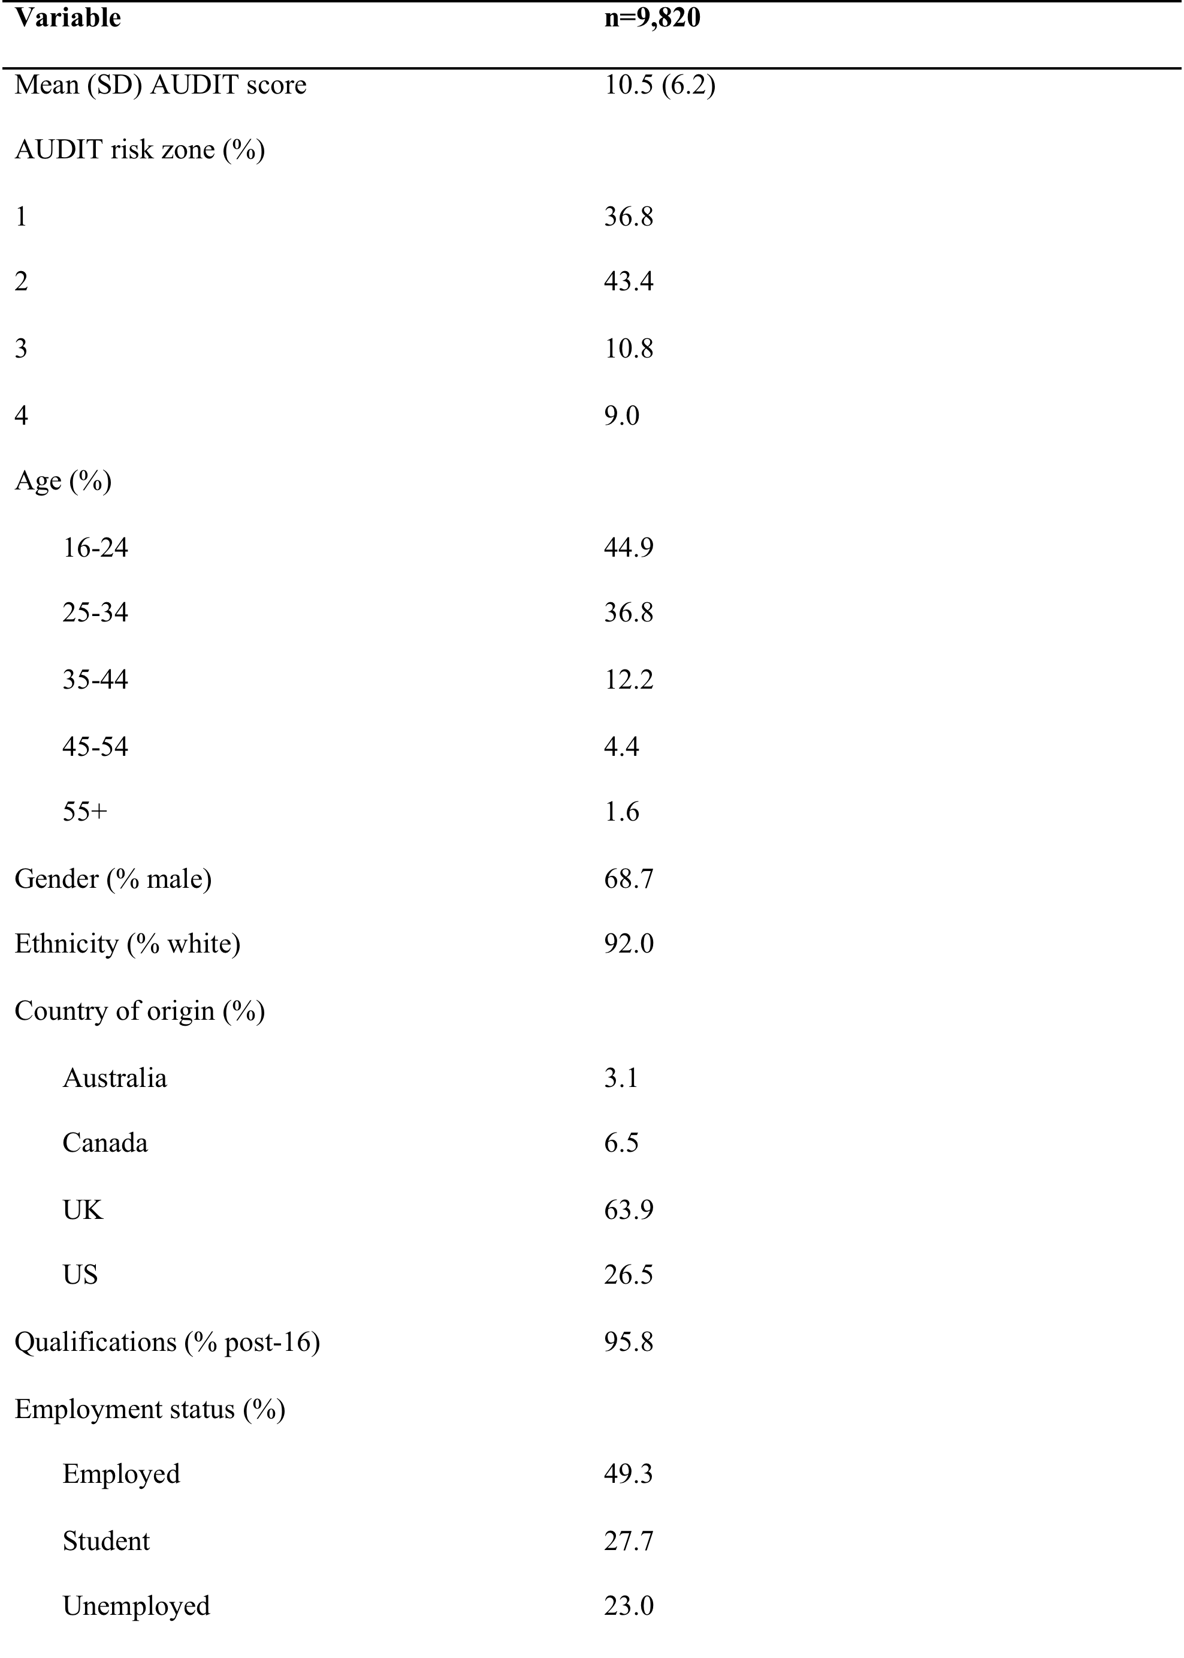
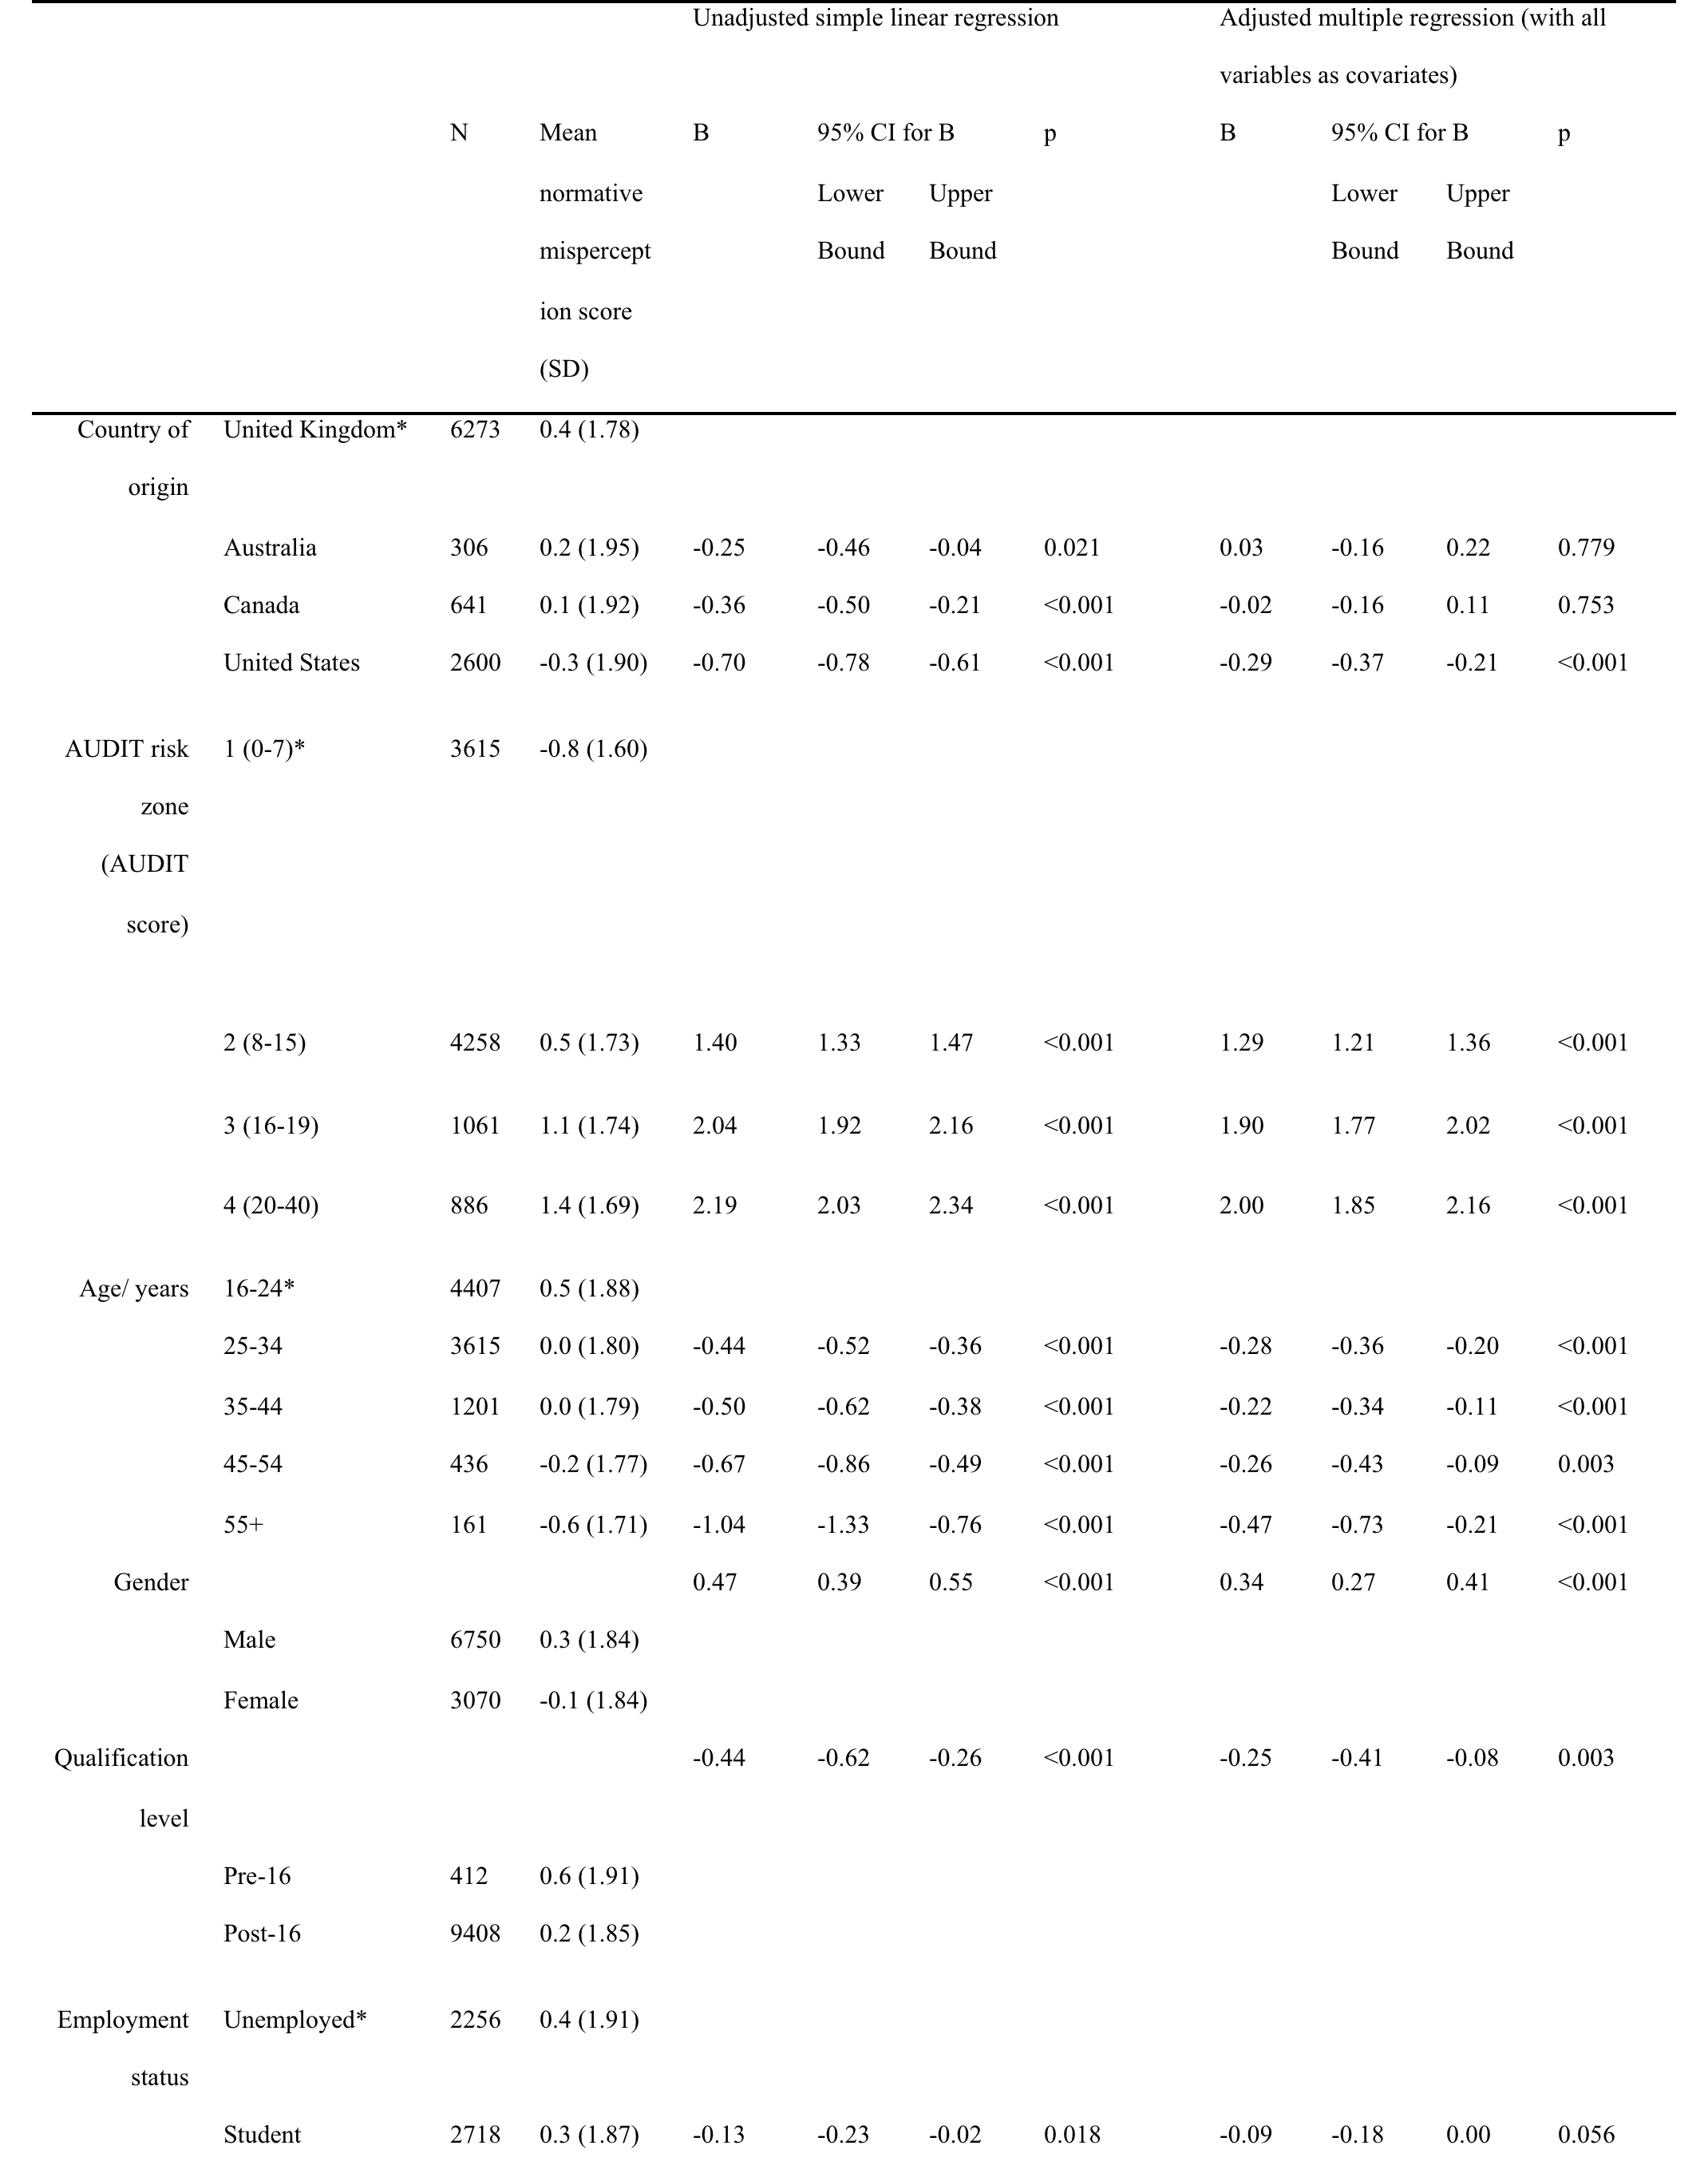
Table 2: Effect of socio-demographic and drinking variables on normative misperception score
Table 1: Participant demographics

