Slide 1
Novel Psychoactive Substances (NPS) - teaching of undergraduate healthcare professionals and educating the educators
Society for the Study of Addiction Annual Symposium Nov. 6th 2015
Christine Goodair, Hugh Claridge, Dr Colin Davidson & Safia Akhtar
Website: eumadness.eu

Slide 2
What is the EU-MADNESS Project
Collaborative – UK, Spain, Italy, Germany & Hungary
European Funded for two years, 2014-16
Monitoring & profiling NPS to identify health harms
Develop educational resources for health professionals

Slide 3
Work streams
WS1 - collating information from across Europe about individuals who have reported using NPS or who died from such use
WS2 – chemical analysis of structures and substances to identify potential psychoactive properties
WS3 – neurobiological pharmacology
WS4 - development of educational materials/resources from knowledge gleaned from WS1-3 and other evidence-based research

Slide 4
Overview of work streams
WS1: Monitoring Fatalities
WS2: Chemical Screening & QSAR
WS3: Neurobiological Pharmacology
WS4: Educational resources

Slide 5
WS4: Current activities
Data information & collation
Horizon scanning
Surveys re NPS Education
Development of resources and dissemination of knowledge
Educators in medical schools and allied health care courses
Pharmacist surveys
Students’ (SGUL) educational needs

Slide 6
Student Survey (BSc project)
Hypothesis -there is a need for education on novel psychoactive substances (‘legal highs’) amongst undergraduate healthcare professionals
Healthcare professionals (HCPs) come into contact with NPS via their health harms in patients
Attitudes
Awareness
Knowledge

Slide 7
Methods
Undergraduate HCPs
Designed a self-administered online survey to collect primary data
Survey in two sections – first covered knowledge about illegal drugs & NPS; second focused on students’ educational needs re NPS

Slide 8
Results: Demographic Information
284 responses collected (23rd January - 13th February 2015)
♀ 63.4%; ♂ 35.6%; unspecified 1.1%
Other HCP | %
Nursing | 15.1
Diagnostic Radiography | 11.8
Postgraduate course | 8.6
Social Work | 7.5
Physiotherapy | 7.5
Masters course | 6.5
Paramedic Science | 5.4
Healthcare Science | 3.2
Midwifery | 3.2

Slide 9
Results: Knowledge
Drug awareness
Knowledge of drugs
97.5% respondents aware of illegal drugs
Prior NPS teaching
66.2% respondents have had no teaching on NPS on their course
Seeking information on NPS
59.5% respondents would look to Internet
23.3% respondents would look to scientific literature
“There is a need for education on legal highs”
85.2% agreed or strongly agreed

Slide 10
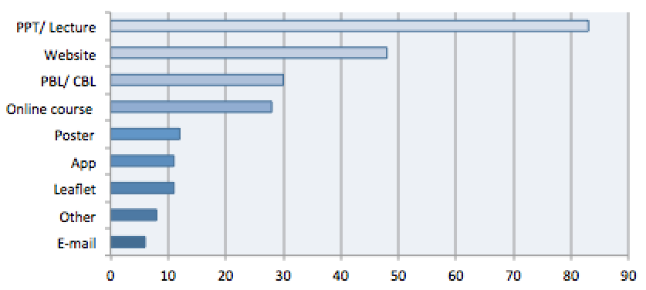
Figure 3. Bar chart showing the methods of learning survey respondents would most prefer, in descending order

Slide 11
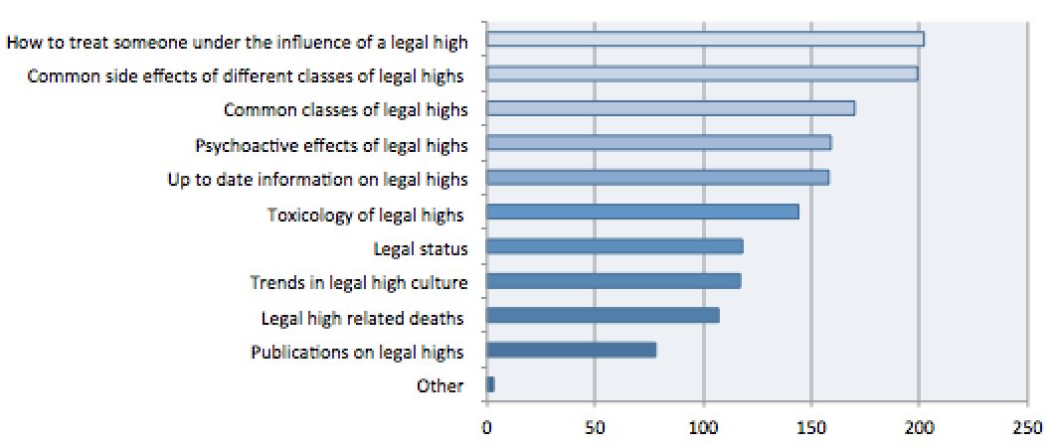
Figure 4. Bar chart showing what content survey respondents would most prefer to be taught on, in descending order

Slide 12
Survey of medical schools and other healthcare courses
Survey went to those in partner countries
Aimed to identify:
What are healthcare professionals being taught across Europe, and what should they be taught?
How much do key course staff know?
Are there any barriers to teaching about NPS?
What teaching resources are wanted?

Slide 13
Responses by country
Total responses = 105
Partner countries’ responses
United Kingdom (35)
Spain (32)
Italy (12)
Germany (6)
Hungary (4)
Belgium
Croatia
Czech Republic
Denmark
Lithuania
Netherlands
Norway
Republic of Ireland
Serbia
Slovakia
Sweden
Switzerland

Slide 14
Responses by course
 | Course | n
 | Medicine | 59
 | Pharmacy | 17
Allied Health Professions (AHP) | Nursing | 11
 | Psychology | 6
 | Physiotherapy | 4
 | Paramedic | 3
 | Physician Associate | 2
 | Epidemiology | 1
 | Occupational Therapy | 1
 | Social Work | 1

Slide 15
NPS-related teaching
There was substantial difference between courses in certain areas of NPS teaching:
NPS/‘legal highs’ as a general topic?
No teaching:
Synthetic cannabinoids?
Medicine 36%
Pharmacy 12%
AHP 21%

Slide 16
NPS-related teaching
There was little difference between the courses regarding the amount of teaching on:

Slide 17
NPS-related teaching
There were some marked differences between the UK & RoI when compared to the rest of Europe regarding the amount of teaching on:
NPS in general
Cathinones

Slide 18
NPS-related teaching
At least 75% of those responding from all courses thought that their students should have at least one dedicated lecture on the following aspects of NPS:
General information
Desirable effects
Pharmacology
Legal status
Overall danger
>93%
>81%
>76%
>79%
>86%
Mortality
Acute harms
Chronic harms
Clinical signs of intoxication
Overdose intervention
Psychopathological consequences
>79%
>89%
>87%
>75%
>86%
>76%
The only suggested topic that failed to garner similar levels of support from all courses was the verification of NPS by laboratory means.

Slide 19
NPS knowledge of staff
Not at all familiar or have only heard of them (%) | Topic | Read at least one academic article on them (%)
15 | NPS in general | 73
16 | Synthetic cannabinoids | 65
21 | Cathinones | 65
41 | New dissociatives | 38
45 | Phenethylamines | 37
45 | Tryptamines | 35
48 | Piperidines | 31

Slide 20
Barriers to teaching

Slide 21
Preferred resources & teaching materials
There was almost complete consensus among all courses:
Wanted |  % |  %
Powerpoint slides | 82 | 18
Websites/links | 68 | 32
Factsheets | 58 | 42
Seminar materials | 57 | 43
Not wanted |  % |  %
Webinar | 73 | 27
App | 70 | 30
Audio podcast | 67 | 33
Advanced reading | 60 | 40

Slide 22
Summary
Students want more education on legal highs and illicit drugs
Students want to be made more aware of harms in general, and how to treat patients
The inclusion of specific NPS in medical curricula across Europe is limited
Educators have difficulty in finding time to teach NPS on their courses
Educators want specific teaching resources on legal highs

Slide 23
References
Simonato. P., et al. (2013) Novel psychoactive substances as a novel challenge for healthcare professionals: results from an Italian survey. Hum. Psychopharmacol. Clin.Exp.:28 pp.324-331 doi:10.1002/hup.2300
Thurman & Boughelaf 2015 “We don’t get taught enough”: an assessment of drug education provision in schools in England. Drugs and Alcohol Today, Vol. 15 Iss: 3, pp.127-140

