Slide 1
The MENSTRUAL CYCLE, MOOD AND ALCOHOL
Jasmine warren Supervisors
PhD student Dr abi rose
Department of psychological sciences Dr laura Goodwin
University of Liverpool Dr suzi gage
contact
J.Warren2@Liverpool.ac.uk
@Jasmine_Grace_
Notes:
This was my MSc dissertation which is acting as a pilot study for the PhD. We are still collecting data so I am presenting interim findings.

Slide 2
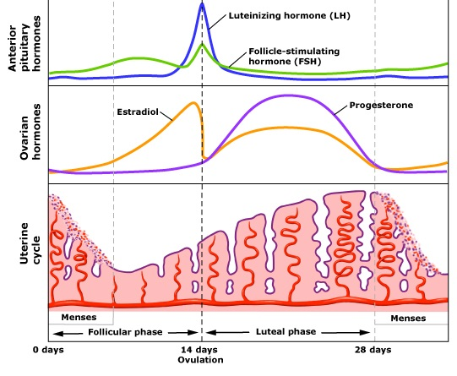
Definition of cycle stage
*natural fluctuations not present for hormonal contraception users
https://www.memorangapp.com/flashcards/103950/The Reproductive System: Menstrual and Ovarian Cycles/
Notes:
The Follicular Phase (FP) is the time between day 1 and ovulation and during this phase, oestrogen levels tend to be higher than progesterone levels. The Luteal Phase (LP) is characterised with progesterone levels higher than oestrogen levels.
HC – constantly higher estrogen compared to progesterone.

Slide 3
Background & aims
Background
Sex differences may impact on treatment effectiveness for Alcohol Use Disorder (Becker & Hu, 2008)
Animal models have suggested a role of ovarian hormones (Franklin & Allen, 2016; Bucelli et al., 2016)
Recent literature reviews (e.g. Erol & Karpyak, 2015) have stated the need to comprehensively investigate the role of the menstrual cycle
Aims
Investigate the relationship between menstrual cycle stage (FP vs LP) and status (NC vs HC) on alcohol consumption and craving
Investigate the role of potential mediators (mood, stress, and craving)
Notes:
Those that have also used females have stated a difference between the sexes but do not explore why

Slide 4
Methods
Information taken from period tracker app (NC only for cycle phase confirmation)
Baseline measures: Alcohol Urge Questionnaire; State Trait Anxiety Inventory; Profile Of Moods Scale; Stress statement
10 minute ad-libitum taste test
Post-consumption measures: Profile Of Moods Scale; Stress statement
Methods
2x2 mixed design with 28 participants (13 NC; 15 HC)
Participants attended the lab twice for testing (NC once during the FP and once in the LP)
Lab sessions:
DVs
Milliliters (mL) alcohol consumption
Alcohol Urge Questionnaire scores (craving)

Slide 5
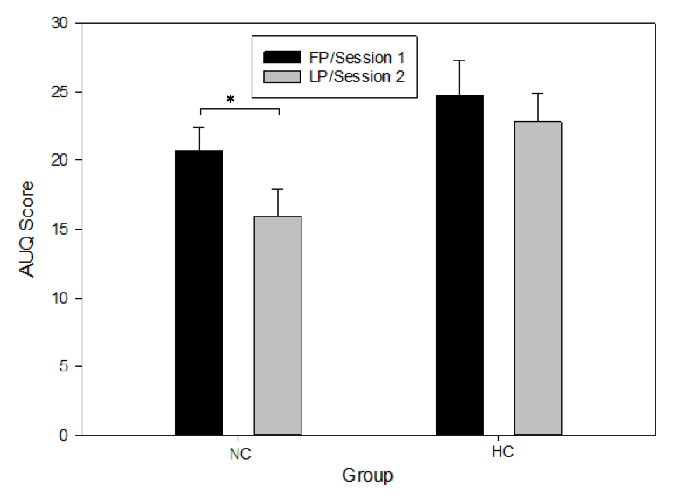
results
No effect of phase/session or status on stress or mood (ps>.05)
No effect of phase/session or status on alcohol consumption (p=.053)
Significant effect of phase/session on alcohol craving (F=6.24, p=.019, ηp²=.19)*
Mediation will be analysed at the end of data collection
Notes:
EFFECT SIZES
.14 consumption
.19 consumption
SAME DIRECTION – SAMPLE SIZE

Slide 6
Conclusions & Future directions
Conclusions:
Alcohol craving was affected by menstrual cycle stage (FP=higher AUQ scores)
Evidence suggests higher reward during the follicular phase (FP) compared to the Luteal phase (LP) (Anker & Carroll, 2010; Graziani, Nencini, & Nisticò, 2014)
This effect was not present for the HC participants
No effect found for subsequent alcohol consumption, although the effect is in the same direction as craving
Future directions:
PhD – robust measures (e.g. hormonal analysis); in-lab stress manipulations; longitudinal study design
Consideration for hormonal status and cycle stage for future studies
Implications for treatment of Alcohol Use Disorders

Slide 7
Thank you
J.Warren2@Liverpool.ac.uk
Anker, J. J., & Carroll, M. E. (2010). Females are more vulnerable to drug abuse than males: evidence from preclinical studies and the role of ovarian hormones. In Biological basis of sex differences in psychopharmacology (pp. 73-96).
Becker, J. B., & Hu, M. (2008). Sex differences in drug abuse. Frontiers in neuroendocrinology, 29(1), 36-47.
Buccelli, C., Della Casa, E., Paternoster, M., Niola, M., & Pieri, M. (2016). Gender differences in drug abuse in the forensic toxicological approach. Forensic science international, 265, 89-95.
Erol, A., & Karpyak, V. M. (2015). Sex and gender-related differences in alcohol use and its consequences: Contemporary knowledge and future research considerations. Drug and alcohol dependence, 156, 1-13.
Franklin, T. R., Napier, K., Ehrman, R., Gariti, P., O'Brien, C. P., & Childress, A. R. (2004). Retrospective study: influence of menstrual cycle on cue-induced cigarette craving. Nicotine & Tobacco Research, 6(1), 171-175.
Graziani, M., Nencini, P., & Nisticò, R. (2014). Genders and the concurrent use of cocaine and alcohol: pharmacological aspects. Pharmacological research, 87, 60-70.
Memorang. (n.d.). The Reproductive System: Menstrual and Ovarian Cycles (MCAT 2018: Biology) Flashcards. Retrieved August 08, 2018, from https://www.memorangapp.com/flashcards/103950/The Reproductive System: Menstrual and Ovarian Cycles/

Slide 8
MORE INFORMATION
Methods
Power Calculation on G*Power: beta error probability = 0.80; alpha error probability =0.05
Tested between 12-6pm
Findings
FP is likely to be driving the effect rather than LP as estrogen is higher. HC has estrogen, hence why that group does not fluctuate and has higher levels of craving
Craving and consumption are not highly correlated in the lab
Implications
Interventions: considering cycle stage, educating women that cravings may change, progesterone-only pill (luteal phase content)

