Slide 1







How Have Social Norms Towards Smoking Changed Over Time? Findings From The
International Tobacco Control (ITC) Four Country Survey
Katherine East^{1,2}, Sara C. Hitchman^{1,2}, Ann McNeill^{1,2}, Stuart G. Ferguson³, Hua Yong^{4,5}, Michael K. Cummings⁶, Geoffrey T. Fong⁷, Ron Borland⁴
¹King’s College London (UK), ²UKCTAS (UK), ³The University of Tasmania (Australia), ⁴Cancer Council Victoria (Australia), ⁵Deakin University (Australia), ⁶Medical University of South Carolina (US), ⁷University of Waterloo (Canada)
SSA PhD Symposium
Newcastle, UK
Wednesday 7th November 2018
Notes:
Final year PhD student at King’s College London
PhD funded by UKCTAS
Awarded the SSA Travelling Scholarship to visit research institutions in Australia.
Specifically Cancer Council Victoria, where I worked on this study.

Slide 2

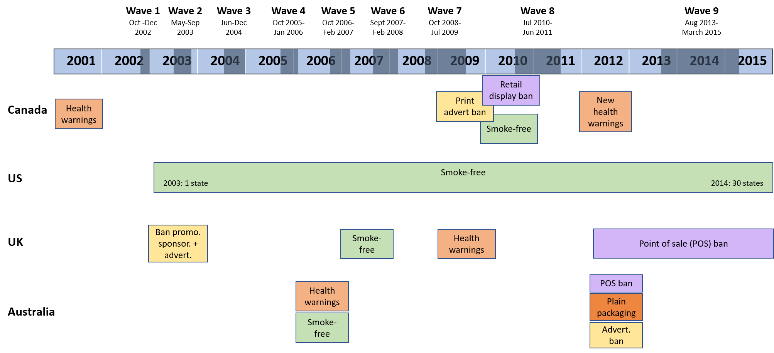

Introduction • Objectives • Methods • Results • Discussion
PhD overview and introduction
    My PhD aims to assess whether social norms towards smoking:
    Are associated with smoking (and e-cigarette use)
    Vary across countries and over time
    My PhD aims to assess whether social norms towards smoking:
    Are associated with smoking (and e-cigarette use)
    Vary across countries and over time → ITC project (started in 2002)
Hypothesis: Social norms would become more anti-smoking over time
Notes:
2
These are the main policy changes that are most likely to influence social norms.
I’m not going to go into this in detail, but what you mainly need to know is that in the four countries there have been an increasing number of tobacco control policies since 2002.

Slide 3
Introduction • Objectives • Methods • Results • Discussion
Methods and analyses
  Dataset: International Tobacco Control (ITC) Four Country Survey W1 (2002) – W9 (2013-2015): UK, Australia, Canada, US
  Sample: Nationally representative longitudinal sample of daily smokers age 18+, n=23,831
  Analyses: 3 Generalised Estimating Equation (GEE) logistic regressions with outcomes:
      Over half of friends smoke
      People important to you believe you shouldn’t smoke
      Society disapproves of smoking
    Covariates: Heaviness of Smoking Index, Age, Sex, Ethnicity, Income, Education,
    Survey Mode, Time-in-sample, Time-between-waves
All analyses weighted on gender, age and region
Notes:
3

Slide 4
Introduction • Objectives • Methods • Results • Discussion
Results
Over half of friends smoke
Friends smoking largely unchanged over time
General shift to less anti-smoking injunctive norms from ~2007
Smokefree fairly invisible, no longer societal problem
Smoking “no longer a public health priority”
Daily smokers only Lower SES, older, won’t/can’t quit, more isolated/marginalised
E-cigarettes “renormalising” smoking (?!?!?!)
People important to you approve of smoking
Possible explanations
Society approves of smoking
Notes:
4
Having more than half of friends smoke did not change between 2002 and 2015, and there were no cross-country differences except respondents from the US had greater odds of friend smoking than Australia.
Agreeing that people important to you believe you shouldn’t smoke increased between 2003 and 2007, then decreased until 2015. Daily smokers from the UK had lower agreement than all other countries, followed by Australia.
Agreeing that society disapproves of smoking increased between 2002 and 2007, then decreased until 2015.
The first and most likely explanation is smokefree policy, which was implemented in 2006/2007 in UK and Australia, 2010 in Canada and on a state-by-state basis in the US and is therefore most consistent with the observed trends. Smokefree policy could mean that smoking is fairly invisible in society, and therefore no longer seen as a societal problem.
A second explanation is that smoking may no longer be perceived as a public health priority. The prevalence of obesity, dementia and other burdens have increased whereas smoking has decreased. However, this can’t explain the increase around 2006/2007.
A third explanation could be as this study only included daily smokers at each wave. Daily smokers are more likely to be of lower SES, older, and importantly those who won’t or can’t quit. These are therefore unique individuals likely living in areas with less restrictive norms towards smoking, more entrenched views and potentially feel more isolated and stigmatized. These individuals with potentially pro-smoking norms would have been retained in this study, whereas those who quit with potentially anti-smoking norms would have been dropped.
A final explanation which needs to be considered is that e-cigarettes are renormalising smoking. However, e-cigarettes only really became popular in the last two survey waves, and the pattern is similar in Canada and Australia, which have restrictive e-cigarette policies, vs. the UK and US which are more liberal. We therefore think this explanation is unlikely.

Slide 5
Introduction • Objectives • Methods • Results • Discussion
Implications and avenues for future research
No convincing explanation for trends. Perhaps not just one?
Why do these trends matter?
Threat to tobacco control efforts?
Norms ≠ prevalence – friend smoking unchanged
Smoking prevalence decreasing
Recent trends? ITC 2016 available, but changes in sample and measures
What about non-daily smokers? Non-smokers? Youth?
Notes:
5
To summarize then, there are no convincing explanations for these trends. There may not be just one, and their effects are probably additive or even multiplicative.
If anyone has any other potential reasons, they would be massively welcome!
It’s important to consider why these trends matter. Could they be a threat to tobacco control efforts? We don’t know. Norms don’t necessarily translate to prevalence, indeed friend smoking, the norm most related to prevalence, remained unchanged. And smoking prevalence has been decreasing while injunctive norms have been changing.
However, it’s possible that norms might pre-empt an increase in smoking prevalence.
We really need to look at more recent trends. Data from 2016 is available, however the sample completely changed and the measures used also changed, so it’s difficult to incorporate.
And we also need data on trends in non-daily smokers and non-smokers and youth, to see what’s going on in these groups.

Slide 6
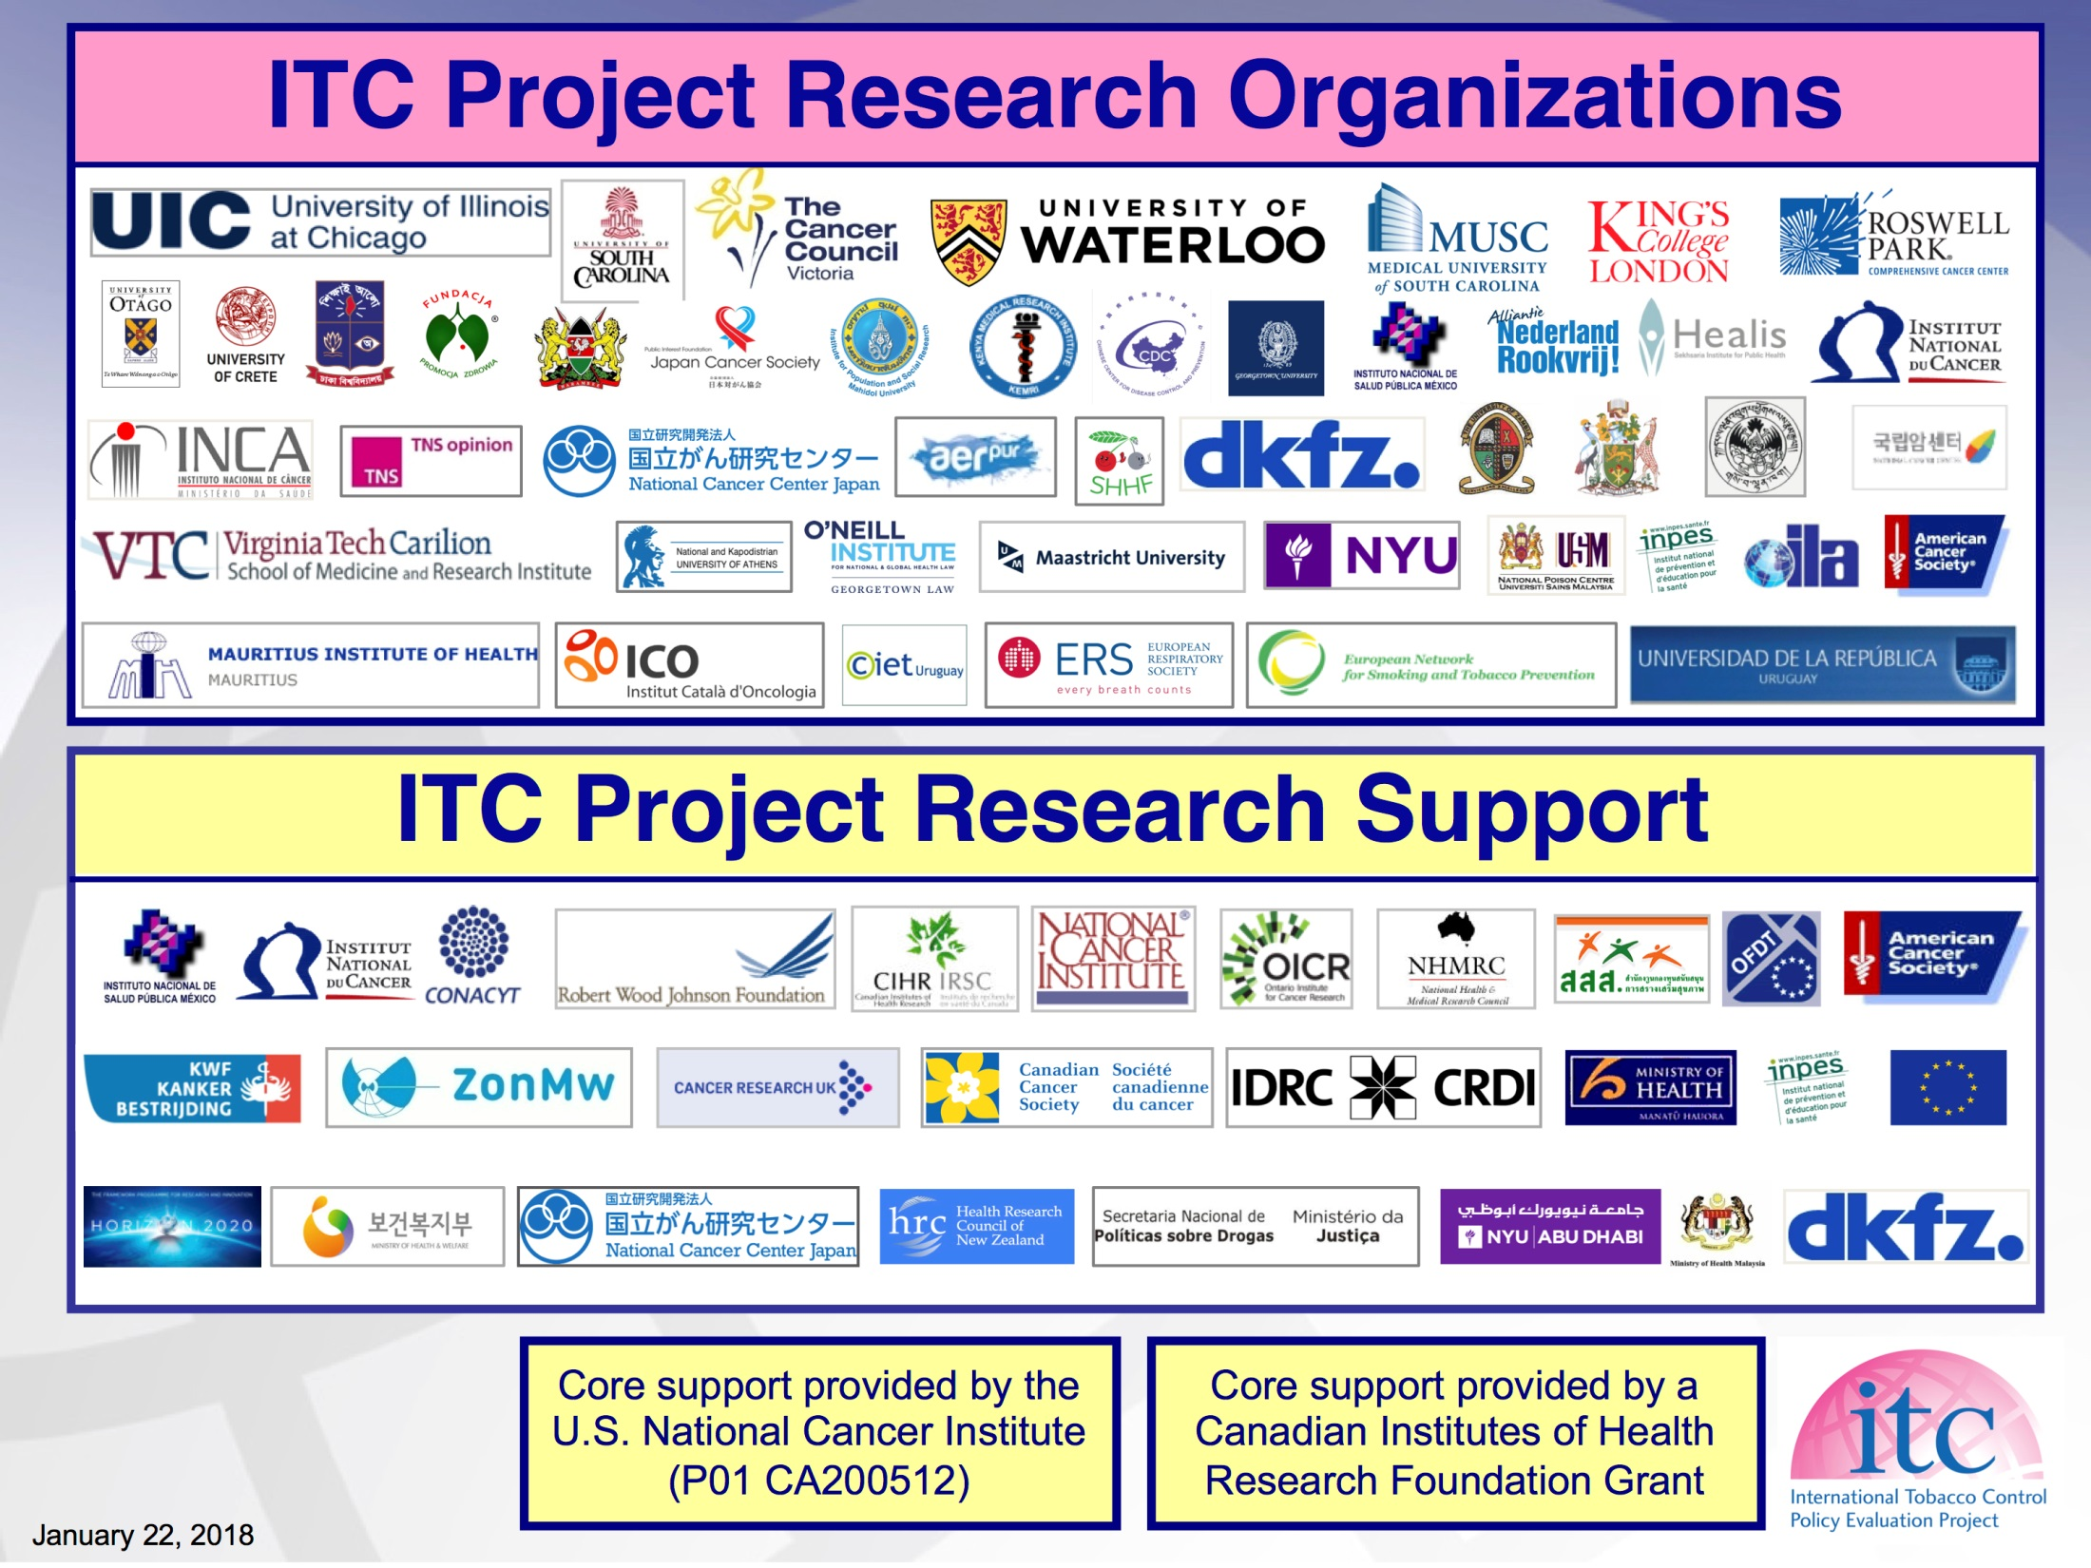
Thank you!
My supervisors:
Sara C. Hitchman
Ann McNeill
Co-authors:
Stuart G. Ferguson,
Hua Yong
Michael K. Cummings
Geoffrey T. Fong
Ron Borland
+ the rest of the ITC team
katherine.east@kcl.ac.uk
Twitter: @kingsNRG

Slide 7
Introduction • Objectives • Methods • Results • Discussion
Objectives
To assess differences over time (2002-2015) and between countries (UK, AU, CA, US) in:
Descriptive norm:
Friend smoking. Less than half (0-2) vs. more than half (3-5).
Injunctive norms:
(ii) People important to you believe you shouldn’t smoke. Agree vs. not agree.
(iii) Society disapproves of smoking. Agree vs. not agree.
Opinion:
(vi) Negative opinion of smoking? Negative vs. not negative.
Given increasingly restrictive policies, we hypothesised a reduction in (i) and an increase in (ii)-(vi)
Notes:
7

Slide 8
Introduction • Objectives • Methods • Results • Discussion
Results: Prevalence estimates
 | CA (%) | US (%) | UK (%) | AU (%)
(i) More than half of friends smoke
W1 – 2002 | 58.90 | 60.69 | 60.56 | 59.69
W9 - 2013-2015 | 50.26 | 56.01 | 47.41 | 51.97
(ii) Agree that people important to you believe you shouldn’t smoke
W1 – 2002 | 89.76 | 89.51 | 85.48 | 88.70
W9 - 2013-2015 | 85.50 | 75.58 | 72.38 | 76.66
(iii) Agree that society disapproves of smoking
W1 – 2002 | 88.34 | 79.03 | 77.36 | 81.69
W9 - 2013-2015 | 80.86 | 68.23 | 75.28 | 78.05
(iv) Negative opinion of smoking
W1 – 2002 | 62.34 | 52.74 | 47.93 | 55.80
W9 - 2013-2015 | 58.54 | 45.29 | 45.88 | 52.26
✓
Weighted on gender, age and region
Daily smokers only
Notes:
8

Slide 9
Introduction • Objectives • Methods • Results • Discussion
Results: Prevalence estimates
 | CA (%) | US (%) | UK (%) | AU (%)
(i) More than half of friends smoke
W1 – 2002 | 58.90 | 60.69 | 60.56 | 59.69
W9 - 2013-2015 | 50.26 | 56.01 | 47.41 | 51.97
(ii) Agree that people important to you believe you shouldn’t smoke
W1 – 2002 | 89.76 | 89.51 | 85.48 | 88.70
W9 - 2013-2015 | 85.50 | 75.58 | 72.38 | 76.66
(iii) Agree that society disapproves of smoking
W1 – 2002 | 88.34 | 79.03 | 77.36 | 81.69
W9 - 2013-2015 | 80.86 | 68.23 | 75.28 | 78.05
(iv) Negative opinion of smoking
W1 – 2002 | 62.34 | 52.74 | 47.93 | 55.80
W9 - 2013-2015 | 58.54 | 45.29 | 45.88 | 52.26
✓
?
?
?
Weighted on gender, age and region
Daily smokers only
Notes:
9

Slide 10
Introduction • Objectives • Methods • Results • Discussion
Results: More than half of friends smoke ([3-5] vs. less than half [0-2])
Adjusted for heaviness of smoking, age, sex, ethnicity, income, education, mode, time in sample, time between waves
Weighted on gender, age and region
Daily smokers only
Notes:
10

Slide 11
Introduction • Objectives • Methods • Results • Discussion
Results: Agree that “people important to you believe you shouldn’t smoke”(vs. not agree)
Adjusted for heaviness of smoking, age, sex, ethnicity, income, education, mode, time in sample, time between waves
Weighted on gender, age and region
Daily smokers only
Notes:
11

Slide 12
Introduction • Objectives • Methods • Results • Discussion
Results: Agree that “society disapproves of smoking” (vs. not agree)
Adjusted for heaviness of smoking, age, sex, ethnicity, income, education, mode, time in sample, time between waves
Weighted on gender, age and region
Daily smokers only
Notes:
12

Slide 13
Introduction • Objectives • Methods • Results • Discussion
Results: Negative opinion of smoking (vs. not negative)
Adjusted for heaviness of smoking, age, sex, ethnicity, income, education, mode, time in sample, time between waves
Weighted on gender, age and region
Daily smokers only
Notes:
13

