Slide 1


Is Alcoholics Anonymous Religious, Spiritual, Neither? Findings from 25 years of Mechanisms of Behavior change Research
John F. Kelly, Ph.D.
SSA, York, UK, November 2016

Slide 2
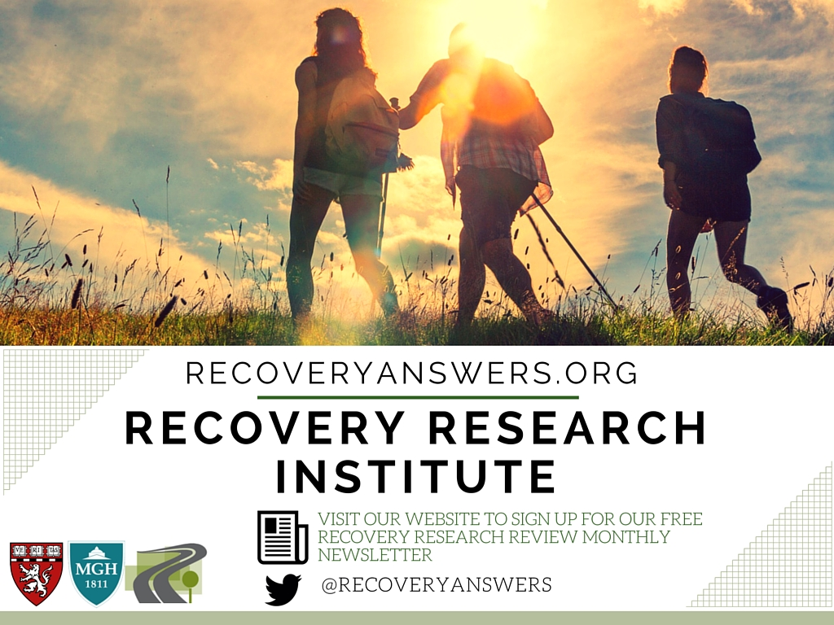
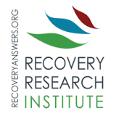

Slide 3


Slide 4
Outline
Is there a real effect of AA/TSF that needs explaining? Does AA participation (causally) lead to better outcomes?
What are the mechanisms of interest to the study of AA/TSF?
What are the implications of AA/TSF MOBC research for direct care to patients and/or programs/service contexts?
What are the next steps for this work in relation to informing direct care to patients and/or programs/service contexts?

Slide 5
Outline
Is there a real effect of AA/TSF that needs explaining? Does AA participation (causally) lead to better outcomes?
What is/are the mechanism/s of interest to the study of AA/TSF?
What are the implications of AA/TSF MOBC research for direct care to patients and/or programs/service contexts?
What are the next steps for your work in relation to informing direct care to patients and/or programs/service contexts?

Slide 6



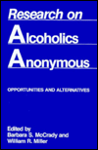
Notes:
Prior to 1990 AA research methodologically poor….

Slide 7
TSF Delivery Modes
TSF
OTH
  Stand alone
  Independent therapy
  Integrated into an existing therapy
  Component of a treatment package (e.g., an additional group)
As Modular appendage linkage component
In past 25 years, AA research has gone from contemporaneous correlational research to rigorous RCTs and …
Notes:
TSF implemented in various ways:

Slide 8
…and lagged moderated multiple mediation studies to elucidate its impact and MOBCs
Source: Kelly, Hoeppner, Stout, Pagano (2012) , Determining the relative importance of the mechanisms of behavior change within Alcoholics Anonymous: A multiple mediator analysis. Addiction 107(2):289-99

Slide 9
TSF Delivery Modes
TSF
OTH
  Stand alone
  Independent therapy
  Integrated into an existing therapy
  Component of a treatment package (e.g., an additional group)
As Modular appendage linkage component
Notes:
TSF implemented in various ways:

Slide 10
TSF often produces significantly better outcomes relative to active comparison conditions (e.g., CBT)
Although TSF is not “AA”, it’s beneficial effect is explained by AA involvement post-treatment.

Slide 11
Also, state of the art instrumental variables analyses, as well as propensity score matching (Ye and Kaskutas, 2013) that help to remove self-selection biases, indicate AA has a causal impact on enhancing abstinence and remission rates.

Slide 12
Linkage to AA can lead to much higher rates of full sustained remission
(Project MATCH, 1997)
Notes:
For example, patients with more severe alcohol dependence had better outcomes in TSF. In addition, less psychiatrically severe patients had better outcomes in TSF than in comparison treatments (Project MATCH Research Group, 1997). Also, outpatients with social networks supportive of drinking, measured at treatment intake, had better long-term outcomes in TSF than in the other treatment conditions (Longabaugh, Wirtz, Zweben & Stout, 1998).
For outpatients at 3yrs 36% of TSF patients were abstinent compared to 25% in MET and CBT (that’s almost 50% more)
The superior outcomes attained by these patient subgroups when treated in TSF appear to be explained by mutual-help group attendance during the follow-up period. Such attendance may have buffered the negative effect from the existing social network and provided a new abstinence-focused social network. (Project MATCH Research Group, 1997, 1998).
Also, regardless of which tx patients had received, those who attended 12-step groups had better outcomes
mutual-help valuable adjunct to SUD treatment - even when not formally emphasized

Slide 13


Slide 15
Health Care cost offset
CBT VS 12-STEP RESIDENTIAL TREATMENT
Compared to CBT-treated patients, 12-step treated patients more likely to be abstinent, at a $8,000 lower cost per pt over 2 yrs ($10M total savings)
Also, higher remission rates, means decreased disease and deaths, increased quality of life for sufferers and their families

Slide 16
Does AA “cause” better outcomes or is AA participation an outcome of better prognosis?
Using accepted scientific standards (Bradford Hill criteria) and the most rigorous scientific methods (i.e., RCTs, instrumental variables analysis, PS matching), evidence indicates causal therapeutic benefit of AA
Given AA is available free of charge in most communities and that an intervention’s “Impact” is a product of = reach x effectiveness (Glasgow et al, 2003), AA can be considered a clinical and public health ally in ameliorating the prodigious burden of disease, disability, and premature mortality, attributable to alcohol addiction
Notes:
All met except “specificity” – there are many pathways and mobilizers of MOBCs but AA is one accessible, free, and ubiquitous one.

Slide 17
Outline
Is there a real effect of AA/TSF that needs explaining? Does AA participation (causally) lead to better outcomes?
What are the mechanisms of interest to the study of AA/TSF?
What are the implications of AA/TSF MOBC research for direct care to patients and/or programs/service contexts?
What are the next steps for your work in relation to informing direct care to patients and/or programs/service contexts?

Slide 18
New York City Addiction Hospital Administrator 1937…
“When my head doctor, Silkworth, began to tell me of the idea of helping drunks by spirituality, I thought it was crackpot stuff, but I’ve changed my mind. One day this bunch of ex-drunks of yours is going to fill Madison Square Garden”
-AA, 1947

Slide 19
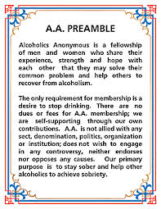
12-step Specific theoretical mechanisms: Program and Fellowship
Recovery achieved via a “spiritual awakening” achieved through working through the 12-step program
Although sometimes manifesting as a quantum change (e.g., Bill W.) it is described broadly as most often of the “educational variety” (Appendix II AA, 2001) emerging gradually leading to “psychic change” that alters view of self, others, and world

Slide 20
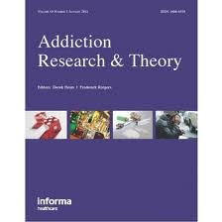
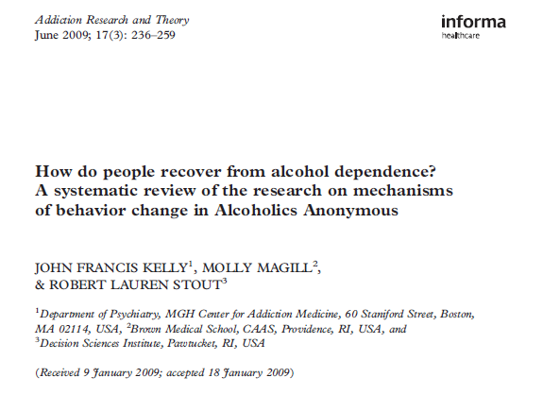
How does AA enhance outcomes? Possible mechanisms
Notes:
20
What I’ve been talking about until now are broad averages across large patient groups without attention paid to possible moderators of effects. Clinical concerns have been raised in relation to the member-group fit with certain mutual-help organizations. For example, do individuals with both a SUD and another comorbid psychiatric diagnosis benefit from 12-step mutual-help groups which focus exclusively on a particular substance, such as alcohol or cocaine? Should non-religious patients be advised to attend 12-step organizations? This section examines the evidence regarding 3 persistent areas of concern: psychiatric comorbidity, religiosity, and gender (women).

Slide 21
Review found n=13 full mediational studies on MOBC and n=6 partial tests
Up until 2009, AA/TSF MOBC fell into three main categories, with most research conducted on/supporting (in descending order):
Common factors (e.g., self-efficacy, motivation for abstinence; coping skills; social network changes)
Specific AA practices (AA behaviors/activities, AA beliefs/cognitions)
AA specific processes (e.g., spirituality)
BUT, since then, more studies conducted supporting AA’s own principal MOBC –spirituality…
Notes:
The systematic review did not find any good studies on spirituality but since then three fully lagged studies supporting S/R as mediators have been published… .

Slide 22
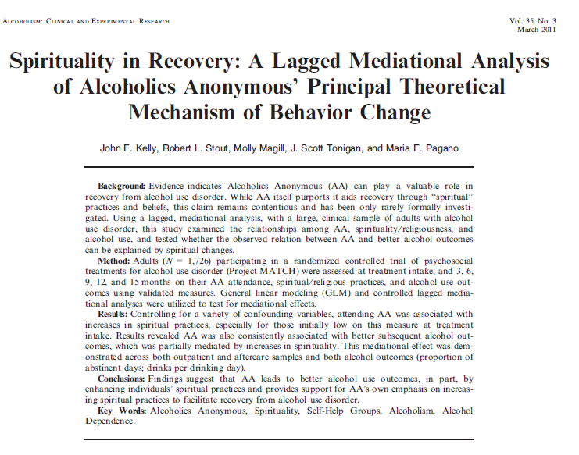
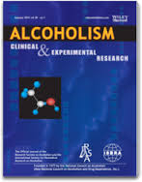

Slide 23
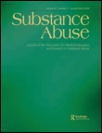

Slide 24


Slide 25
AA shown to increase psychological well-being and reduce craving associated with experiencing AA’s 12 Promises, and confer benefit (i.e., increased PDA) by significantly reducing craving

Slide 26
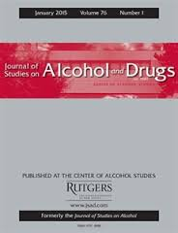

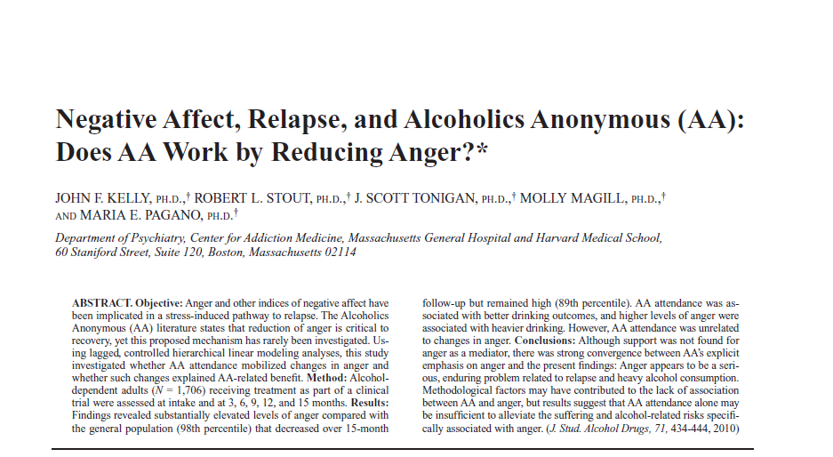

Slide 27
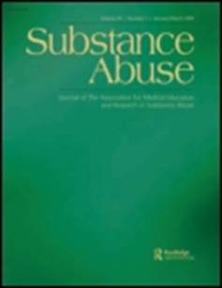

Slide 28
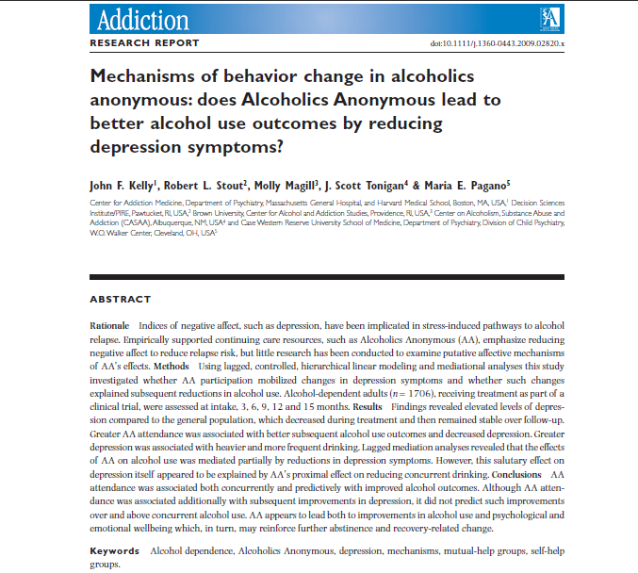

Slide 29
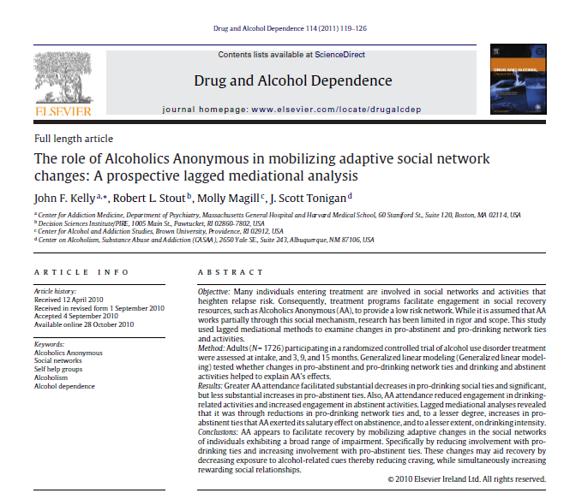

Slide 31
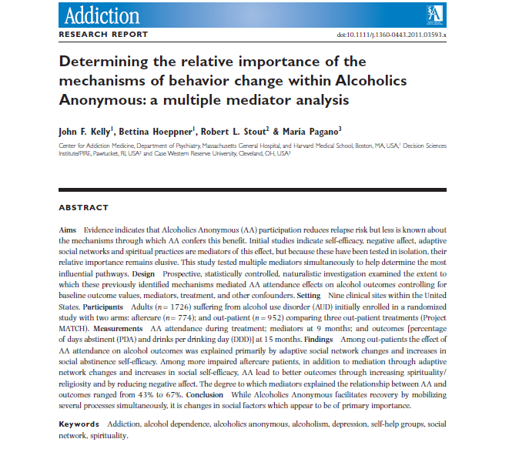
Based on prior mediators of AA on outcomes, several fully temporally lagged multiple mediator and moderated multiple mediator analyses have been conducted…

Slide 32
Source: Kelly, Hoeppner, Stout, Pagano (2012) , Determining the relative importance of the mechanisms of behavior change within Alcoholics Anonymous: A multiple mediator analysis. Addiction 107(2):289-99

Slide 33
Do more and less severely alcohol dependent individuals benefit from AA in the same or different ways?
effect of AA on alcohol use for AC was explained by social factors but also by S/R and through boosting NA ASE (DDD only)
Majority of effect of AA on alcohol use for OP was explained by social factors
Source: Kelly, Hoeppner, Stout, Pagano (2012) , Determining the relative importance of the mechanisms of behavior change within Alcoholics Anonymous:
A multiple mediator analysis. Addiction 107(2):289-99

Slide 34
Do men and women benefit from AA in the same ways?
NA ASE was a MOBC for women but not men - suggests that boosts in NA ASE were available in AA but men didn’t find this aspect relevant.
For men, AA was a way to help them find new sober friends and boost their social ASE much more than women
Source: Kelly and Hoeppner (2013) , Does Alcoholics Anonymous work differently for men and women? A moderated multiple-mediation analysis in a large clinical sample. Drug and Alcohol Dependence
Notes:
Men may use AA more than women to help them buffer socially-relevant relapse risks. Women appear to benefit in similar ways, but more work is needed to understand the additional ways women derive recovery benefit from AA. The pattern of findings underscores some gender-based differences that may have broader implications for the addiction treatment and recovery field. For women between the ages of 30 and 50, a focus on finding alternative ways to cope with negative affect may yield recovery benefits, while among men in the same life-stage, a relatively greater focus on coping with high risk social situations may yield recovery related benefits.

Slide 35
Do young Adults benefit as much and in the same ways as older adults
Young people (18-29yrs) benefitted as much as older adults, but these 6 MOBCs explained a much lower proportion of their benefit
The way AA helped young people differed also - mostly by helping them drop high risk social network members and boosting their social ASE; young people did not find new friends in AA (perhaps due to lack of sober same aged peers) and did not benefit via spirituality as much as older adults
Source: Hoeppner , Hoeppner, Kelly (2014) , Do young people benefit from AA as much, and in the same ways, as adult aged 30+? A moderated multiple mediation analysis. Drug and Alcohol Dependence.

Slide 36
Moderated-Mechanisms: AA effects Moderated by Severity, Gender, Age…
CONCLUSIONS
  6 mediators = about 50% of direct effect of AA on drinking (other 50%?)
  Proportion of direct effect explained even lower among young adults; more research needed on how young people benefit
  Of note, this MOBC research finds that the same entity/intervention (i.e., AA) produces benefits that differ in nature and magnitude between more severely alcohol involved/impaired and less severely alcohol involved/impaired; men and women; and, young adults and adults 30+
  Differences may reflect differing needs based on recovery challenges related to differing symptom profiles, degree of subjective suffering and perceived severity/threat, life-stage based recovery contexts, and gender-based social roles & drinking contexts

Slide 37
Similar to psychotherapy literature rather than thinking about how AA or similar interventions “work”, better to think how individuals use or make these interventions work for them – to meet most salient needs at any given phase of recovery

Slide 38
Outline
Is there a real effect of AA/TSF that needs explaining? Does AA participation (causally) lead to better outcomes?
What is/are the mechanism/s of interest to the study of AA/TSF?
What are the implications of AA/TSF MOBC research for direct care to patients and/or programs/service contexts?
What are the next steps for your work in relation to informing direct care to patients and/or programs/service contexts?

Slide 39
Empirically-supported MOBCs through which AA confers benefit
Social network
Spirituality
Social Abstinence self-efficacy
Coping skills
Recovery motivation
Negative Affect Abstinence self-efficacy
Impulsivity
Craving
Notes:
So, if we apply these to models of common precursors to relapse…

Slide 40
So, how might AA reduce relapse risk and aid recovery?
Cue Induced
Stress Induced
RELAPSE
Social
Psych
Bio-Neuro
Alcohol Induced
AA
Kelly, JF Yeterian, JD In: McCrady and Epstien Addictions: A comprehensive Guidebook, Oxford University Press (2013)
Notes:
We might assert that…

Slide 41
How might AA reduce relapse risk and aid recovery?
Cue Induced
CUES: -AA reduces relapse risks via social network changes that may reduce exposure to triggers and increase active coping and social ASE; AA may also reduce craving and impulsivity;
STRESS: AA helps reduce stress induced relapse possibly via increased coping skills and spiritual framework and boosting NA ASE, particularly among women
ALCOHOL: AA may reduce alcohol induced relapse via reducing cravings, strong emphasis on abstinence (preventing priming dose exposure); boosting social and NA ASE
Stress Induced
RELAPSE
Social
Psych
Bio-Neuro
Alcohol Induced
AA

Slide 42


Implications For AA Referral/TSF
“Big Book” vs “Living Sober”
Although AA’s foundational text (Alcoholics Anonmous,1939; the “Big Book”), based on <100 severely addicted male cases and limited sober experience, posited recovery achieved through quasi-religious/spiritual means (“spiritual awakening”), MOBC research suggest this may be true only for minority
The way AA works appears to have a closer fit with the pragmatic social, cognitive, and behavioral experiences of how its members stay sober documented in its later publications (Living Sober, 1975) based on more than 1 million members half of whom had 5+yrs of sobriety.

Slide 43
Clinical implications of AA/TSF Research
To help enhance patients’ outcomes including full remission, a cost-effective clinical recommendation is to implement TSF procedures
Patients with high network support for drinking are especially likely to benefit from TSF and AA through AA’s ability to facilitate changes in social networks and boost social ASE
“Spirituality” need not be a barrier to participation; although AA ostensibly “spiritual”, the largest part of the effect for facilitating recovery is social (i.e. “fellowship” vs “program”) and otherwise, therapeutically multifaceted; emphasizing this to patients may help remove this attendance barrier

Slide 44
Broader Clinical treatment design and testing
Men use AA more/benefit from AA more by it boosting their social ASE; women use AA more/benefit from AA more by it boosting their NA ASE; Young people benefit through AA helping them reduce high risk social network members and boosting social ASE
Thus, treatments designed to emphasize relapse risks associated with these specific biobehavioral life-stage contexts may improve outcomes
  For men and young adults greater emphasis on social network relapse factors may yield greater dividends; for women, greater clinical attention to negative affect may yield dividends
For more severe patients, spirituality may provide framework giving new meaning and purpose as well self-forgiveness reducing guilt/shame; teach new adaptive ways of reinterpreting and coping with stress; clinicians need to be comfortable broaching and supporting S/R practices as a way potentially to enhance recovery efforts

Slide 45
Outline
Is there a real effect of AA/TSF that needs explaining? Does AA participation (causally) lead to better outcomes?
What is/are the mechanism/s of interest to the study of AA/TSF?
What are the implications of AA/TSF MOBC research for direct care to patients and/or programs/service contexts?
What are the next steps for this work in relation to informing direct care to patients and/or programs/service contexts?

Slide 46
Social network
? (50%)
Spirituality
Social Abstinence self-efficacy
Coping skills
Recovery motivation
Psychological well-being
Negative Affect Abstinence self-efficacy
Impulsivity
Craving
Next Steps:
Educate clinicians about empirically supported MOBCs of AA
New Cochrane Review (Fall, 2017)
Conduct further MOBC

