Slide 1

Mobilizers, Mechanisms, and Moderators of Addiction Recovery
John F Kelly PhD
Harvard Medical School
Massachusetts General Hospital
Society for the Study of Addiction
Annual Symposium, York, UK 2012

Slide 2
Outline:
What do we know about which factors….
mobilize behavior change and lead to addiction recovery
mediate or explain addiction recovery over time
moderate or influence whether mediators differ across different individuals

Slide 3
Outline:
What do we know about which factors….
mobilize behavior change and lead to addiction recovery
mediate or explain addiction recovery over time
moderate or influence whether mediators differ across different individuals

Slide 4
Factors Mobilizing Change
Substance use is operant –shaped by consequences
People attempt behavior change to try to:
  Enhance pleasure
  Reduce suffering
Change attempts are often self-initiated; some are successful (“natural recovery”)/successful for a time
With high severity/complexity + increasing self-regulation deficits, outside help may be sought, although due to stigma/cost, this may take some time (5 yrs on avg. after dependence onset, Wang et al, 2005).
Addiction severity and perceived threats appear important mobilizers of change…

Slide 5
Factors predicting help-seeking: Stress and Coping model of treatment seeking (1 yr prospective study; N=515; 82% follow-up)
Source: Finney and Moos, 1995; Addiction
Notes:
Examined 20 variables

Slide 6
Perceived Severity as the central psychological mediator of treatment entry
Perceived severity (“To what extent do you think your alcohol use was a problem” [“no problem” to “serious problem]) was the most powerful predictor of tx entry suggesting perceived severity plays a central role in the tx entry process.
When perceived severity was controlled in the predictive model, none of the other 20 predictors of treatment entry were significant suggesting a central mediating role for perceived severity in tx entry.

Slide 7
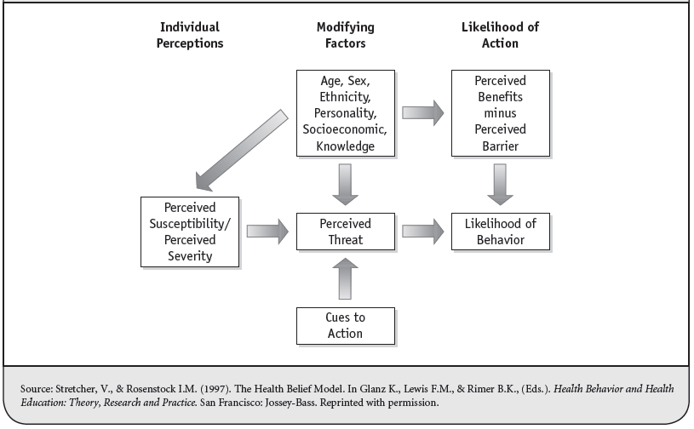
Health Beliefs Model

Slide 8
Cues to Action: SBIRT
Few individuals seek out specially care immediately
It can take up to 5 yrs after the onset of dependence before individuals seek specialty care for alcohol/drug dependence (Wang et al, 2005)
However, individuals will encounter PCPs ED, Police/courts etc. that allow for opportunistic intervention (e.g., SBIRT; court intervention)
This can destabilize patterns of misuse/addiction and lead to earlier changes…

Slide 9
Effectiveness of SBIRT in a half a million (459,599) patients screened at -6 sites (Madras et al. 2009)
Outcomes
Rates of drug use lower by 67.7%
Rates of heavy alcohol use lower by 38.6%
Self-reported improvements in general health, mental health and social measures
22.7% screened positive (104,329)
15.9% recommended for brief intervention
3.2% recommended for brief treatment
3.7% recommended for referral to specialty treatment
Notes:
Some regression to the mean will be operating here, but overall, brief interventions confer small to moderate effect size

Slide 10
Full Remission achieved more quickly the sooner individuals Get Treatment
1.0
.9
Cumulative Survival
.8
.7
Years from first use to 1+ years abstinence
20+
.6
.5
Years to 1st Tx
.4
.3
.2
10-19*
.1
0.0
0-9*
0
5
10
15
20
25
30
Source: Dennis et al, 2005.
Notes:
10
10
So, if you get tx between 0-9 yrs after onset of SUD, you reach FSR sooner.

Slide 11
Outline:
What do we know about which factors….
mobilize behavior change and lead to addiction recovery
mediate or explain addiction recovery over time
moderate or influence whether mediators differ across different individuals

Slide 12
Theories of Remission and Recovery
Studies of treatment are often theory-based (e.g, Longabaugh and Morgenstern, 2002; Moos, 2007)
However, studies of SUD remission and recovery are very seldom theory-based*
But, there are empirically supported theories that help explain the onset of substance use and SUD
These same theories may be useful in helping explain SUD remission and recovery…

Slide 13
Theories of Remission and Recovery
Chronic illness for many (Mclellan et al, 2000); 8yrs to achieve FSR/3-4 tx episodes (Dennis et al, 2005)
General Adaptation Syndrome (Selye, 1956)
Alarm—Resistance—Exhaustion
Self-Control Strength (Muraven et al, 2002; 2006)

Slide 14
Theories of Remission and Recovery
Studies of treatment are often theory-based (e.g, Longabaugh and Morgenstern, 2002; Moos, 2007)
However, studies of SUD remission and recovery are very seldom theory-based
But, there are empirically supported theories that help explain the onset of substance use and SUD
These same theories may be useful in helping explain SUD remission and recovery…

Slide 15
Parallels in the onset and offset of SUD
People want to use substances for 4 main reasons (NIDA, 2005):
To feel good
To feel better
To do better
Because others are doing it

Slide 16
Parallels in the onset and offset of SUD
People want to use substances for 4 main reasons (NIDA, 2005): | People want to stop using substances and recover for the same 4 main reasons:
To feel good | To feel good
To feel better | To feel better
To do better | To do better
Because others are doing it | Because others are doing it

Slide 17
Source: Moos, RH (2011) Processes the promote recovery from addictive disorders.

Slide 18
“The social contexts that underlie the initiation and maintenance of substance misuse may hold within them the potential for resolution of the problems they create”
(Moos, 2011)

Slide 19
Social Control Theory Examples
Physicians Health Program
HOPE Probation
24/7 Sobriety
Recovery Management check-ups (early re-intervention)

Slide 20
Physicians Health Programs
Emerged in 1970s, through the American Medical Association to help alcohol/drug impaired physicians
Services provided include:
- long-term monitoring
- professional intervention services
- referral to formal evaluation
- referral to formal treatment
Source: White, W.L., DuPont, R.L. & Skipper, G.E. (2007)
Notes:
Although this program is not implemented in the judicial system, it provides a framework which can be used as part of the judicial system. Individuals in the PHPs are motivated to stay sober because of a threat of losing something valuable (their medical license). In the case of the judicial system, offenders would be motivated to participate in a program like that and stay sober because of a threat of losing their freedom.

Slide 21
PHPs 5-7yr study outcomes (N=904)
72% completed the contract; a further 22% signed a new one (78% of these voluntarily)
79% licensed and working at 5-year follow-up
92% participated in AA or NA; 61% participated in continuing groups
78% had zero positive screens; 22% had at least one positive test at some point, however, only 1 in 200 drug screens were positive over the 5-7yr monitoring period
Source: Du Pont, R.L. et al. (2011)

Slide 22
Hawaii Opportunity Probation with Enforcement (HOPE) program
Goal - to reduce drug use, new crimes, and incarceration
Drug-testing-and-sanctions approach
Does not mandate treatment; 12-step participation encouraged
Started as pilot program 2004 with 36 offenders expanded to over 1500 participants 2009

Slide 23
Pilot study by the Integrated Community Sanctions unit in Honolulu
Offenders in HOPE vs. comparison offenders
HOPE procedure:
- initiation/overview conducted by judge
- call HOPE hotline every morning
- if selected for testing, must appear by 2pm
- if fail to appear or test positive, “Motion to Modify Probation”
- after immediate hearing, if offender has violated probation, sentenced to short jail stay (several days)
- HOPE participation resumes upon release
Probation as usual:
- no random drug testing
- scheduled appointments with a probation officer once a month

Slide 24
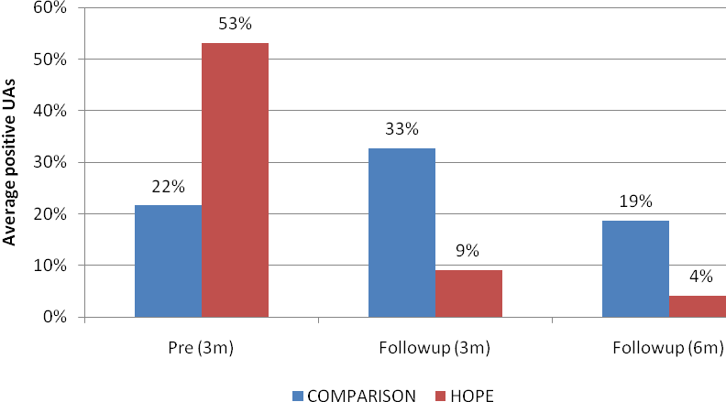
Average number of positive UAs, by period. (Hawken et al. , 2009)
In a 12-month period 61% of HOPE participants had zero positive UAs
Note: Data are from PROBER. For comparison probationers, data reflect urinalysis results for
regularly scheduled UAs. For HOPE probationers UAs include regularly scheduled tests, and
random testing. Pre (3m) refers to the average number of missed appointments in the three
months before the study start date (baseline). Follow-up (3m) refers to the average number of
missed appointments in the three-month period following baseline and Follow-up (6m) refers to
the average number of missed appointments in the six-month period following baseline.
Notes:
Comparison-group probationers were not randomly tested. Testing was conducted on dates scheduled in advance, during routine office visits. HOPE probationers were subject to routine testing, but were also tested randomly (six times per month during their first two months, and less frequently thereafter based on performance). Although the study groups were selected to be comparable (drawn from similar cases from the caseloads of other first circuit courts), baseline data show higher-risk (based on recent history of drug use and missed appointments) probationers were assigned to HOPE. HOPE caused a reversal: HOPE probationers had higher positive drug test rates than the comparison group before being placed on the program, but much lower rates thereafter.

Slide 25
RCT of HOPE Intervention (N=493) (Hawken et al., 2009)
HOPE vs. probation-as-usual
One year follow up
Results
HOPE in comparison with probation-as-usual:
60% fewer no-shows
70% fewer positive urine tests
55% fewer new arrest rates
53% lower revocation rate
48% lower incarceration

Slide 26
South Dakota’s “24/7 Sobriety” project
(Larry Long)
For repeat DUI offenders
Objective verification of abstinence (twice a day breath, blood or other bodily substance testing; or SCRAM bracelet
Positive/missed tests results in immediate 24-hour incarceration
No treatment referral or requirement; 12-step attendance encouraged

Slide 27
24/7 Sobriety Outcomes
Urinalyses (July 1, 2007-July 20, 2011):
N= 1,990
46,648 tests administered
Pass Rate 96.9%
SCRAM bracelets (Nov. 6, 2006-July 20, 2011):
N=3,177
77.9% had no violations
22.1% participants had some type of violation
Drug patches (July 1, 2007-July 20, 2011):
N=94
Pass Rate 80%
Source: http://apps.sd.gov/atg/dui247/247stats.htm

Slide 28
Clinical Monitoring: 4-year outcomes using Recovery Management Checkups (RMCs)
N=446 adults with SUD, mean age = 38, 54% male, 85% African-American
Randomly assigned to either
  Quarterly assessment only
  Quarterly assessment plus RMC
RMCs (TALER)
  Linkage manager who used MI to review participant’s substance use, discuss treatment barrier/solutions, schedule an appointment for treatment re-entry, and accompany participant through intake
  If no substance use in previous quarter, linkage manager reviewed how abstinence has changed their lives and methods used to maintain abstinence
Source: Dennis & Scott (2012). Drug and Alcohol Dependence, 121, 10-17

Slide 29
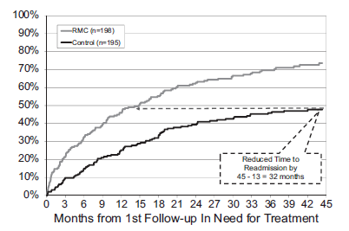
Results 1
Return to treatment
  RMC participants needing treatment were sig. more likely to return to treatment sooner
Source: Dennis & Scott (2012). Drug and Alcohol Dependence, 121, 10-17

Slide 30
Results 3
Use and problems
*All differences were significant at p<.001

Slide 31
Results 4
Days abstinent (0-1350)
*p<.01

Slide 32
Results 5
Other subject factors impacting time to readmission
  In multivariate model with 18 variables, only randomization to RMC remained a significant predictor of time to return to treatment
Evidence of subject by treatment interactions
  The positive effects of RMC were stronger in those with high crime and violence scores and earlier age of onset (under 15)
Source: Dennis & Scott (2012). Drug and Alcohol Dependence, 121, 10-17

Slide 33
Social Control
Strong support for elements of social control theory in initiating and sustaining remission over time…
Monitoring and goal direction with clear, immediate, non-severe, penalties in criminal justice populations can produce v. impressive change in substance misuse
In clinical samples, ongoing monitoring, MI, and goal-directed referral can also make a difference in achieving higher rates of tx readmission and remission
However, as yet, unclear what happens to individuals following removal of the monitoring and contingencies or how long monitoring must be in place behavior change becomes self-perpetuating
Therapeutic workplaces (Silverman et al, 2012) may offer a further real-world way of long-term monitoring that might enhance community recovery rates

Slide 34
Outline:
What do we know about which factors….
mobilize behavior change and lead to addiction recovery
mediate or explain addiction recovery over time
moderate or influence whether mediators differ across different individuals

Slide 35
Addiction Recovery Mutual aid organizations
Source: Moos, RH (2011) Processes the promote recovery from addictive disorders.
Notes:
Social learning, stress and coping, and behavioral economic theories all pertain to ongoing mutual-help organization participation that can aid long term recovery…

Slide 36
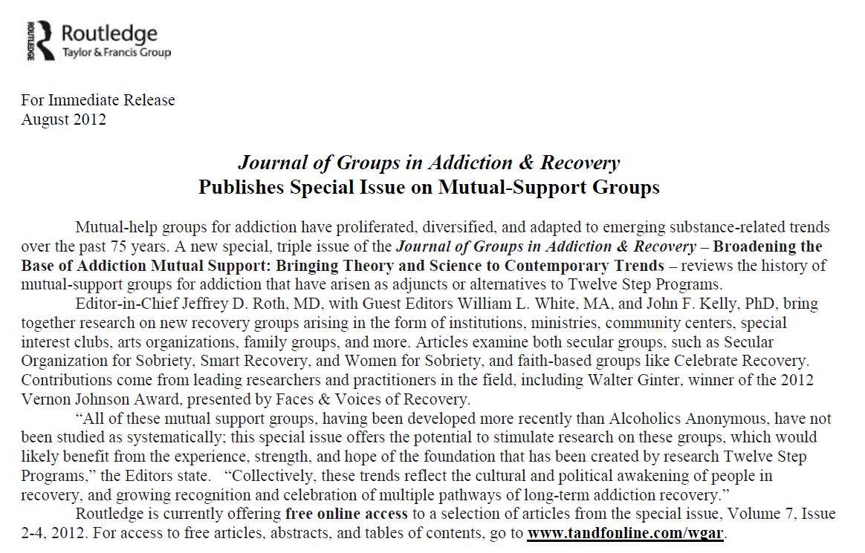

Slide 37
How might MHOs like AA reduce relapse risk and aid the recovery process? Do these mechanisms differ for different people?
Cue Induced
Stress Induced
RELAPSE
Social
Psych
Bio-Neuro
Drug Induced
MHO

Slide 38
Path diagram of the lagged mediational model for inpatient vs. outpatient and men vs. women.

Slide 39
Project MATCH
Multisite randomized clinical trial of alcohol dependent individuals
  2 arms
    Aftercare (n=774)- recently finished inpatient treatment
    Outpatient (n=952)
  3 conditions, all with ultimate goal of abstinence
    Cognitive Behavioral Therapy
      - Therapist assisted in building skill set to maintain abstinence
    Motivational Enhancement Therapy
      - Therapist aimed to build motivation to accept abstinence
    Twelve Step Facilitation
    - Assisted in engagement with AA; abstinence oriented/disease model

Slide 40

CBT

Slide 41

Motivational Enhancement Therapy

Slide 42

TSF

Slide 43
Project MATCH- Results
All treatments did equally well on main outcomes (PDA; DDD)
Across txs, pts attending AA better outcomes (Tonigan et al, 2002)
Substantially higher proportion of patients continuously abstinent/in remission at 1- and 3-yr follow-up
Notes:
For example, patients with more severe alcohol dependence had better outcomes in TSF. In addition, less psychiatrically severe patients had better outcomes in TSF than in comparison treatments (Project MATCH Research Group, 1997). Also, outpatients with social networks supportive of drinking, measured at treatment intake, had better long-term outcomes in TSF than in the other treatment conditions (Longabaugh, Wirtz, Zweben & Stout, 1998).
For outpatients at 3yrs 36% of TSF patients were abstinent compared to 25% in MET and CBT (that’s almost 50% more)
The superior outcomes attained by these patient subgroups when treated in TSF appear to be explained by mutual-help group attendance during the follow-up period. Such attendance may have buffered the negative effect from the existing social network and provided a new abstinence-focused social network. (Project MATCH Research Group, 1997, 1998).
Also, regardless of which tx patients had received, those who attended 12-step groups had better outcomes
mutual-help valuable adjunct to SUD treatment - even when not formally emphasized

Slide 44
Path diagram of the lagged mediational model for inpatient vs. outpatient and men vs. women.

Slide 45
Do more and less severely alcohol dependent individuals benefit from AA in the same or different ways?
effect of AA on alcohol use for AC was explained by social factors but also by S/R and through negative affect (DDD only)
Majority of effect of AA on alcohol use for OP was explained by social factors
Source: Kelly, Hoeppner, Stout, Pagano (2012) , Determining the relative importance of the mechanisms of behavior change within Alcoholics Anonymous:
A multiple mediator analysis. Addiction 107(2):289-99

Slide 46
Do men and women benefit from AA in the same ways?
Percentage of effect of AA attendance on outcomes (PDA; DDD) for men and women accounted for by the six mediators
Source: Kelly & Hoeppner (In press) Do men and women benefit differently from Alcoholics Anonymous: A moderated-multiple mediation analysis in a large clinical sample. Drug and Alcohol Dependence
Notes:
Men may use AA more than women to help them buffer socially-relevant relapse risks. Women appear to benefit in similar ways, but more work is needed to understand the additional ways women derive recovery benefit from AA. The pattern of findings underscores some gender-based differences that may have broader implications for the addiction treatment and recovery field. For women between the ages of 30 and 50, a focus on finding alternative ways to cope with negative affect may yield recovery benefits, while among men in the same life-stage, a relatively greater focus on coping with high risk social situations may yield recovery related benefits.

Slide 47
Moderated-Mechanisms in Recovery: AA effects Moderated by Severity and Gender
CONCLUSIONS
  Recovery benefits derived from AA differ in nature and magnitude between more severely alcohol involved/impaired and less severely alcohol involved/impaired; and between men and women (young people also shown to differ in derived benefits too; Kelly et al, 2000; 2002)
  These differences reflect differing needs based on recovery challenges related to differing symptom profiles, degree of subjective suffering and perceived severity/threat, developmentally-related recovery challenges, and gender-based social roles & drinking contexts
  Similar to psychotherapy literature (Bohart & Tollman, 1999) rather than thinking about how AA or similar organizations work, better to think how individuals use or make these organizations work for them – to meet their most urgent needs at any given phase of recovery

Slide 48
Are social networks a causal mechanism in recovery pathways?
Employed propensity score stratification (e.g., Dehejia and Wahba, 2002), designed to minimize impact of selection biases due to measured covariates.
No statistical adjustment can completely eliminate chance that an unknown factor is responsible for improvement/deterioration that appears to be correlated with a change in social networks.
However, propensity stratification methods represent the state of the statistical art in this domain (Rubin, 2006), and have been rarely utilized in addiction research
Source: Stout, Kelly, Magill, Pagano (2012) Journal of Studies on Alcohol and Drugs

Slide 49
Are social networks a causal mechanism in recovery pathways?
Predictor variables selected based on prior research or theory indicative of an association between each proposed predictor variable and at least one of the social network measures
23 baseline and 3m (AA only) predictors of social networks were used in propensity analysis
If significant effect of the variable of interest after propensity score adjustment then there is stronger evidence that this plays a “causal” role on the outcome; if not, then assumed that the variable’s relationship to outcome is accounted for by other variables and is not causal

Slide 50
Pro-drinkers and pro-abstainer network variables were found to exert enduring influence across a 3yr period over and above that of other influential social organizations like AA

Slide 51
Changing Network Support for Drinking (Litt et al., 2009)
Network Support Project -to determine if tx can change social networks to be supportive of sobriety
Alcohol dependent individuals (N=210) randomly assigned to 1 of 3 txs:
  Network Support (NS)
    Meant to help patients change social network to include people in support of abstinence; based on TSF treatment created for Project MATCH; 6 core sessions+ 6 elective sessions
  Network Support +Contingency Management (NS+CM)
    Same network support as described above, plus drawings from a “fishbowl” if soc. network enhancing tasks completed (eg. AA meeting, having coffee with a sober friend)
  Case Management (CaseM, control condition)
    Based on intervention used in Marijuana Treatment Project; therapist and participant worked together to identify barriers to abstinence and develop goals and identify resources to be used to aid in achieving abstinence

Slide 52
Changing Network Support for Drinking- Findings

Slide 53
Summary and Conclusions
Perceived severity/threat (personal illness/consequences; criminal justice) and cues to action (screening; SBIRT) serve to mobilize recovery-related changes
Similar to other illnesses, the earlier SUD is detected and treatment is begun, the shorter the time to remission
While theories of treatment abound, theories of remission/recovery remain thin and limited
Several psychosocial theories (social control; social learning; stress and coping; behavioral economics) show promise in helping to explain recovery-related change
Equifinality: pathways to the same developmental endpoint (recovery) are varied; individuals seek out and utilize available resources to varying degrees and in different ways based on their own life-contexts and related needs.

