Slide 1
A multi-methodological approach to studying alcohol-related cognitions
Rebecca Monk
Derek Heim
Monk, R. L., & Heim, D. (2013). Panoramic projection: Affording a wider view on contextual influences on alcohol-related cognitions. Experimental and Clinical Psychopharmacology, 21, 1-7.
Monk, R. L., & Heim, D. (2013). Environmental context effects on alcohol-related outcome expectancies, efficacy and norms: A field study. Psychology of Addictive Behaviors, 27, 814-818.
Monk, R. L., & Heim, D. (2014). “There’s an App for that”: Using smartphone technology to investigate how personal and environmental contexts impact alcohol-related cognitions. Addiction: Clinical and Experimental Psychopharmocology, 21, 1-7.
Edge Hill University
Notes:
PHD…..

Slide 2
Context effects and the de-contextualisation of research
“The decision to drink or exercise restraint is ultimately determined by self efficacy and outcome expectancies formulated around a current situational context”
‘Environments of perceptual distortion’
Yet:
- Diminutive research which assesses contextual focus
- Favour the use of lab and solitary testing
- De-contextualised and de-socialised research
Notes:
Abrams and Niauru
Mcalaney

Slide 3
Multi-methodological research approach
Field Research: Pub vs. Lecture sampling
Lab research: Panoramic Projection
Experiential Sampling: Smartphone Application

Slide 4
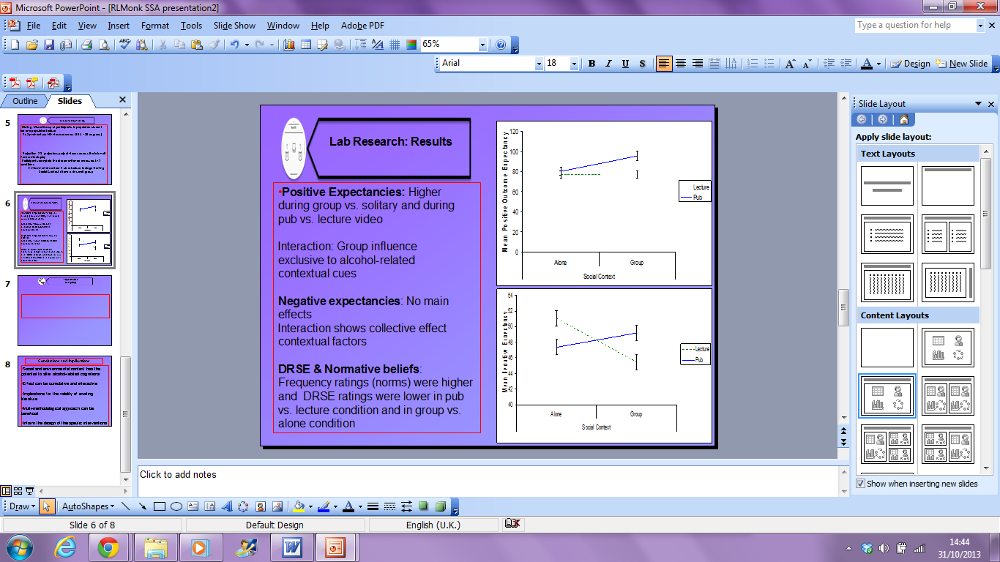
Field Research
Recruitment of student participants on student lecture theatres or bars (between 1 p.m. and 6 p.m.)
Contextual differences in expectancies and DRSE
Statistical controls of between-participant variation in self-reported typical consumption
Notes:
Assessment of alcohol-related expectancies, drink refusal self-efficacy (DRSE) and normative frequency ratings
Positive social, fun, and tension reduction outcome expectancies were higher in a student bar relative to those questioned in a university lecture theatre
Social drink refusal self efficacy was lower in the bar

Slide 5
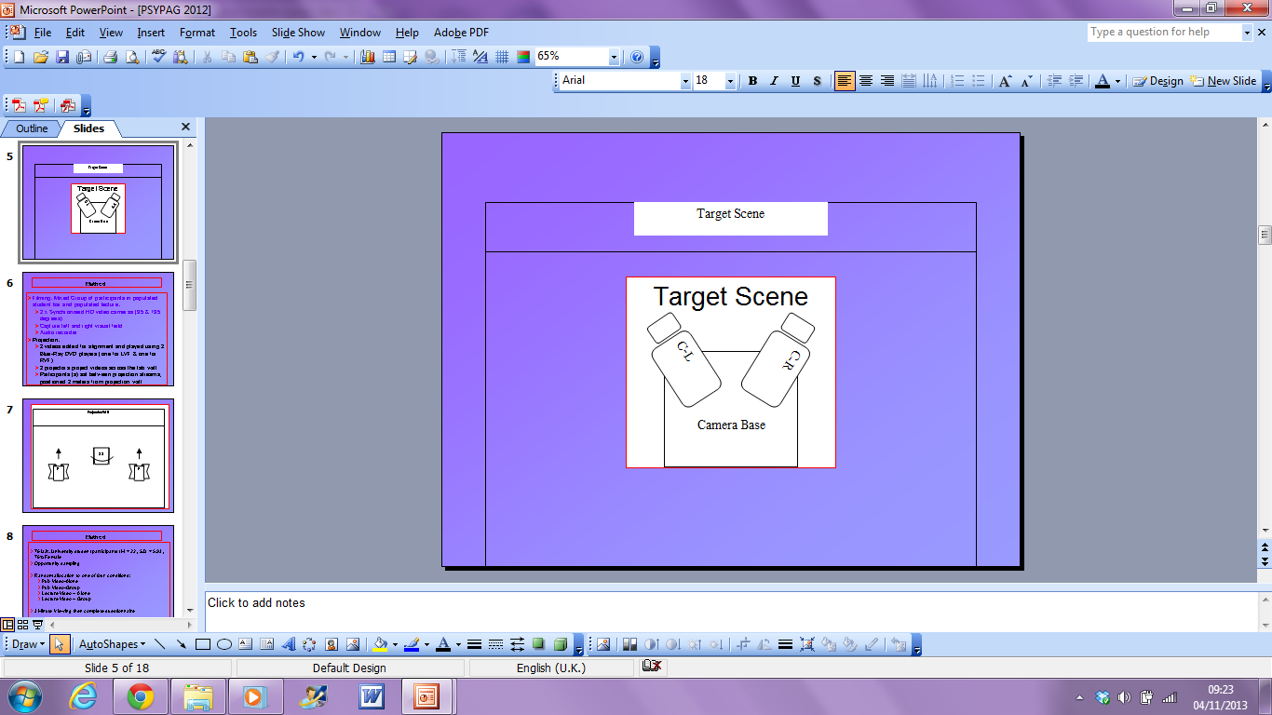
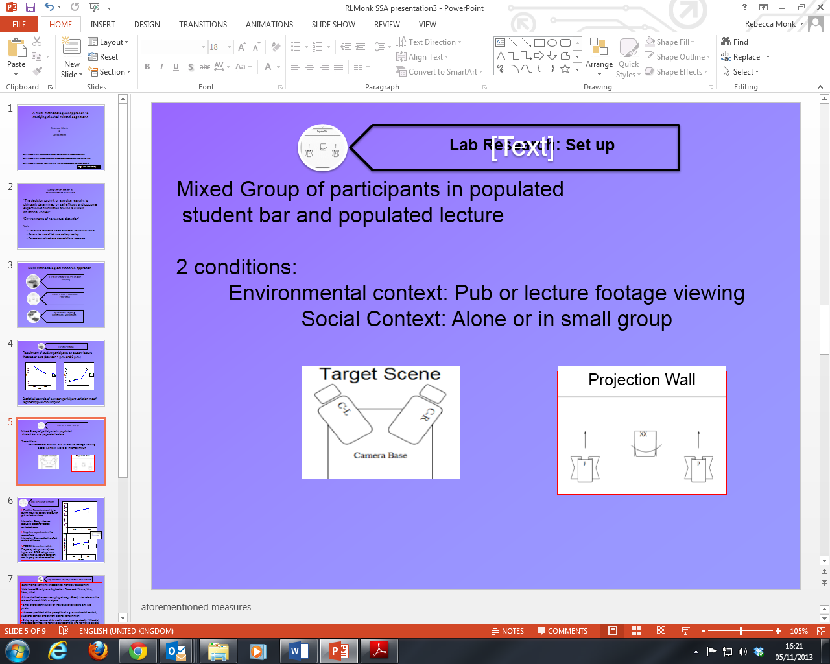
Lab Research: Set up
Mixed Group of actors filmed whilst in populated student bar and populated lecture
Images projected to participants in order to create panoramic display
  Conditions - Social Context: Alone or in small group
  - Environmental Context: Pub vs lecture viewing
Notes:
2 x Synchronised HD
video cameras (35 & 135 degrees)
Projection: 2 X Projectors project
videos across the lab wall:
Panoramic display
Participants complete the
aforementioned measures

Slide 6
Lab Research: Results
Positive and Negative Expectancies show interactive effects of environmental and social contexts
Frequency ratings (norms) were higher and DRSE ratings were lower in pub vs. lecture condition and in group vs. alone condition
Notes:
Pos Interaction: Group influence exclusive to alcohol-related contextual cues
Neg: No main effects but Interaction: Shows collective effect
contextual factors

Slide 7
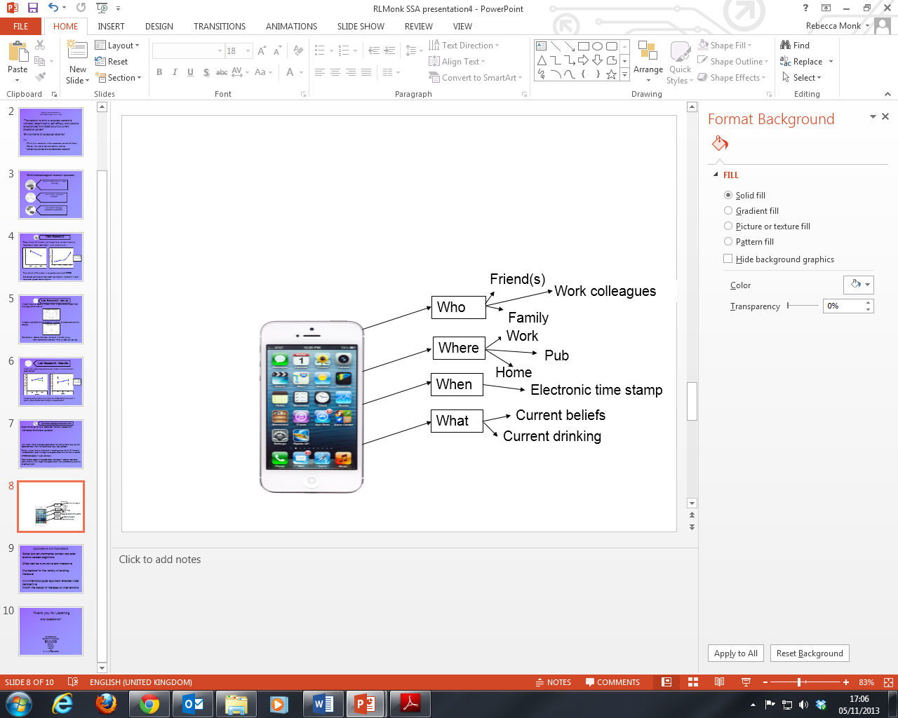
Experiential Sampling: Method and Results
Experiential sampling or ecological monetary assessment
Web-hosted Smartphone Application
MLM showed that more variance was predicted at the prompt level (e.g. current social context) than at the individual level (e.g. gender)
Being in pubs, bars or clubs and in social groups -family & friend(s) increased both positive/negative expectancies and normative beliefs and decreased DRSE
Positive and negative expectancies increased if alcohol had been consumed but only negative expectancies were predicted by quantity
Notes:
. Recorded: Where, Who, When, What
A time-stratified random sampling strategy: 5-daily intervals over the course of a week: MLM analyses
MLM show more mall contribution for individual level factors e.g. Age, gender
Variance predicted at the prompt level e.g. current social context, situational context and current alcohol consumption
Being in pubs, bars or clubs and in social groups -family & friend(s) increased both positive/negative expectancies and normative beliefs
DRSE decreased in such contexts
MLM show more variance explained at the prompt level (e.g. current social context) than individual level (e.g. Age, gender)
Being in pubs, bars or clubs and in social groups -family & friend(s) increased both positive/negative expectancies and normative beliefs
DRSE decreased in such contexts

Slide 8
Conclusions and Implications
Social and environmental contexts can alter alcohol-related cognitions
Effect can be cumulative and interactive
Implications for the validity of existing literature
Multi-methodological approach enables wider perspective
Inform the design of therapeutic interventions

Slide 9
Thank you for Listening
Any questions?
Dr Rebecca Monk
Department of Psychology
Edge Hill University
Saint Helens Road
Ormskirk,
Lancashire
L39 4QP
UK
Tel: +44 (0)1695 65 0940

