Slide 1



Q Sense: A context aware smartphone sensing app for smoking cessation
Felix Naughton
Behavioural Science Group
University of Cambridge
Collaborators
Neal Lathia
Sarah Hopewell
Rik Schalbroeck
Cecilia Mascolo
Andy McEwen
Stephen Sutton
fmen2@medschl.cam.ac.uk
@FelixNaughton
SSA 2015

Slide 2
Background
Over half of those attempting to quit smoking relapse within one month (high income countries)
Borland et al (2012), Addiction
Cue-induced cravings implicated in almost half of all smoking lapses – major support gap
Shiffman et al (1996), J Consult Clin Psychol; Ferguson & Shiffman (2009), J Subst Abuse Treat
Mobile phone-based Ecological Momentary Interventions (EMIs) have potential to address gap
Naughton et al (2011), EHP; McClernon & Choudhury (2013), Nicotine Tob Res

Slide 3
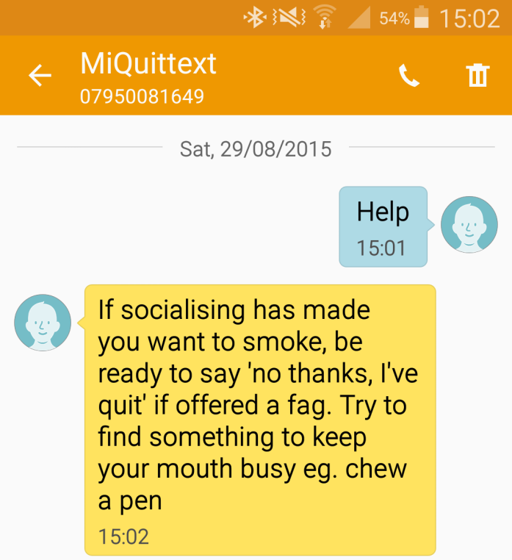
How can EMIs address gap?
Three key ways of delivering real time cessation support:
  User triggered
    Relatively low usage, rarely strategic
Brendryen & Kraft (2008) Addiction; Naughton et al (2014) Addiction
Notes:
User triggered e.g. texting HELP, opening an app for help, calling an Interactive Voice Response (IVR) helpline
System triggered e.g. Fixed schedule/random timing/user preference

Slide 4
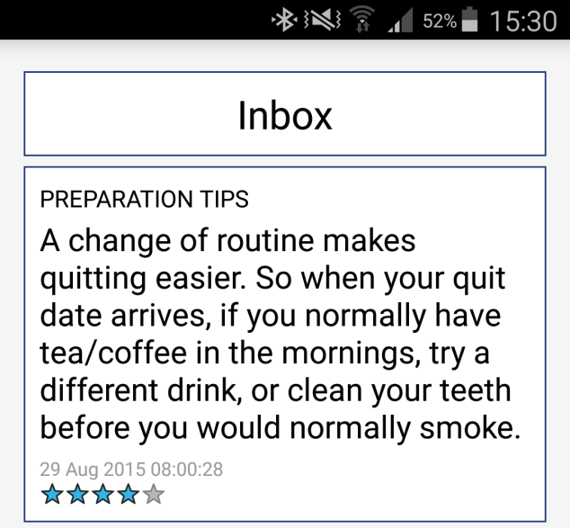
How can EMIs address gap?
Three key ways of delivering real time cessation support:
  User triggered
    Relatively low usage, rarely strategic
Brendryen & Kraft (2008) Addiction; Naughton et al (2014) Addiction
  System triggered
    Difficult to deliver support ‘just-in-time’
Notes:
User triggered e.g. texting HELP, opening an app for help, calling an Interactive Voice Response (IVR) helpline
System triggered e.g. Fixed schedule/random timing/user preference

Slide 5
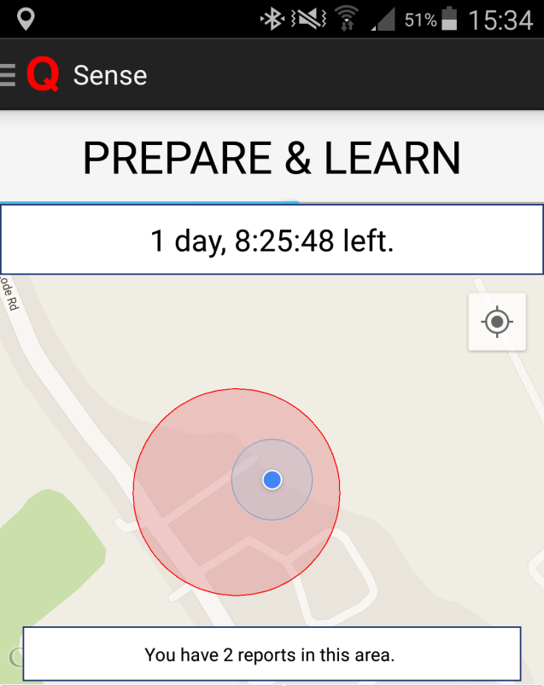
How can EMIs address gap?
Three key ways of delivering real time cessation support:
  User triggered
    Relatively low usage, rarely strategic
Brendryen & Kraft (2008) Addiction; Naughton et al (2014) Addiction
  System triggered
    Difficult to deliver support ‘just-in-time’
  Context triggered
    Phone sensors can predict context and
    trigger support in real-time
Burns et al (2011) JMIR
Notes:
User triggered e.g. texting HELP, opening an app for help, calling an Interactive Voice Response (IVR) helpline
System triggered e.g. Fixed schedule/random timing/user preference

Slide 6

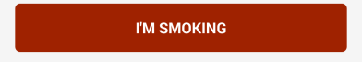
Sense
SET QUIT DATE

Slide 7
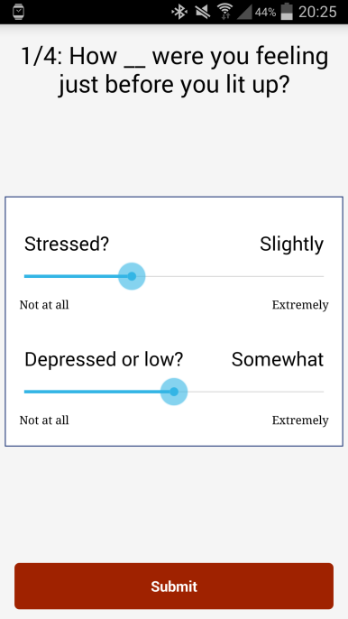
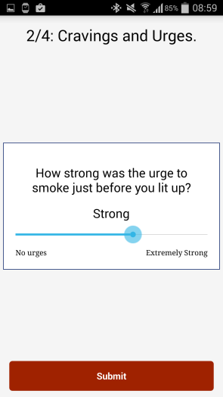
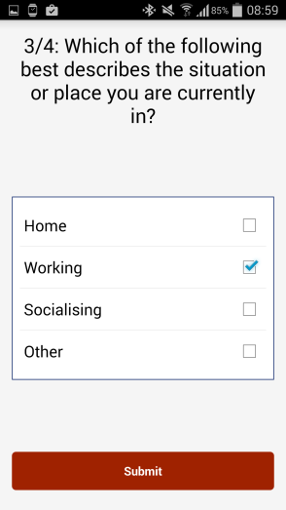
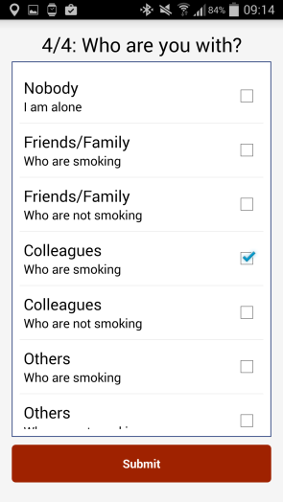
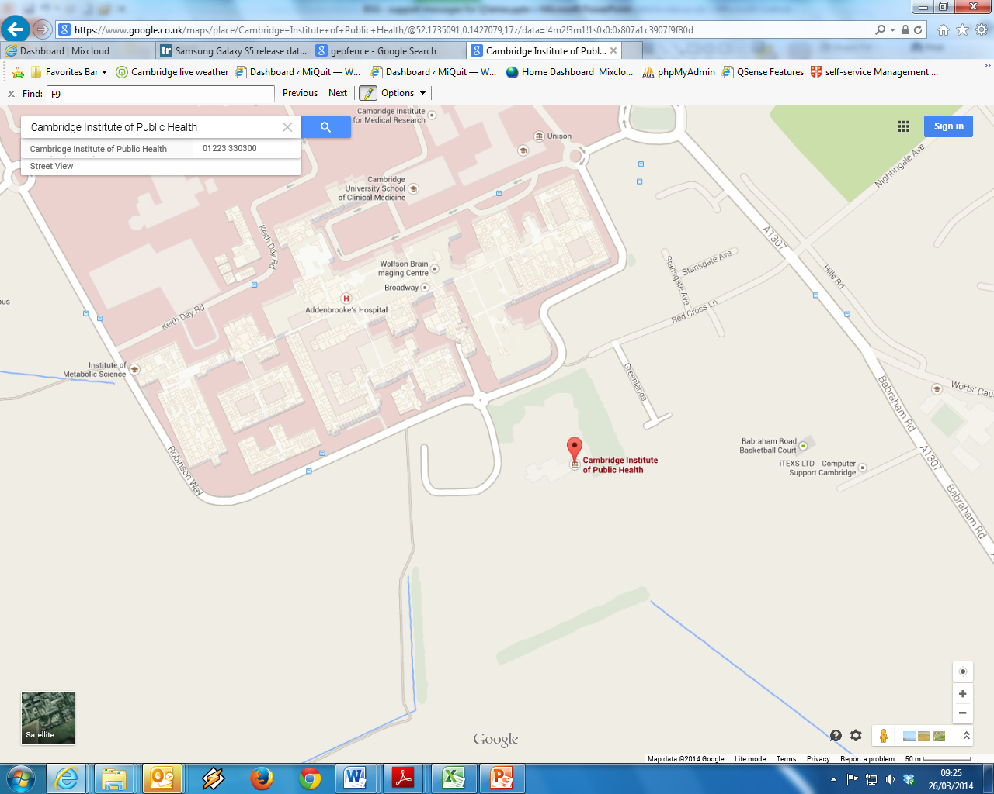
Sense
SET QUIT DATE

Slide 8
Sense
IF REPORTS > THRESHOLD THEN ACTIVE GEOFENCE CREATED
SET QUIT DATE

Slide 9
Sense
IF REPORTS > THRESHOLD THEN ACTIVE GEOFENCE CREATED
SET QUIT DATE

Slide 10
Sense
AFTER QUIT DATE

Slide 11
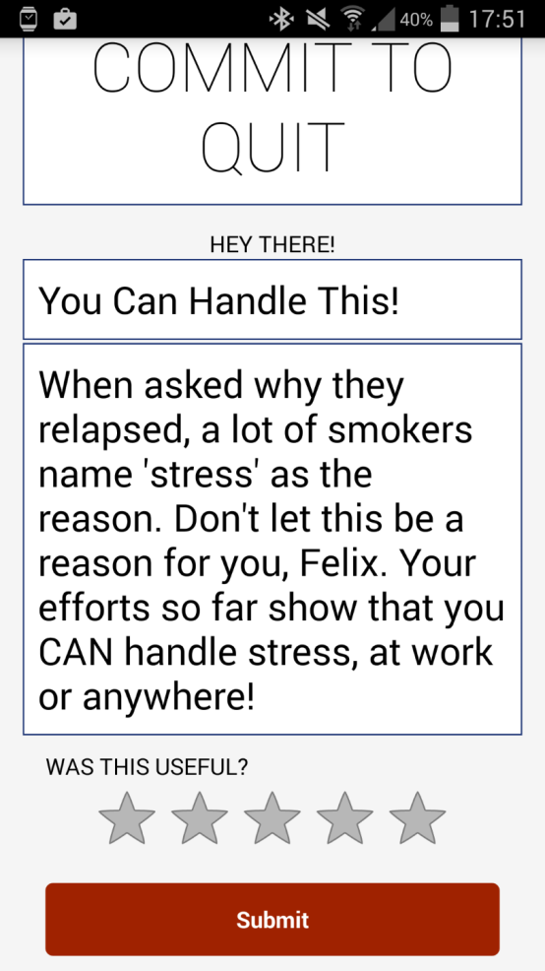

Sense
AFTER QUIT DATE
Notes:
Compliance with reporting important for system that relies on some element of manual training.

Slide 12
Sense
AFTER QUIT DATE
No research into behavioural support
triggered by context sensing
Compliance important – user-initiated reporting of smoking lower than when prompted
Schuz et al (2014), Nicotine Tob Res; Thrul et al (2015), Eur Addict Res
Notes:
Compliance with reporting important for system that relies on some element of manual training.

Slide 13
Aims and design
Explanatory sequential mixed methods design
 | Quantitative | Qualitative
Data | App data: self-report, sensor and system data | Data-prompted one-to-one interviews
Aims | 1. Compliance and... | ...reasons for non-compliance
 | 2. Geofence accuracy and... | ...perceived geofence accuracy
 | 3. Feasibility of geofence triggered support and... | ...views on optimisation
 | 4. Technological issues and... | ...data privacy concerns
Notes:
Data was mixed during data collection – preliminary analysis of quantitative data informed each interview (in part via data-prompt sheet)

Slide 14

Aims and design
Participants (opportunistic, via adverts)
  Smokers (N=15), willing to set a quit date within two weeks, use of Android phone
Pre-quit date
~ 2 weeks
Quit date
Post-quit date
~ 2 weeks
Interview
Notes:
No training, reinforcement or payment for using app. Participants were just provided the app and we let them get on with it (or not)

Slide 15
Findings 1.Compliance
Mean smoking reports per participant pre-quit date
  38 (SD 21) or 2 (SD 2) p/d
Based on End of Day Surveys, underreported smoking on:
  56% days

Slide 16
Findings 1.Compliance
Mean smoking reports per participant pre-quit date
  38 (SD 21) or 2 (SD 2) p/d
Based on End of Day Surveys, underreported smoking on:
  56% days
Mean time taken to report smoking
  18 seconds
6%
13%
50%
31%

Slide 17
Findings 1.Compliance
Mean smoking reports per participant pre-quit date
  38 (SD 21) or 2 (SD 2) p/d
Based on End of Day Surveys, underreported smoking on:
  56% days
Mean time taken to report smoking
  18 seconds
Reasons for non-compliance
Forgetting
Not wanting to appear rude
Driving
Not being in the mood
Not understanding purpose of reporting
Losing motivation to report
Relapse (post quit-date)
Self-monitoring effects
“When I was logging how much I am craving it was lower than what I thought it would have been without the app which was really good. So that made me think well actually do I really need a cigarette now?” (P6)
6%
13%
50%
31%

Slide 18
Findings 2. Geofence accuracy
Smoking reports where geospatial location collected:
  97%
Accuracy of geospatial location:
  32 meters (SD 17)
Mean number of active geofences created per participant
  1.5 (SD 0.7)

Slide 19
Findings 2. Geofence accuracy
Smoking reports where geospatial location collected:
  97%
Accuracy of geospatial location:
  32 meters (SD 17)
Mean number of active geofences created per participant
  1.5 (SD 0.7)
Perceived accuracy
Smoking locations (active geofences) deemed accurate - few exceptions

Slide 20
Findings 3. Feasibility
Participants who received at least one geofence triggered message (of those eligible n=9):
  56%
Aggregated mean delivery rate per day per participant:
  3.0 (SD 0.8)

Slide 21

Findings 3. Feasibility
Participants who received at least one geofence triggered message (of those eligible n=9):
  56%
Aggregated mean delivery rate per day per participant:
  3.0 (SD 0.8)
Generated geofence messages rated:
  78%
Time elapse between support alert/notification and opening of app
  63.9 minutes
  50% opened within 30 mins

Slide 22
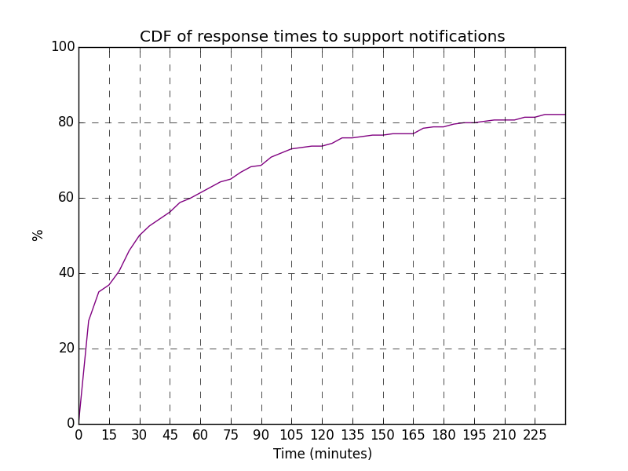
Findings 3. Feasibility
Participants who received at least one geofence triggered message (of those eligible n=9):
  56%
Aggregated mean delivery rate per day per participant:
  3.0 (SD 0.8)
Generated geofence messages rated:
  78%
Time elapse between support alert/notification and opening of app
  63.9 minutes
  50% opened within 30 mins

Slide 23
Findings 3. Feasibility
Participants who received at least one geofence triggered message (of those eligible n=9):
  56%
Aggregated mean delivery rate per day per participant:
  3.0 (SD 0.8)
Generated geofence messages rated:
  78%
Time elapse between support alert/notification and opening of app
  63.9 minutes
  50% opened within 30 mins
Views
Largely positive
“But I guess it was kind of based on the time it knew I was at home or whatever, you know…those sort of trigger times it sort of sent a message to say, yes, so I felt it was aimed directly at me as opposed to just a random blanket message.” (p20)
Risk of reminding them of smoking, though can be outweighed by message
“Even with the Champix tablets I’m still thinking about smoking...And then when that message come through it says like ’[NAME], don’t do it”’I’m like, ‘Oh okay. Alright, I won’t!”’(laughter)...I thought that was really helpful.” (p8).

Slide 24
Findings 4. Issues and concerns
Some (4/9; 44%) did not receive geofence triggered support:
  Bug
  Narrow geofence diameter

Slide 25
Findings 4. Issues and concerns
Some (4/9; 44%) did not receive geofence triggered support:
  Bug
  Narrow geofence diameter
Privacy concerns
Participants unanimous in stating no privacy concerns...
...in part due to source of app
“I would have been happy to give more time, more personal data, things along those lines. Whilst if it was, I don’t know, Boots or someone along those lines coming up with an app, I would have given them the bare minimum because I don’t trust where that data is going to go” (p17)

Slide 26
Conclusions
Reporting smoking quick; reporting interventions needed
Could partly mitigate by lowering geofence threshold
High engagement with geofence messages, but not always viewed promptly
Privacy issues negligible; source important
Next steps: ongoing acceptability study with larger more varied sample (NHS stop smoking services and adverts)
Notes:
Most aspects demonstrate feasibility

Slide 27

Thank you
Felix Naughton
Behavioural Science Group
University of Cambridge
Collaborators
Neal Lathia
Sarah Hopewell
Rik Schalbroeck
Cecilia Mascolo
Andy McEwen
Stephen Sutton
fmen2@medschl.cam.ac.uk
@FelixNaughton

