Slide 1
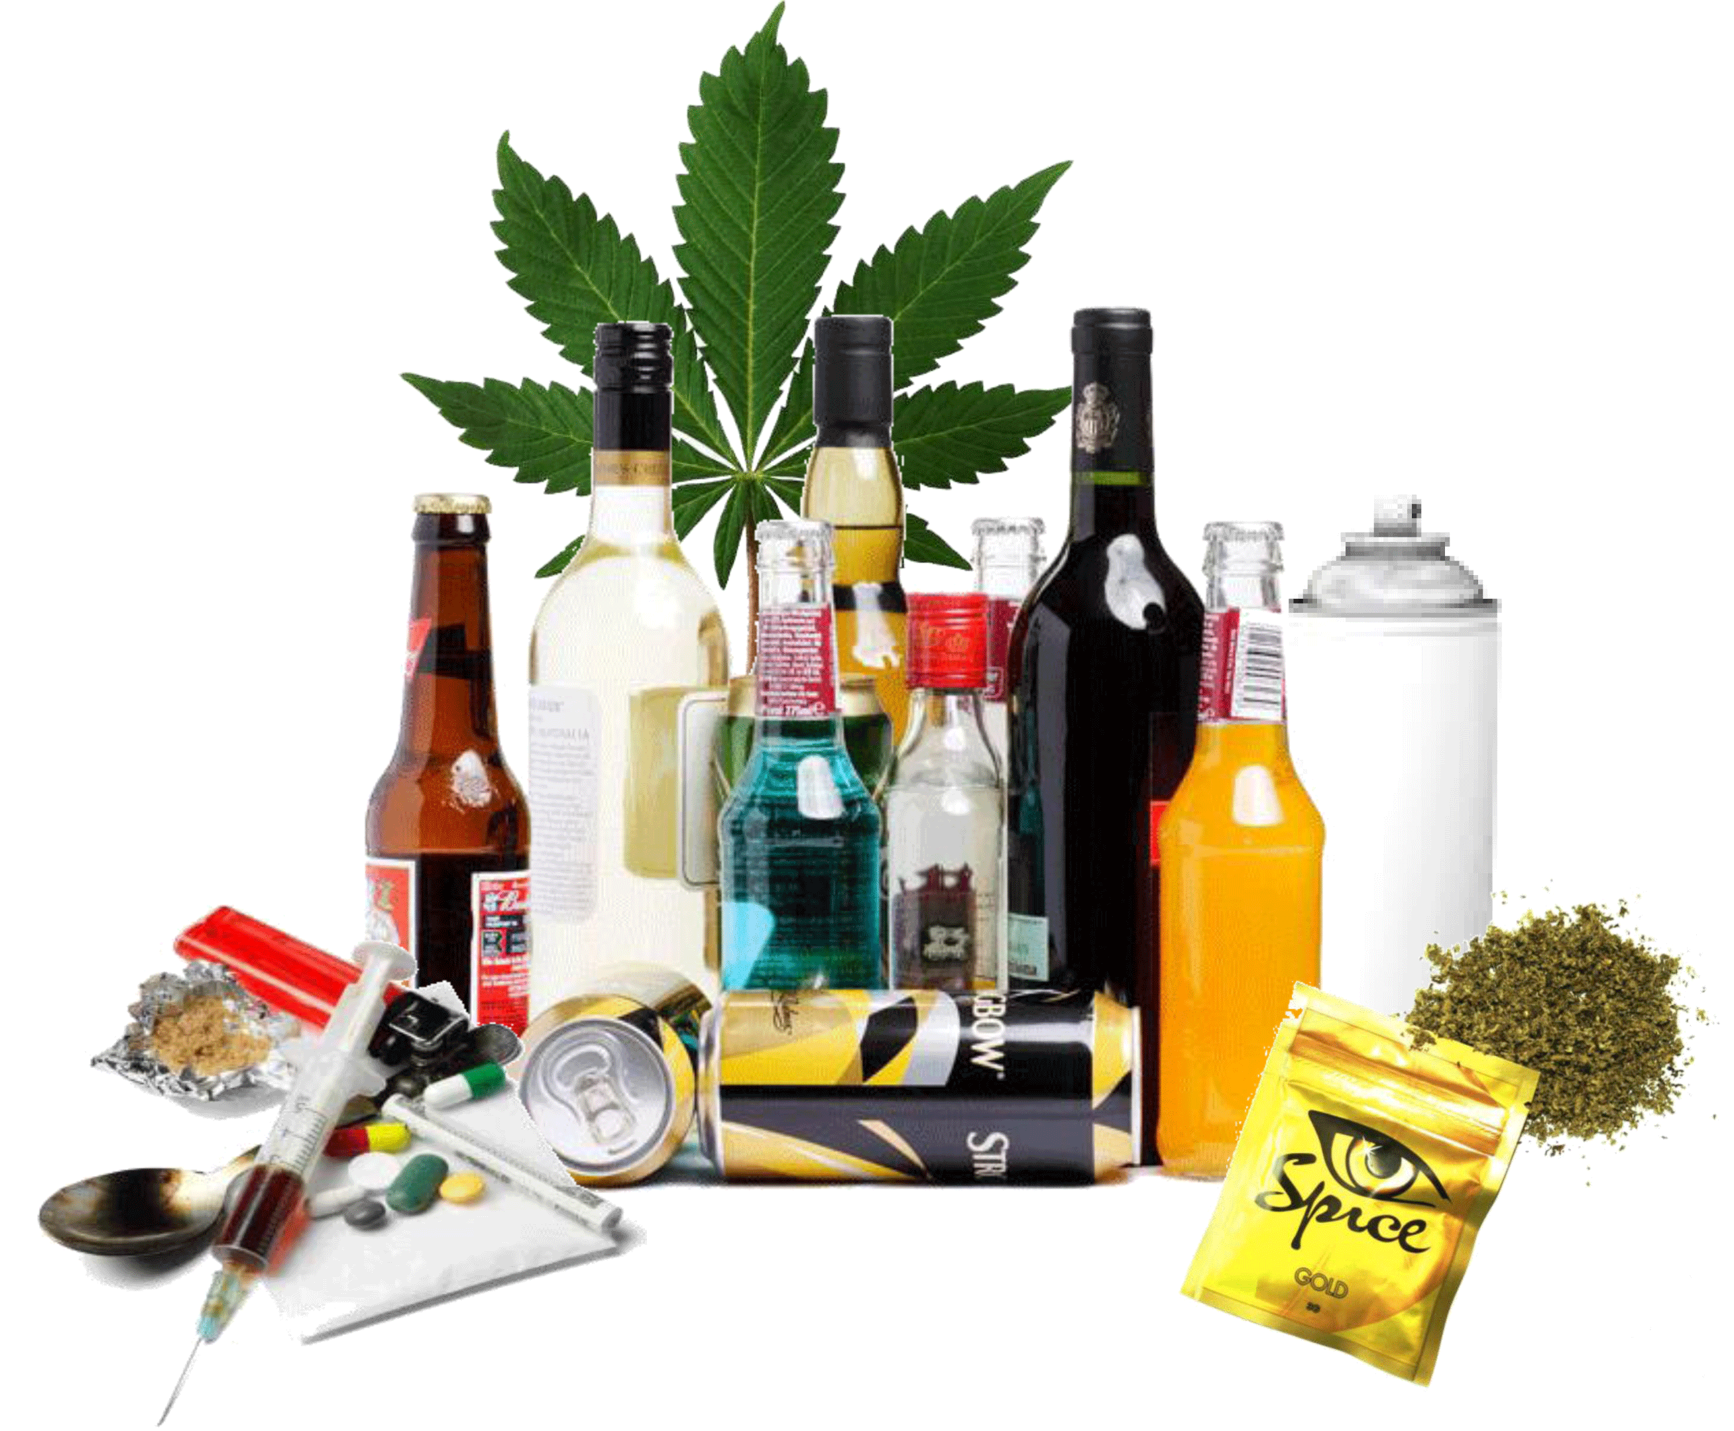
Measuring Substance Use
Duncan Raistrick
SSA 10th November 2016

Slide 2
How useful are substance use data?
Not very for treatment planning but
❝substance use is substance use❞

Slide 3
Can argue for different data for….
  Detection
  Assessment
  Monitoring treatment
  Preparation for substitute prescribing
  Preparation for detoxification
  Rating recovery
  …but clinicians want something simple and universal

Slide 4
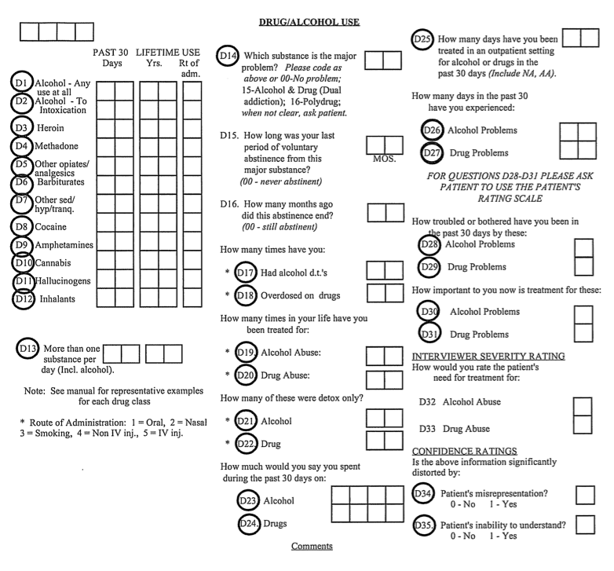
Addiction Severity Index

Slide 5
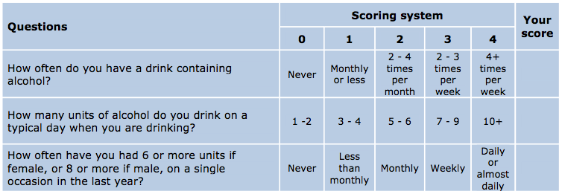
AUDIT QF measures
Screening tool with 10 questions
Self completion – time window last month
Frequency as categorical data
ASSIST follows same format – last 3 months
ASSIST drugs: tobacco, alcohol, cannabis, cocaine, amphetamine, inhalants, sedatives, hallucinogens, opioids

Slide 6
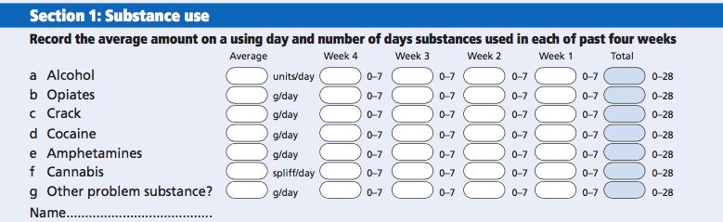
Treatment Outcome Profile
First section of a composite measure
Practitioner rated
Limited choice of drugs
Quantity for all drugs – unit stated
Frequency measures as continuous data using TLFB technique

Slide 7
Why ask about quantity?
Psychosocial interventions typically used in the UK do not require quantity
Prescribing for inexperienced practitioners is protocol driven – quantity not major variable
The relationship between tissue damage and alcohol is understood – not so for other drugs
Quantity is usually not recordable – unable to remember, purity unknown
Reporting in different units – joints, pounds, bags, rocks, tablets, grams

Slide 8
AUDIT and ASSIST categories as Continuous Data
Logical days | SUSS days | Ordinal Categories
 |  | AUDIT (Last Month)
0 1 2-4 8-12 16-28 | 0 1 2-7 8-15 16-28 | Never Monthly or less 2-4 x monthly 2-3 x weekly 4 or more times weekly
 |  | Assist (Last 3 months)
0 1 1 4-16 20-28 | 0 1 2-3 4-19 20-28 | Never Once or twice Monthly Weekly (1-4x) Daily or almost daily (5-7x)

Slide 9
Correlations of AUDIT, ASSIST, TOP and SUSS
Day | 0 | 1 | 2 | 3 | 4 | 5 | 6 | 7 | 8 | 9 | 10 | 11 | 12 | 13 | 14 | 15 | 16 | 17 | 18 | 19 | 20 | 21 | 22 | 23 | 24 | 25 | 26 | 27 | 28
AUDIT | 58 | 19 | 14 |  |  |  |  |  | 21 |  |  |  |  |  |  |  | 88
ASSIST | 36 | 26 | 14 |  | 30 |  |  |  |  |  |  |  |  |  |  |  |  |  |  |  |  | 94
TOP | 61 | 12 | 6 | 2 | 0 | 3 | 0 | 7 | 7 | 2 | 1 | 0 | 10 | 0 | 5 | 0 | 5 | 2 | 2 | 0 | 10 | 2 | 0 | 1 | 3 | 3 | 0 | 0 | 56
SUSS | 57 | 8 | 10 | 2 | 2 | 6 | 1 | 6 | 2 | 3 | 7 | 1 | 4 | 1 | 4 | 4 | 2 | 3 | 3 | 0 | 8 | 2 | 0 | 1 | 4 | 4 | 2 | 0 | 53
Spearman correlation coefficient for TOP x SUSS=0.94
AUDIT and ASSIST work well as screening tools – sensitive at low frequency
Unsuitable as outcome measure in many situations
Primary care encouraged to use AUDIT – not adequate for specialist services – how to avoid duplication?
Why use categorical data? Is it as easy to provide continuous data?

Slide 10
SUSS designed to meet…
expectations of help seekers, family and friends
treatment planning requirements
treatment/recovery measurement requirements
Features…
Same choice of drugs as ASSIST including smoking
Self completion format
Measures frequency and not quantity except for alcohol units and cigarettes
Includes main problem drug
Includes prescribed drugs

Slide 11
Numbers of Current Users Identified by ASSIST, TOP, SUSS, and AUDIT
n=200 | ASSIST | TOP | SUSS | AUDIT
Tobacco | 144 | n/a | 146 | n/a
Alcohol | 123 | 139 | 143 | 142
Cannabis | 39 | 53 | 50 | n/a
Cocaine (crack) | 35 | 25 | 23 | n/a
Cocaine (powder) |  | 23 | 24 | n/a
Amphetamine | 10 | 10 | 12 | n/a
Inhalents | 1 | n/a | 0 | n/a
Sedatives | 22 | n/a | 16 | n/a
Hallucinogens | 2 | n/a | 2 | n/a
Opioids | 32 | 36 | 34 | n/a
Injecting | 17 | 15 | 13 | n/a

Slide 12
SUSS frequencies with ASSIST & TOP
 | ASSIST | TOP
Tobacco n=146 | 0.75*** | n/a
Alcohol n=143 | 0.93*** | 0.90***
Cannabis n=50 | 0.96*** | 0.91***
Cocaine (crack) n=26 | 0.96*** | 0.83***
Cocaine (powder) n=24 |  | 0.70***
Amphetamine n=12 | 0.98*** | 0.40
Inhalants n=1 | Too few cases
Sedatives n=16 | 0.22 | n/a
Hallucinogens n=3 | Too few cases
Opioids n=34 | 0.94*** | 0.68***
Injecting n=13 | n/a | 0.64*
Significance ***p<0.001 *p<0.05

Slide 13
Convergent Validity: correlation of SUSS frequencies with LDQ, CORE10, SSQ & EQ5D
 | LDQ | CORE10 | SSQ | EQ5D
Tobacco n=138 | 0.12 | 0.02 | -0.10 | -0.05
Alcohol n=136 | 0.42*** | 0.25** | -0.06 | -0.30**
Cannabis n=45 | 0.40** | 0.20 | 0.05 | 0.17
Cocaine (crack) n=24 | 0.70*** | 0.45** | -0.39 | -0.45*
Cocaine (powder) n=22 | 0.17 | -0.01 | 0.06 | -0.09
Amphetamine n=11 | 0.83** | 0.13 | 0.19 | -0.03
Inhalants n=1 | Too few cases
Sedatives n=25 | 0.18 | 0.36 | -0.13 | 0.16
Hallucinogens n=3 | Too few cases
Opioids n=30 | 0.42* | 0.36* | -0.40* | -0.35
Injecting n=14 | 0.81*** | 0.53 | -0.62** | -0.48
Spearman significance *p<05 **p<01 ***p<001

Slide 14

❝There is no gold standard for substance use data❞
SUSS is not intended as the definitive measure rather it is a template based on key principles
Visit our website:
www.result4addiction.net

