Slide 1
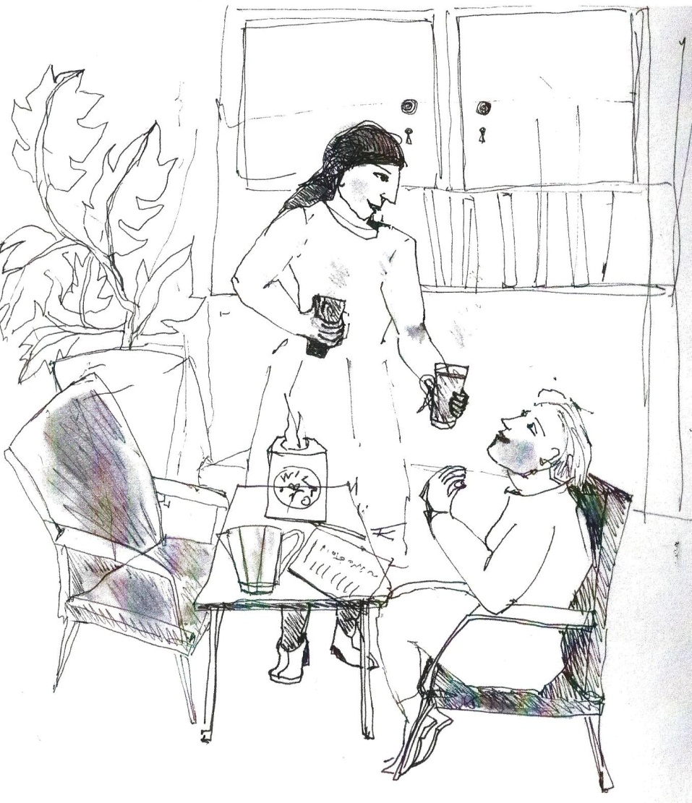
The Addiction Recovery Questionnaire SSA Conference, York 5th & 6th November 2015 Duncan Raistrick

Slide 2
Published research on outcome measures since 1983
Developed a package called RESULT
accessible soon on our website

Slide 3
Dimensions of Addiction our understanding in 1980
psychological well being - CORE
substance use
AUDIT/ASSIST C
Dependence - LDQ
social well being - SSQ
Criteria for scales: universality – psychometrics – plain language – change measure

Slide 4
Service User Evaluation of Measures qualitative analysis of 40-70min interviews with 10 people
 | EQ5D | LDQ | CORE | SSQ | All
Acceptability rating 0-10 | 7.9 | 9.2 | 8.0 | 6.6 | 8.0
All scales have high acceptability rating
SSQ lowest rating because low expectation of change
Themes:
completion is awareness raising
honesty difficult until trust with key-worker established
measures are irrelevant
need explanation of what the measures are about
motivational to map progress
more feedback good if feedback is relevant to goals
Source: Anson & Raistrick (Clin Psych assignment)

Slide 5
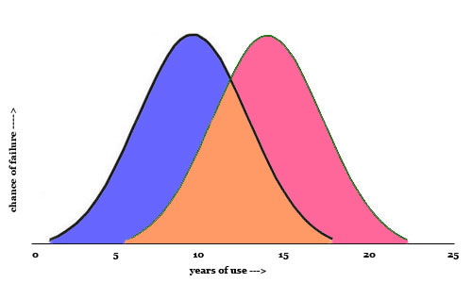
Clinically Significant Change - ‘Gold Standard’
Jacobson et al. (1999) proposed that in order to take account of baseline scores and measuring error, clinically significant change should:
be statistically reliable
Have end scores in a well functioning population range
 | Reliable Change Score | Well Functioning Population
LDQ | >= 4 | < 12
CORE-10 | >= 6 | < 14
SSQ | >= 4 | > 10
Source: Raistrick et al (2014) Psychiatric Bulletin

Slide 6
Dimension & Condition Specific Measures our understanding in 20124
psychological well being
substance use
dependence
social well being
Source: Fairhurst et al (2014) Drug & Alcohol Review

Slide 7
PROMs in Routine Clinical Practice % in each outcome category at 3-12 months
 | n= | Reliably Worse |  |  | No Change |  |  | Reliably Better |  |  | Clinically Better
 |  | LDQ | C-10 | SSQ | LDQ | C-10 | SSQ | LDQ | C-10 | SSQ | LDQ | C-10 | SSQ
Male | 270 | 4.8 | 4.8 | 14.7 | 25.9 | 46.0 | 54.2 | 69.3 | 49.2 | 31.8 | 50.4 | 26.8 | 23.7
Female | 241 | 4.6 | 9.6 | 13.6 | 44.0 | 45.4 | 59.1 | 51.4 | 45.0 | 29.6 | 33.6 | 28.8 | 22.9
Alcohol | 319 | 3.4 | 3.1 | 11.5 | 22.9 | 38.4 | 57.5 | 73.7 | 58.5 | 31.0 | 51.4 | 34.7 | 23.9
Heroin | 68 | 4.4 | 13.2 | 10.3 | 48.5 | 48.5 | 51.5 | 47.5 | 38.2 | 38.2 | 35.3 | 19.1 | 29.4
Methadone | 49 | 0 | 12.2 | 24.0 | 93.9 | 75.5 | 62.0 | 12.2 | 12.2 | 14.0 | 4.1 | 12.2 | 12.0
Stimulants | 22 | 9.1 | 13.6 | 9.1 | 45.5 | 54.5 | 59.1 | 45.5 | 31.8 | 31.8 | 27.3 | 13.6 | 22.7
Source: Raistrick et al (2014) Psychiatric Bulletin

Slide 8
Why a recovery scale? What should it look like?
Treatment and recovery are polar extremes of a ‘journey’: problems > solutions
Reflects the views of service users and concerned others: items generated from focus groups
Face validity gives meaning to service users, concerned others, public, commissioners, and practitioners
Creates a set of goals: keep therapists focussed
….so we created the Addiction Recovery Questionnaire

Slide 9
Recovery is not a new idea….
“Recovery from substance dependence is a voluntarily maintained lifestyle characterized by sobriety, personal health, and citizenship.”
Early sobriety 1-11 months
Sustained sobriety 1-5 years
Stable sobriety >5yrs
Betty Ford Institute Consensus Panel (2007) J Substance Abuse Treatment
Being free from drugs of dependence
Reduced re-offending or continued non offending
Improved health and wellbeing
HM Government (2010)
….a lot of views expressed….we asked service users….

Slide 10
Service User views on what outcomes are important
 | Agency Type | Type of Activity | SU | F&F
FG1 | NHS | Treatment | 7 | 4
FG2 | NHS/3rd sector | DRR | 3 | 2
FG3 | NHS/3rd sector | Harm reduction | 0 | 0
FG4 | SMART group | Recovery mutual aid | 7 | n/a
FG5 | 3rd sector | Recovery SU only | 7 | n/a
FG6 | 3rd sector | Recovery F&F only | n/a | 6
FG7 | NHS | Recovery | 5 | 5
 | TOTAL |  | 29 | 17
Six focus groups (FGs) were held to elicit service user (SU)views and views of Family and Friends (F&F) on what for them constitutes a good outcomes.
Source: Drugs: education, prevention and policy 2014 21:324-332

Slide 11
What do service users and carers think “being better” means?
Relationships
Improved
New friendships with non users
Staying away from users
Social Situation
Money
Accommodation
Self Awareness
Confidence
Self esteem
Trust
Optimism
Abstinence
Not taking any medication
Stopping using
Activities
Personal Care
Day to day tasks
Alternative activities
Personal development
Health
Mental Health
Physical Health
Sense of wellbeing
Friends and family
Wellbeing of friend and family
Support for friends and family
Being better
Relationships
Activities
Health
Friends and family
Social Situation
Abstinance
Self awareness
Source: Drugs: education, prevention and policy 2014 21:324-332

Slide 12
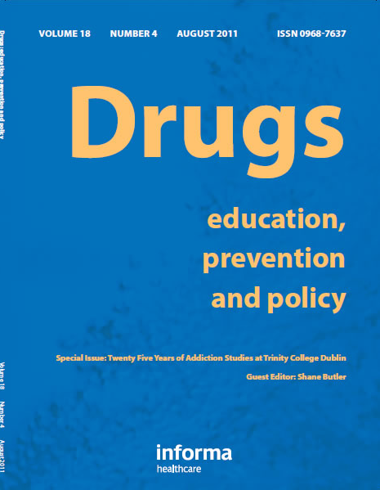
Phase 1 Service user, family and friends’ views on the meaning of a ‘good outcome’ of treatment for an addiction problem Thurgood et al (2014) Drugs: education, prevention and policy 21:324-332
DOI: 10.3109/09687637.2014.899987

Slide 13
Stakeholder groups SURVEYED n=255: service users 73 drinking/using 35 abstinent concerned others 41 addiction specialists 62 other health workers 40 commissioners 39 20 items rated ‘not important’ to ‘very important’ rank 1st and 2nd most important
1st step
Item validity
2nd step
FACTOR ANALYSIS produced four factors: i) abstinence ii) normality iii) wellbeing iv) relationships
Stakeholder 1st & 2nd rankings allocated to one of these factors – next slide
Item structure
3rd step
Best 3 items from factor analysis selected for final questionnaire FACTOR ANALYSIS produced three factors: i) abstinence ii) normality iii) positivity
Exception was to include Criminal Activity not Wellbeing of Family and Friends
Item reduction

Slide 14
Percent of stakeholders rankings in Abstinence, Normality, Wellbeing or Relationship cluster from validation of 20 items
Ranked 1st
Ranked 2nd

Slide 15
Component Interpretation – factor loadings >0.4
 | Abstinence | Normality | Positivity
1 Staying away | .736
2 New friends | .684
3 Being abstinent | .608
4 Substitute prescriptions | .585
5 Money |  | .722
6 Trust |  | .662
7 Accomodation |  | .659
8 Activities of daily living |  | .595
9 Criminal activity | .501 | .541
10 Optimism |  |  | .797
11 Self esteem |  |  | .701
12 Confidence |  |  | .659

Slide 16
‘Abstinence’ subscale
In the last month have you…
… been mixing with people who are problem drinkers/drug users?
…taken prescribed drugs that have a psychoactive effect?
…been abstinent from alcohol and other drugs?
… been friends with people who do not drink or take drugs?
Alternative to asking about consumption?
Abstinence controvertial:16 possible responses
No prescription drugs
not at all – rarely – often – all the time

Slide 17
‘Normality’ subscale
In the last month have you…
… had enough money to live reasonably well?
… found that you are trusted by important people in your life?
… been living in suitable accommodation?
… been keeping up with everyday chores and activities?
… been involved in criminal activities?
Fundamentals of stability
Trust earned by consistent behaviour
Chores and activities often not taken up in therapy
not at all – rarely – often – all the time

Slide 18
‘Positivity’ subscale
In the last month have you…
…had a positive feeling about the future?
…felt generally good about yourself?
…had confidence to deal with situations where you might drink or take drugs?
Action stage of change
Possible deep seated problems – ‘dual diagnosis’
Rehearsed coping strategies
not at all – rarely – often – all the time

Slide 19
Phase 2 A brief Addiction Recovery Questionnaire derived from views of service users and concerned others Iveson-Brown & Raistrick (2015) Drugs: education, prevention and policy (in press)
DOI 10.3109/09687637.2015.1087968

Slide 20
Conclusion
The Addiction Recovery Questionnaire was developed from service user views and refinements
High face validity gives meaning across different stakeholder groups and suitable for routine practice
The big question??
Could a recovery scale replace assessment scales?

Slide 21
Recent References
Iveson-Brown, K. and Raistrick, D (2015) A Brief Addiction Recovery Questionnaire derived from the views of service users and concerned others. Drugs: Education, Prevention, and Policy
doi: 10.3109/09687637.2015.1087968
Fairhurst, CM; Böhnke, JR; Gabe, R; Croudace, TJ; Tober, G; Raistrick, D (2014) Factor analysis of treatment outcomes from a UK specialist addiction service: relationship between the Leeds Dependence Questionnaire, Social Satisfaction Questionnaire and CORE-10. Drug and Alcohol Review. 33(6) 643-650.
Thurgood, S., Crosby, H.F., Raistrick, D., & Tober, G. (2014) Service user, family and friends’ views on the meaning of a ‘good outcome’ of treatment for an addiction problem. Drugs: Education, Prevention and Policy. 21(4) 324-332.
Raistrick, D., Tober, G., Sweetman, J., Unsworth, S., Crosby, H., & Evans, T. (2014). Measuring clinically significant outcomes – LDQ, CORE-10, and SSQ as dimension measures of addiction. The Psychiatrist, 38: 112-115.
Tober G. W. (2000) The nature and measurement of change in substance dependence, (University of Leeds, Unpublished PhD thesis).

