Slide 1

A survey of tobacco cessation support in 121 countries
Martin Raw
Universities of Nottingham, UK and Sao Paulo, Brazil
SSA York, November 2013

Slide 2
Survey team and papers
Martin Raw, Ann McNeill, Rachael Murray, Hemba Pine-Abata, Nancy Rigotti, Asaf Bitton
Piné-Abata H, McNeill A, Raw M, Bitton A, Rigotti N, Murray R. A survey of tobacco dependence treatment guidelines in 121 countries. Addiction 2013, in press
Piné-Abata H, McNeill A, Murray R, Bitton A, Rigotti N, Raw M. A survey of tobacco dependence treatment services in 121 countries. Addiction 2013, in press
The papers will be free to view for everyone

Slide 3
Survey funding
This survey was funded by the Society for the Study of Addiction, to whom we are extremely grateful
Notes:
3

Slide 4
Interests statement
I do not accept funding from the manufacturers of stop smoking medications
My funding since 2008 is from:
Society for the Study of Addiction, Roswell Park Transdisciplinary Tobacco Use Research Centre, SRNT, FCA, Global Bridges, Bloomberg Philanthropies
Notes:
4

Slide 5
Sample
All Parties to the FCTC in December 2011
173 (174 less EU)
Couldn’t find contacts in 10 so 163
We surveyed four UK countries separately so
166 survey emails sent out
121 replies (73%)

Slide 6
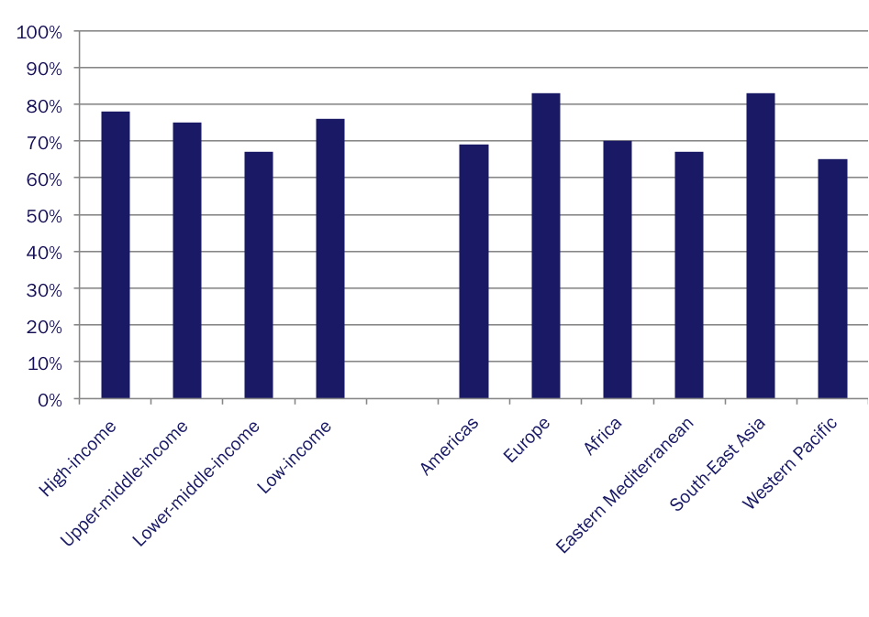
Response rates by region and income level
Notes:
WHO Region and World Bank national income level

Slide 7
Basic infrastructure
Does your country | % Yes
Have an officially identified person responsible for treatment? | 41
Have national treatment guidelines? | 44
Have a clearly identified budget for treatment? | 20
Offer to help healthcare workers to stop using tobacco? | 46
Mandatory recording of tobacco use in medical notes | 22
e
n = 121

Slide 8
Basic infrastructure by income level
 | % Yes
 | High | UM | LM | Low
Official responsible for treatment | 47 | 44 | 40 | 21
National guidelines | 75 | 42 | 30 | 11
Clearly identified treatment budget | 36 | 17 | 17 | 0
Help for healthcare workers | 56 | 47 | 40 | 32
Mandatory recording of tobacco use | 28 | 25 | 13 | 16
High=High income countries; UM=Upper middle income countries; LM=Lower middle income countries; Low=Low income countries

Slide 9
Components of national treatment system
Does your country | % Yes
Run mass media campaigns promoting cessation? | 54
Promote/encourage brief advice in existing services? | 56
Have a national telephone quitline? | 36
Have nationwide specialised treatment facilities? | 17
Have specialised treatment facilities but only in selected areas? | 51
Have no specialised treatment facilities at all? | 32
n = 121
Notes:
Check n

Slide 10
Components of national treatment system by income level
 | % Yes
 | High | UM | LM | Low
Promote brief advice | 56 | 50 | 60 | 63
National quitline | 75 | 28 | 20 | 5
High=High income countries; UM=Upper middle income countries; LM=Lower middle income countries; Low=Low income countries

Slide 11
Quitline characteristics
Does the quitline | % Yes
Offer free callers for calling in? | 73
Have people answering always or almost always? | 80
Offer multiple sessions with counsellors calling back offering ongoing support? | 56
Refer to local specialist treatment services? | 86
Offer information about tobacco cessation medications? | 80
Offer tobacco cessation medication to callers? | 21
n = 44

Slide 12
Specialised treatment provision by income level
 | % Yes
 | High | UM | LM | Low
Has nationwide treatment services | 36 | 19 | 0 | 0
Has no treatment services at all | 14 | 25 | 43 | 63
n = 121
High=High income countries; UM=Upper middle income countries; LM=Lower middle income countries; Low=Low income countries

Slide 13
Availability of help by income level
Can tobacco users easily get help to stop in the following settings?
Notes:
13

Slide 14
Availability of medications by income level
 | % Yes
 | All (n=121) | High (n=36) | UM (n=36) | LM (n=30) | Low (n=19) | Respondent’s awareness of medication (n/base)
NRT | 51 | 97 | 61 | 17 | 0 | 92
Bupropion | 17 | 42 | 14 | 0 | 0 | 100
Varenicline | 52 | 83 | 58 | 33 | 11 | 86
Cytisine | 10 | 3 | 17 | 13 | 5 | 67
High=High income countries; UM=Upper middle income countries; LM=Lower middle income countries;
Low=Low income countries

Slide 15
Affordability of medications by income level
 | % Yes *
 | All | High | UM | LM | Low
NRT | 81 | 94 | 60 | 63 | -
Bupropion | 70 | 80 | 40 | - | -
Varenicline | 48 | 64 | 32 | 29 | 0
Cytisine | 100 | 100 | 100 | 100 | 100
* % expressed as n/base

Slide 16
Basic infrastructure
Does your country | % Yes
Have an officially identified person responsible for treatment? | 41
Have national treatment guidelines? | 44 (n = 53)
Have a clearly identified budget for treatment? | 20
Offer to help healthcare workers to stop using tobacco? | 46
Mandatory recording of tobacco use in medical notes | 22
e
n = 121
Notes:
Check n

Slide 17
Countries that have treatment guidelines by region and income level
Notes:
17

Slide 18
Guidelines content
 | % Yes
For whole healthcare system and all professionals? | 72
Do they recommend brief advice? | 93
Do they recommend quitlines? | 66
Do they recommend intensive specialist support? | 93
Do they recommend medications? | 96
Do they include evidence on cost effectiveness? | 45
Do they reference the Cochrane Library? | 68
Are they based on another country’s guidelines? | 55
Do they stress importance of service providers not using tobacco? | 57
n = 53

Slide 19
Guidelines writing process
 | % Yes
Did national professional associations participate in drafting and/or reviewing? | 70
Are they formally endorsed by national prof associations? | 68
Are they formally endorsed by your government? | 70
Do they clearly describe the writing and review process? | 66
Were they peer reviewed? | 72
n = 53

Slide 20
Guidelines funding and conflicts of interest
 | % Yes
Do they clearly state who funded the guidelines? | 76
Did they receive financial support from government or other public health organisations? | 77
Did they receive financial support from the pharmaceutical industry? | 15
Do they include conflict-of-interest statements for all authors? | 40
Do the names and/or logos of any pharmaceutical companies appear in the guidelines? | 11
n = 53

Slide 21
Guidelines dissemination strategy
 | % Yes
Is there a strategy to disseminate the guidelines? | 57
n = 53

Slide 22
Conclusions
Very good response rate – possibly largest most detailed treatment survey ever
The basic infrastructure data suggest that for most countries treatment is low on their agenda
Perhaps not surprisingly existence of treatment infrastructure is related to income level
Key measure for getting tobacco use on healthcare system agenda – recording tobacco use in notes – VERY POOR INDEED

Slide 23
Conclusions
Relatively few countries have quitlines
Their provision also is strongly related to income level
Those that exist are run broadly in line with the evidence base
Provision of specialist treatment facilities strongly related to income level
As is the rated affordability of medications

Slide 24
Can tobacco users easily get help to stop in the following settings?
The reality is that in most of the world tobacco users cannot easily get help to stop
Outside high income countries NO percentage reached 30% in any setting
Even in high income countries percentage only exceeded 30% in general practice, pharmacies, hospitals, and from the internet
Notes:
24
Re-check exactly what the measure is - % of country contacts who said help was easily available in their country?

Slide 25
Guidelines
Broadly evidence based
More than half based on those of other countries
Majority follow good practice in their writing
Except in declaration of conflicts-of-interest
But only half had a dissemination strategy

Slide 26
Guidelines
Clear relationship between having guidelines and income level
Most high income countries have guidelines but very few low income countries
No African countries at all in our survey have guidelines
Notes:
26

Slide 27
What should ALL countries be doing now?
Ensuring that tobacco use is recorded in all notes
Addressing the issue of tobacco use in healthcare workers
Integrating brief advice into all healthcare systems (or at least making a start on this)
Encourage the licensing of affordable medications
Notes:
27

Slide 28
One sentence summary of our results?
Offering support to tobacco users who wish to stop is not yet a priority for the majority of countries in the world
Notes:
28

Slide 29
Thank you martin@martinraw.com
Notes:
29

Slide 31
Arial 35pt red bold
Arial 25pt blue bold

Slide 32
Arial 35pt red bold
Bulleted Text 25pt bold
Bulleted Text 2
Bulleted Text 3
Bulleted Text 4
Bulleted Text 5
Bulleted Text 6

