Slide 1




Alcohol treatment policy and the AMPHORA project
J. Rehm & A. Gual
Leeds, November 8th 2013

Slide 2
Conflicts of interest J. Rehm
Interest | Name of organisation
Current roles and affiliations | Director, Social and Epidemiological Research (SER) Department, Centre for Addiction and Mental Health, Toronto, Canada Professor and Chair, Addiction Policy, Dalla Lana School of Public Health, University of Toronto (UofT), Canada Head, PAHO/WHO Collaborating Centre for Mental Health & Addiction Head, Epidemiological Research Unit, Technische Universität Dresden, Klinische Psychologie & Psychotherapie, Dresden, Germany
Grants | EU FP-7, CIHR, Lundbeck, German government
Honoraria | Lundbeck
Advisory board/consultant | WHO HQ, WHO Euro, PAHO, Belgium Alcohol Plan, UK alcohol guidelines, Lundbeck,

Slide 3
Conflicts of interest T. Gual
Interest | Name of organisation
Current roles and affiliations | Addictions Unit, Psychiatry Department, Neurosciences Institute, Hospital Clinic, University of Barcelona; IDIBAPS; Vice President of INEBRIA
Grants | FP-7, SANCO, RETICS, Lundbeck, D&A Pharma,
Honoraria | Lundbeck, D&A Pharma, Servier, Lilly, Abbvie
Advisory board/consultant | Lundbeck, D&A Pharma, Socidrogalcohol (Alcohol Clinical Guidelines) 2013

Slide 4

Alcohol Measures for Public Health Research Alliance 2009-2012

Slide 5

Who are the AMPHORA partners
13 European countries
33 partner organizations
More than 50 researchers
Our goals:
To add European knowledge to alcohol policy
To disseminate this knowledge to those engaged in making policy

Slide 6


Berzelius Symposium 84
European Debate on Evidence-based Alcohol Policy
Fifth European Alcohol Policy Conference
18 – 19 October 2012 in Stockholm - Sweden

Slide 7
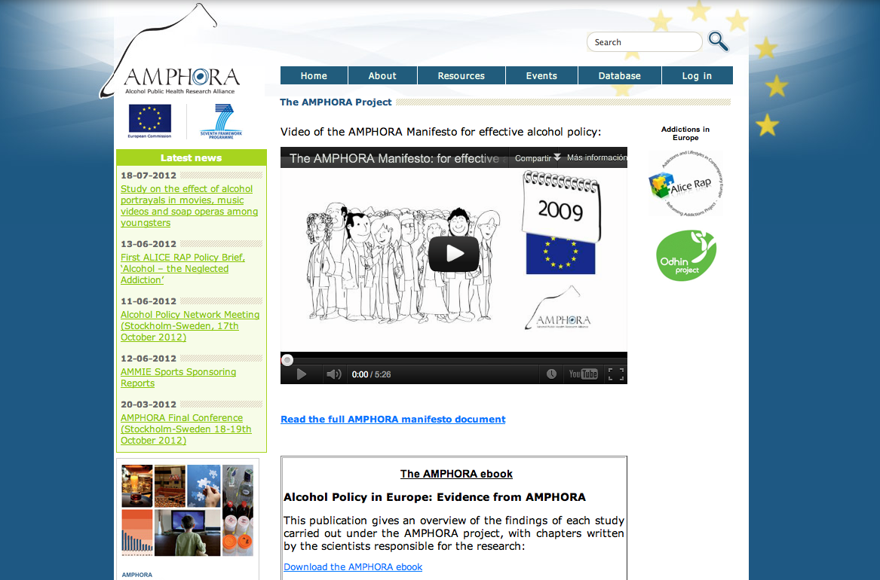
www.amphoraproject.net

Slide 8
AMPHORA project
WP1 Coordination and Related Issues
WP2 Epidemiology
WP3 Culture and Alcohol Policy
WP4 Alcohol Marketing
WP5 Availability of Alcohol
WP6 Early Identification and Management
WP7 Drinking Environments and Harm Reduction
WP8 Infrastructures for Alcohol Policy
WP9 From Science to Policy

Slide 9
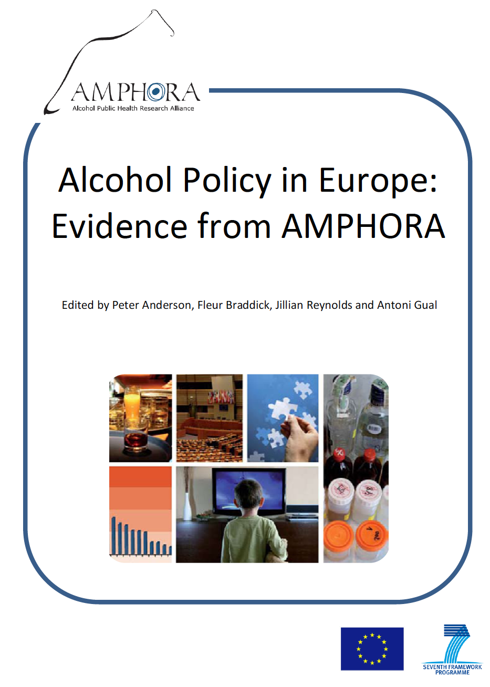
E-book
Second edition available on the web

Slide 10
CHAPTER 2: WHAT ALCOHOL CAN DO TO EUROPEAN SOCIETIES
Jürgen Rehm, Gerrit Gmel, Maximilien X. Rehm, Emanuele Scafato, Kevin D. Shield
We have estimated alcohol-attributable mortality and burden of disease
Using the methodology of the Comparative Risk Assessment for alcohol within the Global Burden of Disease and Injury 2005/2010 Study (GBD).
In addition, we have tried to develop guidelines for monitoring and surveillance based on efforts of the EU, the World Health Organization and the GBD study.

Slide 11
Alcohol-attributable mortality (2004)
 | Men | Women | Total
% of premature deaths | 13,9% | 7,7% | 11,9%
95% CI | 8,1 – 19,2% | 3,1 – 12,1% | 6,5 – 16,9%
Number of premature deaths | 94.500 | 25.000 | 119.500
95% CI | 55.500 – 130.500 | 10.500 – 40.000 | 66.000 – 170.500
Proportion | One in 7 | One in 13 | One in 8
Premature deaths are defined as deaths in the age group between 15 and 64 years of age.

Slide 12
The role of heavy drinking and AD
25
20
15
Percentage of deaths
10
5
0
Alcohol-attributable deaths for people 15 to 64 years of age
Heavy drinking accounts for 78 % ( 9,2% of 11,8%) of the net burden
and 68 % of the total alcohol-attributable burden (9,2% of 13,6%)
Rehm et al. 2012. Alcohol consumption, alcohol dependence, and attributable burden of disease
Notes:
12

Slide 13
Alcohol dependence incurs an enormous financial burden on society
Breakdown of costs, in billions, attributable to alcohol-related problems in the EU in 2010
Total = €155.8 billion
Social costs defined as costs to society, i.e., all costs arising from alcohol consumption that are not borne exclusively by the drinker, such as spending on the drinks
Rehm et al, 2012

Slide 14
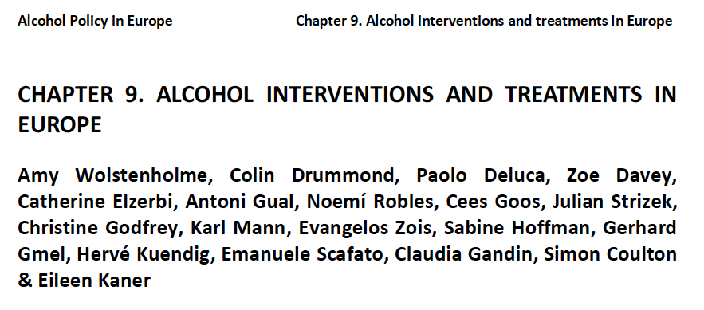
CHAPTER 9. ALCOHOL INTERVENTIONS AND TREATMENTS IN EUROPE

Slide 15
CHAPTER 9. ALCOHOL INTERVENTIONS AND TREATMENTS IN EUROPE
1. Alcohol treatment system characteristics
2. Implementation of Screening and Brief Interventions at the practitioner level
3. The gap between need for and access to treatment for alcohol dependence.

Slide 16
Descriptive study of alcohol intervention systems in six European countries
Key informants (government officials; senior public health specialists; senior alcohol treatment providers; senior PHC practitioners).
Formal literature search of available published and unpublished official information on provision of alcohol interventions
Semi-structured questionnaires based on previous published, mapping the provision of alcohol interventions, (PHEPA, UK National Audit Office - 2008, and WHO - 2010).

Slide 17
Problems found
Drawing meaningful comparisons on national prevalence of AUD and numbers receiving an alcohol-specific intervention presented challenges.
Data are available across all countries on patients who have received specialist treatment, but methods of coding and recording are different.
In the case of hospital discharge diagnoses it is unclear if patients identified with alcohol dependence actually received an alcohol intervention as opposed to being in hospital only for treatment of a physical illness (e.g. alcoholic liver disease).
The resulting between-country comparisons are therefore less robust than would be ideal.
Countries were able to provide little recorded or monitored information on SBI taking place within non-specialist settings

Slide 18
Implementation of Screening and Brief Interventions at the practitioner level
Random sample of 100 primary care staff in each country: 683 participants.
Five A&E departments in each country. 20 staff from each department were invited to complete the survey
Survey based on the UK (Kaner et al., 2008; Deluca et al., 2008), US and WHO surveys of health professionals on the identification and management of AUDs, which included the Short Alcohol and Alcohol Problems Perception Questionnaire (SAAPPQ, Anderson and Clement, 1987).

Slide 19
Sample demographics and patients seen and screened positive for AUD per week
Country | Gender (% males) | Age (Mean) | Patients per week | Patients screen positive/week (%)
Austria | 46.5% | 55.2 | 285 | 6.54 (2.5%)
Germany | 53.4% | 53.8 | 203 | 7.76 (3.8%)
Italy | 74.2% | 56.2 | 117 | 5.18 (4.4%)
Spain (Catalonia) | 23.3% | 47.3 | 149 | 4.14 (2.8%)
Switzerland | 61.8% | 52.5 | 98 | 4.40 (4.5%)
UK (England) | 52.4% | 46.5 | 110 | 3.87 (3.5%)
Total (mean) | 56.3% | 52.7 | 154 | 5.34 (3.5%)

Slide 20
Are GPs familiar with standardized alcohol screening tools?

Slide 21
Are GPs familiar with brief interventions

Slide 22
The gap between need for and access to treatment for alcohol dependence.
Need for treatment: Data was combined from country reports, to estimate the prevalence of alcohol dependence in each country.
Access to treatment: All available published or unpublished national data on patients accessing specialist treatment was identified. Data on self-help and mutual aid organisations was not included.

Slide 23
Per cent of adults who would benefit from treatment for sustained heavy alcohol use who actually receive treatment

Slide 24
Part 3: What would happen if people received more treatment?
Based on
Rehm, J., Shield, K.D., Rehm, M.X., Gmel, G., & Frick. U. (2013). Modelling the impact of alcohol dependence on mortality burden and the effect of available treatment interventions in the European Union. European Neuropsychopharmacology, 23(2), 89-97. doi:10.1016/j.euroneuro.2012.08.001

Slide 25
Simulations: what burden could be prevented by increasing treatment rates?
Most conservative estimate: mortality burden!
Approach bottom up: estimates for each country and then aggregated
Approach was selected as current treatment rates are lowest for all mental disorders: under 10% in the EU!
Effectiveness of treatment was based on Cochrane reviews
Five scenarios selected
Rehm et al., 2012 Alcohol consumption, alcohol dependence, and attributable burden of disease

Slide 26
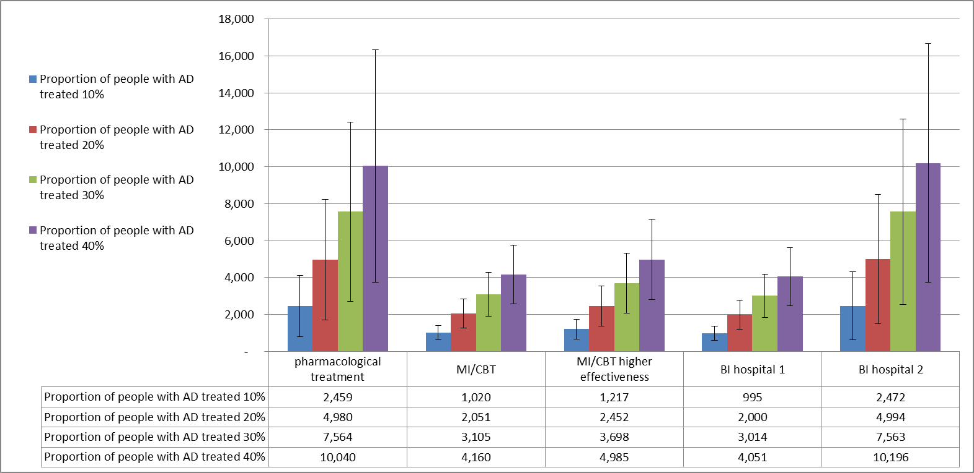
Number of deaths avoided over one year in men by treatment for AD in the EU in 2004 by five different treatment modalities (up to 13% of all alcohol-attributable deaths)
Rehm et al., 2012 Alcohol consumption, alcohol dependence, and attributable burden of disease

Slide 27
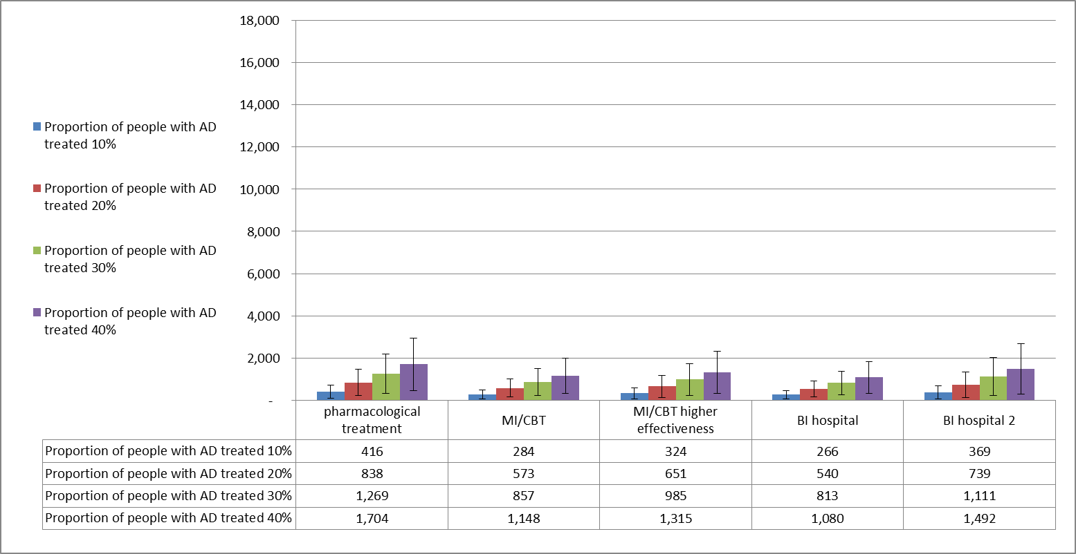
Number of deaths avoided over one year in women by treatment for AD in the EU in 2004 by five different treatment modalities (up to 9% of all alcohol-attributable deaths)
Rehm et al., 2012 Alcohol consumption, alcohol dependence, and attributable burden of disease

Slide 28
Why is alcohol dependence treatment successful?
It reduces level of consumption either to abstinence or by sizable reduction of heavy drinking.

Slide 29
In summary
Alcohol dependence has a big impact in terms of disability and premature mortality in Europe
There is considerable variation in the implementation of alcohol interventions across Europe.
There is a need to implement evidence based alcohol interventions and to reduce the treatment gap.
There is a lack of comparable high quality information on the prevalence of alcohol use disorders and access to interventions.
A Europe-wide system for estimating alcohol consumption, prevalence of alcohol use disorders and monitoring implementation of early identification and treatment is needed.

