Slide 1
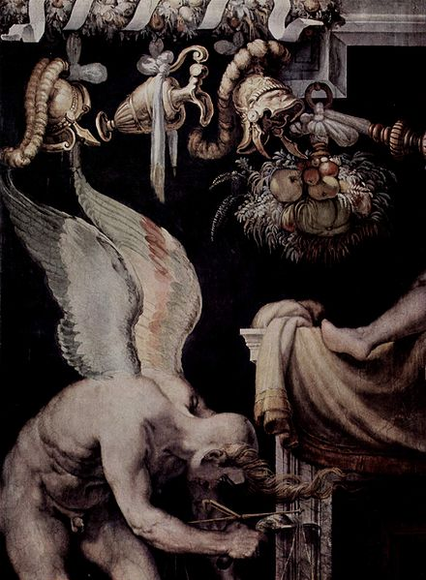
Time and Change:
A Developmental Model of Young Men’s Recovery
Lymarie Rodriguez
Department of Psychological Sciences
Birkbeck University of London

Slide 2
BACKGROUND
Recovery or self-change?
Increased use of AA and 12-Step fellowships
Small but increasing number of qualitative studies looking at the personal experience of recovery
Empirical research has so far been focused on the mature adult experience
How do young adults experience the process of recovery from addiction in 12-Step fellowships?

Slide 3
METHOD
Qualitative approach
Eighteen young men (22-35 years old)
Data collection: semi-structured interviews & autobiographies
Data analysis: interpretative phenomenological analysis (IPA)

Slide 4
PARTICIPANTS
Tom Mike Dan Arjun James Eric Early Recovery Adam Bill Alexis Peter Ethan Andy Robert Sean Henry Long Term Recovery Danny Mark Jamie
Early Recovery
Twelve participants
AA, NA & CA
Long-term Recovery
Eight participants
AA, NA & CA

Slide 5
Early Recovery
Missing out
I used to go out Friday nights and think, I’m the only fucking one, I’m the only fucking young person that can’t drink or do drugs, look, look at them, they’re all going out and having a good time.
- Robert
Like to be fair, people in recovery they look good, but all of a sudden and really quite all of the sudden, I don’t see any of my old friends. Like you know what I mean. I see them here and there, I go to the odd party and that but I don’t go and just go on Tuesday into the pub and get drunk. It’s that sort of thing that you kind of, you’re out of the loop.
- Tom

Slide 6
Early Recovery
Self and time
It was important for me to be on the move, definitely in the early days…I found it really quite difficult at points just having nothing to do…I found it quite hard to sort of motivate myself to go out and do different stuff whereas I find work’s important for me erm just to have a structure in my life.
- Mike
I was like, I will never have drinks or drugs again, and it was too much to take in you know. But if I just thought of, if I put it like I’m not doing drugs just for today, it was a lot easier to comprehend…So all you worry is not using drinks or drug just for today, and in that way it’s not overwhelming.
- Robert

Slide 7
Early Recovery
Self and identity
I’m comfortable with that now, I’m comfortable with that fact ’cause I’m not fighting it anymore ’cause for so long I was fighting it now erm I can carry on I can still do it but there’s certain comfort in accepting that you can’t do it…if I’m being perfectly honest sometimes it does piss me off that some people can sit down and have a lovely meal with one or two glasses of wine and just leave it like that, that pisses me off sometimes.
- James

Slide 8
Early Recovery
Care of the self
I take better care of myself, I care about my surroundings, simple things like I have a shower every day, I brush my teeth twice a day, I make sure that I eat three meals a day, I pay my bills, yeah I’m paying my bills, I’m not just letting all the letters pile up. I actually open them now and read them...I feel a lot more alive and healthy and I listen to my body more as well you know, when I’m tired I think right okay I’m going to sleep before I fight it you know.
- James
I’m very capable, I have potential but I’ve got in my own way. A huge reason for me to feel sorry for myself is that I didn’t stand up for myself….I’m doing it, I’m taking responsibility, I feel like erm I’m looking after me, I’m putting value back in me.
- Arjun

Slide 9
Middle recovery
A new life structure
Outward changes: good jobs, owning my own home, further qualifications, committed relationship, successfully being a good father, being faithful to my partner, creating a safe home for my children, much more contact with my family, giving money to those in my family who need it.
- Danny
[this] phase finished around two years in when my emotional recovery became the focus. It was during this phase (that lasted for some time) that I became aware of my level of emotional maturity, which was pretty juvenile at that time. The emotional ‘defrosting’ was an uncomfortable process…I think this is an unavoidable part of the process for many, especially men, who are less able to express emotion in true form.
- Mark

Slide 10
Middle recovery
Alcoholic/addict identity
When I’m in meetings you know my name’s James and I’m a recovering alcoholic you know or my name’s James and I’m an addict and I do you know I, I, I erm believe, I believe that I do suffer from the disease of addiction and I notice in lots of aspects of my life especially with food that’s a big issue for me now.
- James

Slide 11
Middle recovery
Self and others
I want to keep knowing myself and have good relationships. I now really value my relationships. They are the most important thing in my life.
- Sean
I think all my relationships are sort of changing...I started to reevaluate my relationships with people in a lot of ways and look at the reasons, not necessarily with family but the reasons why I might be friends with such person or why, why I’m feeling, why I’m feeling, how do I do, it’s sort of like I’ve just got a new perspective on things really.
- Henry

Slide 12
Long-term recovery
Towards a balanced self & masculinity
There’s always the positive side and negative side to things. I believe I had this negative and unhealthy side, which is my addiction. But I also believe there’s a nice part of me, a loving part of me, a caring part of me, a compassionate part of me, understanding part of me, which is all based in love…I’ve learnt to listen to this side rather that just let myself be overpowered by the negative side.
- Sean
I believe in being loving and really understand that when someone asks me to help them, it’s a commitment to pass on my experience with love.
- Mark

Slide 13
Long-term recovery
Self and identity
My ‘recovery’ has now become a phrase I am less inclined to use a great deal as it seems to indicate I am or was in some way ill. I feel like a pretty balanced human being these days. I love going to the meetings as I really love the sense of unity and hope. I live my life outside of recovery now, and try to integrate more of the ‘real’ world in my life.
- Mark

Slide 14
Long-term recovery
Becoming
I would like to see myself as useful to others…would like to learn to be more free from fear and to learn to love more. I would like to live in the country (near the sea) and garden more. I would like to cook more.
- Danny
I want to develop spiritually as well I want to lay a portion of each day aside to focus on that because I do feel better when I take the time out to think you know, to think and try to give more importance to that.
- James

Slide 15
Stages of Recovery
Developmental model of recovery Early recovery: Focus on abstinence Middle recovery: Focus on developing a new life structure Long-term recovery: Focus on self-actualizing possibilities (Brown, 1985; Chapman, 1991; Flores, 2001; Laudet & White, 2008; Margolis, Kilpatrick, & Mooney, 2000) | Self-managed change stages Stage 1: Resolving to stop Stage 2: Breaking away from the addiction Stage 3: Staying abstinent Stage 4: Becoming and being ‘ordinary’ (Biernacki, 1986; Copeland, 1996; Sobell et al., 1996)

Slide 16
Stages of Recovery
Early Recovery | Middle Recovery | Long-term Recovery
(Care of the self) Enhanced bodily awareness Ambivalence Exit of drinking/drug-taking identity Healthy habits New social network development | (Self and others) Emotional development Building a new life structure Alcoholic/addict identity Experiencing a new relational world | (Becoming) Self-actualizing possibilities Ethical concerns Individuation Towards a more balanced selfhood & masculinity

Slide 17
Participants
Tom Tom
Mike Mike
Dan Dan
Arjun Arjun
James Eric
Adam Early Recovery Adam Early Recovery
Bill Bill
Alexis Alexis
Peter Peter
Ethan Ethan
Andy Andy
Robert
Robert Sean
Sean Henry Middle Recovery
Henry Jamie
Danny Long Term Recovery
Mark James
Jamie Danny Long Term Recovery
Mark

Slide 18
Stages of Life-span Development
 | Havighurst | Erikson | Levinson | Arnett
22 years | Early adulthood Achieving independence Choosing a career | Young adulthood Intimacy vs. Isolation | Young adulthood | Emerging adulthood Identity exploration Age of instability Feeling in-between Age of possibilities
25 years
28 years
30 years | Middle-age Developing an ethical system Starting family Assuming civic responsibilities |  | Age 30 transition | Young adulthood
35 years |  |  | Settling down

Slide 19
Future Research
More longitudinal research on various pathways of recovery
More qualitative-experiential research with young people
Young women and recovery
Focus on quality of life and well-being

